Slide 1
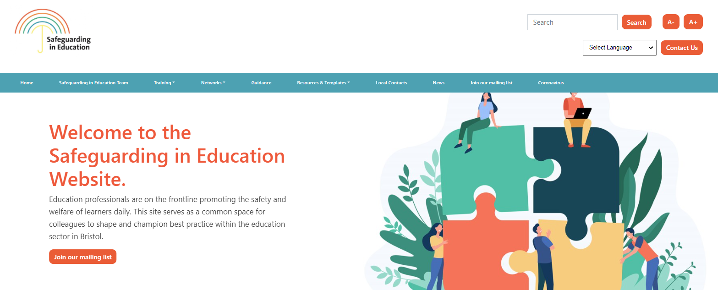
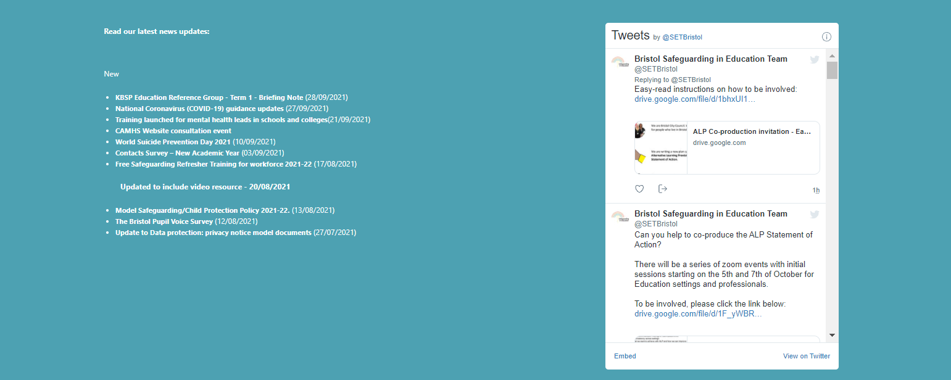


Welcome to the DSL Network Meeting
If you haven't already done so, bookmark our website https://www.bristolsafeguardingineducation.org/
The session will start promptly at: 3.00pm
Facilitated by: Elisabeth Clark
If you have any technical difficulties please email the safeguardingineducationteam@bristol.gov.uk
If you have the functionality, please can
you put your cameras on out of respect for colleagues.
Follow us @SETBristol

Slide 2

Designated Safeguarding Lead Network
Term 3 - 2023-24
Notes:
Welcome to the first DSL network meeting of 2023.
If you have any questions whilst the meeting in running please do put them in the chat and we will answer them throughout the meeting or at the end. Please be mindful of confidentiality if you do have any specific concerns.
The slides will be uploaded to the safeguarding in education team website

Slide 3

Agenda
Local & national news
Keeping Bristol Safe Partnership updates
Early Intervention Team
The Hope Virtual School
Healthy schools
Multi-agency updates
AOB
Notes:
These are the areas we plan to cover today.

Slide 4




Following sad events that took place over the weekend, the Safeguarding in Education Team wrote to all schools offering advice, support and resources around the following:
Identifying vulnerability
Managing speculation
Sourcing support
Updating contacts
If you do not think your setting received this, please email us at safeguardingineducationteam@bristol.gov.uk so we can send to you.
In addition, if you have any intelligence or information relating to the incident this needs to be shared via this link: https://mipp.police.uk/operation/5219P99-PO1
Follow us @SETBristol

Slide 5

FREE – Critical Incident Training for Senior Leaders
Places are still available for this training on 21 February, 26 March and 19 June.
BOOK ON HERE
The course will include the following:
What is a critical incident?
The impact of trauma, bereavement and loss on the school/setting community
Recent, local experiences of critical incidents in Bristol schools and reflections from school leaders around these
How to provide support in the initial days, weeks and subsequent months following a critical incident
Developing your setting’s contingency plan
Communicating difficult news within your school community and externally
Identifying those at-risk following an incident
Specific considerations relating to suicide
Wider legislative documents and procedures to be aware of
Processes and support available from the Local Authority
Local and national support available
Considerations for how to look after yourself and your team
Notes:
The aim for this session is to furnish senior leaders with the knowledge and understanding required to respond to a critical incident confidently and competently.
Training is in person and there are still spaces for March and June available with lunch provided!!!

Slide 6
Role & Remit
HEAL: Helping Empower Adolescents Lives. We are a Mental Health and Wellbeing Service which works to educate and support those affected, indirectly, by serious violence in their community.
How can you refer?
We are able to accept referrals from Safer Options, community organisations and education. Please get in touch!
A referral form will be shared and that can be emailed to: oldmarketservices@barnardos.org.uk
If you would like to discuss a potential referral, please do contact the team manager who will be happy to discuss this.
We can offer:
Workshops (tier 3)
Small group work (tier 2)
Tailored support (tier 1)
Team Manager: Carly Johnson – carly.johnson@barnardos.org.uk
Project worker: Megan Read – megan.read@barnardos.org.uk

Slide 7
Moments matter, attendance counts- From 8 January, Government has launched a national campaign to remind parents and carers of the importance of school attendance. The purpose of this toolkit is to provide schools with off-the-shelf products they can use to support the campaign and create a national moment around attendance - access the toolkit here
Working Together to Safeguard Children- The guidance has been updated and the new version is now in force.
Online Safety- the NSPCC have launched a new web page dedicated to supporting schools with everything to do with online safety including preventing and responding to online harm and abuse, support with policies and procedures and training opportunities for staff.
Kinship care strategy- The strategy shines a spotlight on kinship carers - grandparents, aunts, uncles, siblings and wider family networks - that provide loving homes to children who cannot live with their parents, and who will now receive greater financial stability and support from local authorities and schools.
Follow us @SETBristol
Notes:
Kinship care strategy:
Today we are announcing that:
• We will launch a kinship financial allowance, paid at the same rate as the fostering allowance, beginning in up to 8 local authorities.
• We are expanding the Virtual School Head’s role to promote the education of children in kinship care.
• We will ensure more eligible kinship carers are aware of their ability to access the Adoption Support Fund, by renaming it to the Adoption and Special Guardianship Support Fund, as well as analysing the fund’s applications and the therapies provided.
• We will produce government guidance for employers on how kinship carers can be supported at work. This will include advice on adapting HR policies, signposting to existing workplace entitlements, and creating a culture of support.
• We will introduce a kinship leave and pay entitlement for Department for Education staff (subject to discussions on the detailed arrangements between the department and employee representatives).
• We will establish a kinship training, information and advice offer that all kinship carers will have access to.
• We will continue to support the delivery of peer support groups across England for all kinship carers.

Slide 8
February 1 -29 – LGBTQ+ History Month: LGBT History Month is an annual observance that celebrates the rich history and achievements of the LGBTQ+ community. It provides a platform to highlight key figures, events, and milestones in the ongoing fight for LGBTQ+ rights and acceptance.
February 5 - 11 - Sexual Abuse & Sexual Violence Awareness Week : Sexual Abuse & Sexual Violence Awareness Week is a dedicated week-long campaign that focuses on addressing sexual abuse and sexual violence. It aims to challenge societal norms, stereotypes, and misconceptions surrounding these issues while providing a platform for survivors to share their stories and find support. Sexual violence awareness week
February 5 – 11 Children’s Mental Health Week: Everyone can take part in Children’s Mental Health Week! Download free resources for schools and families and find out how you can take part to raise vital funds and awareness for children’s mental health.
February 6 – Safer Internet Day: The UK Safer Internet Centre has created a new advice page to support parents and carers ahead of Safer Internet Day. It addresses online safety concerns around online games; new devices; and the content children engage with online. The page is designed to be shared by schools and other organisations. Safer Internet Day 2024: free advice for parents and carers
13 March – Young Carers Action Day: Young Carers Action Day is an annual event organised by Carers Trust to raise awareness of the pressures placed on so many young people. This year’s theme is Fair Futures For Young Carers, highlighting how young and young adult carers are significantly less likely to undertake higher education or enter employment than their peers without a caring responsibility. Young Carers Action Day Resources
March 18 – 24 - Neurodiversity Celebration Week : Regardless of labels, neurodiversity is about recognising those who think differently. And no matter whether you are a school, university or organisation you can benefit from different thinkers! Resources
March 23 – National Day of Reflection is a day to remember those who died during the COVID-19 pandemic. It takes place on 23 March, the anniversary of the first lockdown in 2020.
DATES FOR THE DIARY
Follow us @SETBristol
Notes:
Some dates for your diaries in the coming months. Do take a look at the resources linked to the dates highlighted.

Slide 9

Key updates in statutory guidance
Changes include:
multi-agency expectations for all practitioners
working with parents and families
clarifying the roles and responsibilities of safeguarding partners
the role of education and childcare providers
multi-agency practice standards
support for disabled children
tackling harm that occurs outside the home

Slide 10
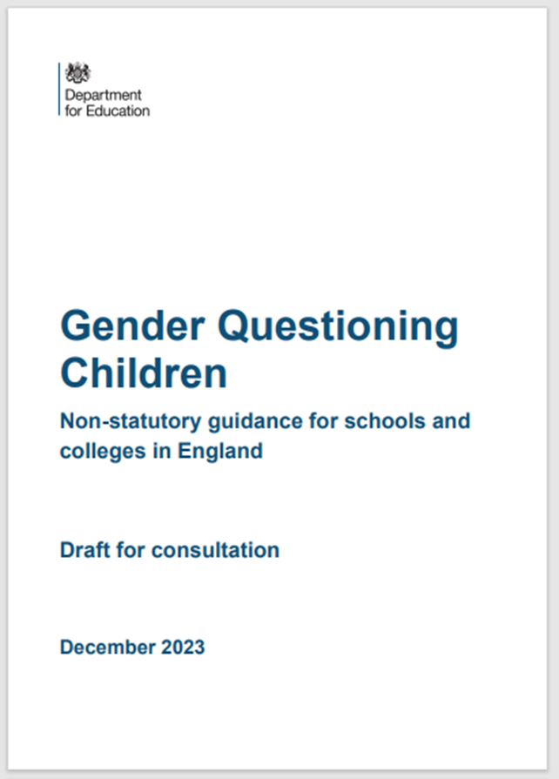
Draft guidance consultation
The DfE released the draft guidance and consultation just before the Christmas holidays.
The consultation can be accessed here and closes on 12th March 2024.
The publication of this has received some high-profile press coverage. We would like to confirm that the status of this is non-statutory guidance and that it remains draft and is subject to consultation.
During this consultation period schools are not required to make any changes to their existing policies or practice.
We know that schools work hard to be inclusive of all our children and young people. We would encourage schools to continue to support children and young people on a case-by-case basis.
The Safeguarding in Education Team are looking to support the creation of a working group for multi-agency colleagues to discuss and reflect on Trans inclusion, the draft guidance and to consider local support and resource depending on the outcome of the consultation. Please email safeguardingineducationteam@bristol.gov.uk if you are interested in joining the group.
Notes:
Schools and colleges will have seen that the DfE published draft guidance on "Gender Questioning Children" after most of you had broken up for the Christmas holidays.
The publication of this has received some high-profile press coverage. We would like to confirm that the status of this is non-statutory guidance and that it remains draft and is subject to consultation.
During this consultation period schools are not required to make any changes to their existing policies or practice.
We know that schools here work hard to be inclusive of all our children and young people and to be sensitive, practical, and responsive to the well-being of students who are trans, non-binary or questioning their gender identity. We would encourage schools to continue to support children and young people on a case by case basis and to follow our trans guidance.
The draft DfE guidance itself states that it "covers areas that remain untested in the courts". Professional Associations and Teaching Unions all confirm that the guidance is draft and is subject to change and that they will all issue advice for their members in due course.
For support for children, young people and their families please contact X. Information on the provision and support available here for Lesbian, Gay, Bisexual, Transgender, Questioning and Intersex young people can be found on the Council website.
Over the coming weeks will be reading and discussing the guidance in depth to inform our response to the consultation. Our recommendations and our response will be informed by the real-life experiences of those the guidance will directly impact; trans, non-binary and gender exploring children and young people and their families.
Schools are invited to contact X if they would like to discuss this statement.
The draft guidance is available here.
The consultation document is here. The consultation closes on 12th March 2024.

Slide 11

Keeping Bristol Safe Partnership Updates

Slide 12
KBSP Education Data Collection
The data request may support with a standardisation of CPOMS categorisation across the education sector.
The information provided will enable the partnership to target whether support and challenge may be required.
This may support with your setting's strategic safeguarding approaches.
This will be mandatory for the academic year 2023-24.
If possible, please can you submit this for the academic year 2022-23 by end of February https://www.smartsurvey.co.uk/s/KBSP-EDU-DATA-2022-23/
KBSP training
For colleagues needing to attend the Advanced Child Protection Course it is no longer a requirement to attend the Working Together course if you have completed DSL training with SET.
This is to recognise the crucial local context element contained within the SET DSL training.
When you book onto the Advanced Child Protection Training please email the KBSP to inform them of your SET DSL training dates. kbsp.training@bristol.gov.uk.
It is recommended that all DSLs complete the Advance Child Protection Training.
Notes:
This will be mandatory for the academic year 2023-24. You may need to adapt your record keeping categories to be able to provide reportable data. You may want to use the excel spreadsheet template to support you if you are unable to amend your CPOMS categories.
You may need to include single cases twice (for example, you would include a case both under dealt with universal level and if the case progressed to a child in need s.17 assessment - you may even have used professional challenge to achieve this).

Slide 13

KBSP - Child Protection Conference guide for Bristol children and families
This is an easy access guide for everyone. It is divided up into relevant sections for parents, carers, children, social workers, and partner agencies to help you through the child protection conference process.
This is now available on the KBSP website in both the Professional Resources section under Multi-Agency meetings, and within the Children’s section, under the subsection of Support for Children and Families.
The Child Protection Conference guide for Bristol children and their families has been created and endorsed by parent experts with lived experience, the children and young peoples’ shadow board, partner agencies and Senior leaders within Children Services.
Notes:
The overarching aim of this guide is to provide essential and useful information to all, in one place.
To help build a better understanding and reduce anxiety about child protection conference and process, for parents, children, and professionals.
This guide can be used by clicking the pages you want to read within the contents page.

Slide 14

Multi-Agency Updates

Slide 15

Early Intervention Team (EIT)
The police EIT work with the VRP (Violence Reduction Partnership).
The VRP is made up of, Health, Police, Local Authority, Young People Drug & Alcohol Services, Third Party Sector, Social Care, YJS, Education, ASB.
The multi-agency team, work in collaboration and come together as one with the aim to protect and safeguard children, as well as improve the quality of life for all residents of Bristol, by reducing opportunities for serious violent crime, through intelligence led problem solving and the delivery of appropriate support interventions with all the partners.

Slide 16

Identify the children at risk of serious violence and exploitation (Thresholds - THRIVE).
Secure intelligence and share information (Safer Options, Education & Inclusion officers) with partner agencies.
Proactive Engagement with the children to deliver - Intervention & Disruption (Pathways, CAWNs, CPNs, CBOs).
YJS (Youth Justice Service) Out of Court Disposal Panel.
The Key Responsibilities:

Slide 17

10 x schools in Bristol / South Glous to take part in a groundbreaking piece of research exploring the impact of Trauma Informed Practice on reducing youth violence funded by the YEF and Home Office.
It’s the impact of police education on subjects such as drugs, personal safety and knife crime on reducing serious youth violence
This is an exciting opportunity to benefit from a fully funded high-quality learning and development programme delivered by professionals (School Engagement PCs) at the forefront of Trauma Informed Practice. Forefront of understanding what works to prevent serious youth violence.
YEF (Youth Endowment Fund):

Slide 18
Hattie Billsberry
Senior Education Advocate – HOPE Virtual School
January/February 2024
Notes:
KJ
Ask attendees to introduce themselves.
18

Slide 19



The HOPE Virtual School
- Virtual School Headteacher a statutory role for children in care (Children & Families Act 2014)
- Strategic role around Previously Looked After Children (PLAC) and Children with a Social Worker (CwSW)
- Part of Children’s Services under James Beardall and report to Corporate Parenting Panel
- More likely to have gaps in education/poor early life experiences
- Less likely to do well at school
- More likely to have additional or special needs
- Promoting the education of children in care from Early Years to University
- Improving educational outcomes
- Responsible for Pupil Premium funding for children in care
Notes:
Introduction to HOPE Virtual School
19

Slide 20

The HOPE Virtual School - Staff
James Gregory
(Interim Virtual School Head)
Virtual School Head
Katherine Juniper
Senior Advocate
Hattie Billsberry
Senior Advocate
Rebecca Harrison
SEND & transition lead
Anne Mortimore
Early Years & Adoption Lead
Wider management team
Sarah Peacock
Yr 1-5
Ian Hutton
Yr 1-5
Carrie-Ann Palmer
Yr 6- 11
Meilir Tecwyn- Business and Data Co-ordinator
Education
Advocates and Business Support
Katie Hook
Yr 6-11
Rene Katiisa
Yr 6-11
Craig Barnett
Yr 6-11
George Lane
Business Support
Penny Russell
Post 16
Angela Ryan
Post 16
Shelina Jerram
PLAC
Bella Markham-Giguere
Business Support
Notes:
HOPE structure
20

Slide 21
What does The HOPE do?
- Named HOPE advocate for all Bristol children in care from Early Years to Post-16
- Attend, collate and quality assure Personal Education Plans
- Train teachers, school governors, social workers and foster carers
- Responsible for administering Pupil Premium funding for children in care and monitoring impact
- Promote and track progress and attainment for children in care as a ‘real’ school would do
- Track attendance, suspensions and absence for children in care as a ‘real’ school would do
- Advocate for educational stability; minimising school moves and planning for transitions
- Support with school applications e.g. into Year 7 or if a child moves a long way away
- Linking corporate parents e.g. Designated Teachers in schools, Special Educational Needs Teams in different local authorities (SEN), ALP Hub (Alternative Learning), Independent Reviewing Officers (IROs)
- Strategic role in advocating for education in placement planning, pathway to adulthood and for children entering and leaving care.
- Advice and guidance for Previously Looked After Children (PLAC) and Children with a Social Worker (CwSW)
Notes:
What does the HOPE Virtual School do currently?
21

Slide 22

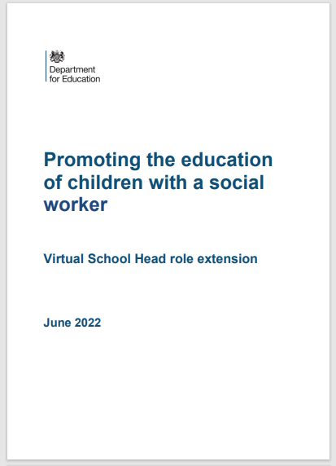

What are the Extended Duties?
From September 2021, the Virtual School Head’s role has been extended to include the strategic leadership of promoting the education outcomes of all children and young people with a social worker. It covers all children who were assessed as needing a social worker within the past 6 Years due to safeguarding and/or welfare reasons, which includes all those subject to a Child in Need plan or a Child Protection plan. This includes children aged from 0 up to 18 in all education settings
Notes:
What are the Extended duties and what is the DoE guidance unpinning this.
22

Slide 23
Why is this new role needed?
The Government’s Children in Need review (2019) identified that:
1.6 million children needed a social worker between 2012 and 2018, equivalent to 1 in 10 children or 3 in every classroom
these children are around 3 times more likely to be persistently absent from school and between 2 to 4 times more likely to be permanently excluded than their peers
these children are present in 98% of state schools and face barriers to education due to experience of adversity and trauma
on average children with a social worker do worse than their peers at every stage of their education
Coronavirus (COVID-19) has affected all children and for many of the most vulnerable has increased barriers to education. It is essential that the cohort of children with a social worker are supported to recover from the pandemic
Notes:
Why the extended duties came about?
Bristol across the board has low attendance and high suspensions for this group of CYP’s. In Bristol they are rank low for progress and attainment across the city compared to their peers, and as a whole cohort compared to our statistical neighbours
23

Slide 24
What are the aims of this role?
The key aims are to:
make visible the disadvantages that children with a social worker can experience, enhancing partnerships between education settings and local authorities to help all agencies hold high aspirations for these children
promote practice that supports children’s engagement in education, recognising that attending an education setting can be an important factor in helping to keep children safe from harm
level up children’s outcomes and narrow the attainment gap so every child can reach their potential. This will include helping to make sure that children with a social worker benefit from support to recover from the impact of COVID-19
Notes:
What are the aims of the extended duties?
24

Slide 25
Why are Virtual School taking on this role?
The Children in Need review (2019) recognised the crucial role that Virtual School Heads have in raising aspirations and promoting the educational achievement of our children placed in care and previously looked after.
The cohort of children and young people with a social worker have not had the benefit of a strategic leader that is able to champion their educational needs. Virtual School are experienced in helping education settings and local authorities work together and can offer advice and support to teachers and social workers, with the aim of narrowing the attainment gap.
Notes:
Why are the Virtual School taking on this role? The HOPE are in a fortunate position to work closely with schools, education colleagues and social care and support working together
25

Slide 26
Virtual School Heads are not being asked to do
work with individual children and their families - including tracking and monitoring educational progress of individual children or providing academic or other interventions
respond to requests from parents or carers to offer advice, intervention and support in relation to individual children with a social worker
take responsibility for children with Special Education Needs and Disability (SEND) who do not require or need a social worker, as defined above
Notes:
There are limitation to the role due to the large numbers with this cohort and limited resources
26

Slide 27
What can The HOPE Virtual School offer?
Although we are unable to individually casework, we can:
offer advice and signpost schools and educational settings to additional services and ensure that they receive the support required to help their cohort of children with a social worker
offer training opportunities to social care and schools
support schools and educational settings and social workers on how they can work together to support improvements in attendance, punctuality and behaviour to avoid exclusion
offer advice on educational issues to social workers to include attainment data, SEND processes, attendance, exclusions and reduced timetables
Offer weekly Drop-In and Consultations
Pilot project with Schools both Primary and Secondary across Localities to support the Education of Children with a Social Worker.
Notes:
We have begun working with 3 secondary's in each locality as a pilot/research project. These are the schools with high numbers of CP and CIN per locality, we will be meeting with 3 primary setting soon. The aim of the pilot is to make this cohort visible, bring together professionals to map out the barriers and challenges and share ideas and good practice of how best to support the Education of Children with a SW.
27

Slide 28
Key Contacts in Bristol:
Service | Responsibility | Contact details
Education Welfare Service | General attendance enquiries | 0117 3521438 or email education.welfare@bristol.gov.uk
 | Team Manager of the EWO Service | vanessa.davies@bristol.gov.uk
 | Children Missing Education (CME) (not on a school roll) | childrenmissingeducation@bristol.gov.uk
SEND | Support the statutory process of Education Health Care Plans | 0117 9223700 or email sen@bristol.gov.uk
Virtual school | Children looked after / previously looked after | 0117 9036282 or email thehope@bristol.gov.uk
Extended duties of the virtual school | Children with a current CP/CIN plan | Hattie.Billsberry@bristol.gov.uk Rachael.hunt@bristol.gov.uk
School Admissions | Allocation of school places for all schools at Reception stage and Y7 stage. Allocation of some in year applications. | 0117 9037694 or email School.admissions@bristol.gov.uk
Free School Meals | Eligibility and claim | Free.school.meals@bristol.gov.uk
Home to school travel | Eligibility and claim | Home.school.travel@bristol.gov.uk
Permanent Exclusions, alternative learning and inclusion hub | Inclusion and alternative learning | alphub@bristol.gov.uk
Post-16 Participation Team | Post-16 education, training and participation options | 0117 3525750 or email Post16participation@bristol.gov.uk
Notes:
Share Key contacts in Bristol to support schools – If further dciussions are required about the Education of children with a SW please contact myself or Rachael Hunt
28

Slide 29
Questions to think about?
How does your school/ academy trust capture and monitor progress data for children on CP plans or those classified as CIN?
Who is responsible for collating and reporting this data in your setting? How frequently is this data collected and reported on?
What support is required to improve the educational outcomes and attainment for children supported by social care?
  For staff
  For specific groups of CYP
  For parents/ carers
What next steps can you take to contribute to improving the educational outcomes of children with a social worker?
  Information you need to gather?
  People you need to liaise with?
  Resources you need to access?
Notes:
Questions to think about – not intended as an activity but points/questions to take away and consider for your setting
29

Slide 30
During term time the designated safeguarding lead (or a deputy) should always be available (during school or college hours) for staff in the school or college to discuss any safeguarding concerns. Whilst generally speaking the designated safeguarding lead (or deputy) would be expected to be available in person,
It is a matter for individual schools and colleges, working with the designated safeguarding lead, to define what “available” means and whether in exceptional circumstances availability via phone and/or other such media is acceptable.
It is a matter for individual schools and colleges and the designated safeguarding lead, to arrange adequate and appropriate cover arrangements for any out of hours/out of term activities.
KCSIE 2023 – Annex C – Role of the DSL.
What are your arrangements for DSL cover in the holidays and what could help to make these more effective?

Slide 31
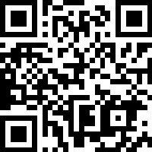
There are difficulties around effective working together during the holidays for chasing up referrals, child protection assessments and conferences.
In most cases colleagues have made themselves available and supported seeing their referrals through.
SET will support where possible but do not have access to your files and sometimes are not provided with reports.
Considerations:
That referrals are ‘No further actioned’ if parents decline or offer a counter narrative that can’t be unverified. Clarification is required sometimes.
Families at conferences often have their sensitive information shared with complete strangers. This may disrupt your working relationships.
Assessment of risks cannot be accurate without your reports and contributions.
Some staff are not paid to cover the holiday period.
Notes:
Some reflections and considerations on DSL availability during out of term activities and holidays.
What arrangements do you have in place and what factors may influence your arrangements?
Please take time over your break to think about cover out of term and to complete the survey using the QR code shown.

Slide 32

Break time

Slide 33





The Solihull Approach - Bristol wide multi-user licence
  Online courses for all parents and parents-to-be in Bristol
  Continuous Professional Development for Bristol children’s workforce

Slide 34


Solihull Approach Model Multi – User Licence – its FREE
Enables FREE access to a suite of online courses for parents and carers in Bristol – 9 courses from pregnancy to adolescence
Provision of FREE online courses for all professionals working with children on understanding trauma, attachment and brain development
Due to launch this February - access code “GROWING” at www.inourplace.co.uk and create an account and complete registration
Contact Lucy.watkins@bristol.gov.uk to be added to the mailing list, for free resources, promotional materials, for comms for parents and ongoing comms ….
Notes:
Some are main courses, some shorter and some are taster courses. New materials are added frequently

Slide 35
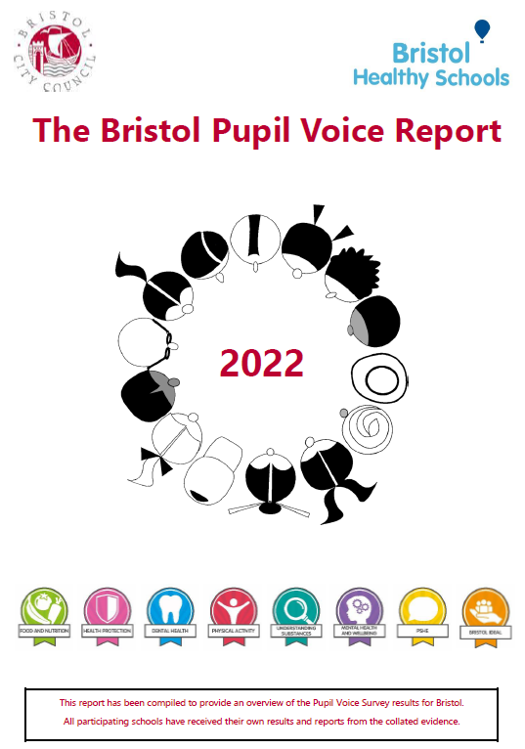

The Bristol
Pupil Voice Survey and
The Bristol Ideal Award
Caoimhe Gowran
Email: Healthy.schools@bristol.gov.uk
Website: www.bristol.gov.uk/bristol-healthy-schools
Notes:
Free offers of support for schools from Healthy Schools Team, Public Health, Bristol City Council.
The Bristol Pupil Voice Survey provides data from young people on a variety of health and wellbeing topics, including domestic and sexual violence -Bristol Pupil Voice Report 2022. The next survey is running in March 2024, Sign-up by FEBURARY 8th here!)
The report shows Bristol-wide data, but each school gets their own school-level data, which can help them identify how they might shape their health and wellbeing objectives. The Healthy Schools team offer 1:1s to schools, to chat through this Pupil Voice data and provide support. The Pupil Voice Survey is free to all schools (primary and secondary). (*they don’t have to be part of the healthy schools programme to take part).
Our support is mainly structured around the healthy schools awards, but any schools can get in touch with questions around health and wellbeing, as we can link to trusted resources/lesson plans/guidance etc.
The Bristol Ideal Award acts as a step-by-step guidance document for settings to follow to improve their approach to: domestic abuse, sexual violence, and healthy relationships, centred around the whole-school approach. (Very much focused on prevention and improving the schools’ culture)
Throughout the guidance we signpost to national and local services, e.g., Keeping Bristol Safe Partnership, Next Link, NSPCC, etc.
You can view the criteria and guidance here à Bristol Ideal Award

Slide 36

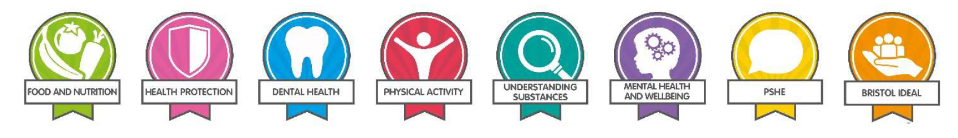
The Bristol Pupil Voice Survey
Free to all Bristol Schools
Every 2 years, since 2008
Thousands of young people take part.
The whole student body can take part, but the report mainly focuses on years 4, 6, 8, 10.
Schools get individual report based on the responses of their pupils.
Bristol-wide data report supports planning and delivery of CYP services.
Topics
Food and Nutrition
Physical Activity
Sexual Health
Understanding Substances
Mental health and wellbeing
Dental Health
Health Protection
Domestic and sexual violence
Bullying
Personal Social and Health Education
Economic Wellbeing
Notes:
KEY POINTS are on the slide. The topics that this group may be interested in are highlighted.
Additional info.
Data is anonymous. However, where there is safeguarding concern the survey provider will flag this, and via safeguarding team, the school can be notified which class the individual is in and can be supported with the approach.
We (Bristol Council) do not have access to school level data, only Bristol wide.
Key themes from each survey are shared in the final report and publicly available on this webpage: Data and research (bristol.gov.uk)

Slide 37
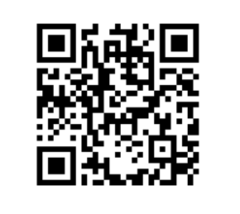
Next Pupil Voice Survey 2024
Sign-up deadline: February 8th
Find out more and sign-up via QR code or this link : www.smartsurvey.co.uk/s/ESBVIB/
OR
contact: healthy.schools@bristol.gov.uk
Notes:
Less than half of Bristol schools have signed up so far – please check if your school has signed up year? Ask your school or email healthy.schools@bristol.gov.uk to check.
It is important for schools to hear from the pupils in their schools re. emerging concerns and meet their needs.
It is important that data is as representative as possible so that services can be designed to best meet the needs of young people in Bristol.

Slide 38

The Bristol Ideal Award
is a set of standards and guidance for settings to follow to improve their approach to:
domestic abuse
sexual violence
healthy relationships
To sign up or find out more:
Email: Healthy.Schools@bristol.gov.uk
Visit the Healthy Schools website
https://www.bristol.gov.uk/bristol-healthy-schools
Notes:
We use the healthy schools award frameworks to support schools with different areas of focus from their Pupil Voice Survey, one of these awards is the Bristol Ideal.
The Bristol Ideal Award acts as a step-by-step guidance document for settings to follow to improve their approach to: healthy relationships, domestic abuse, and sexual violence centred around the whole-school approach. (Very much focused on prevention and school’s culture)
Throughout the guidance we signpost to national and local services, e.g., Keeping Bristol Safe Partnership, Next Link, NSPCC, etc.
You can start an application on the website, but the best way to get started and more support is by contacting Healthy.Schools@bristol.gov.uk
You can find a PDF of the Bristol Ideal Award criteria ← here!

Slide 39

PREVENT education support is moving to SET
We will be providing advice, support and guidance alongside training relating to the prevent duty in education settings.
Notes:
Introduce our plans for Prevent Education and the training offer.

Slide 40
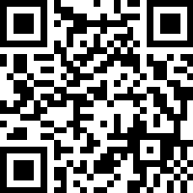
How can we best support you?
Following the completion of the risk assessment, what areas for development did you identify?
Access to relevant, up to date, local data
Cascading information
Enhanced training for Prevent leads
Effective awareness training for wider staff
Comprehensive understanding of Prevent process
Enhancing knowledge of where to access support
Curriculum resources relevant to your cohort
Notes:
Please also share this survey with anyone in your setting who is the Prevent lead.

Slide 41

Education Inclusion Managers
Audit: Academic Year 2023/24 (Term 1&2)
Weapons and Drugs in School data
Update on Education Inclusion Manager offer

Slide 42
Changes to the Weapons in Schools Guidance
The new National ‘Youth Gravity Matrix’ from the Police specifies that the possession an offensive weapon on the premises of an education setting is a crime.
Local Partnership arrangements have allowed for the continuation of Bristol’s diversionary, educational intervention for WiS incidents, as opposed to criminalising young people with a Youth Conditional Caution/Caution.
The following conditions must be met for a young person under 16 (and in exceptional circumstances between 16-17):
There is a low degree of risk or concern of serious harm to others
The weapon has not been used or violence been threatened
There is no evidence of pre-meditation to cause harm
The offence is not motivated by hostility towards those with protected characteristics
Notes:
Crime Recording: Police Statement
Youth Justice Outcome – Deferred Caution → Outcome 22. Non-engagement

Slide 43
Impact of these changes to the Weapons in Schools Guidance
Each incident must be recorded as a Crime on the police system. This will require a named member of school staff to give a brief statement.
  An EIM would send a statement document to be completed by the member of staff who found or was given the knife by the student involved in the incident.
  This member of staff will email the statement directly to a designated police officer who will make record of the incident on the police system.
More direct oversight of the Youth Justice Outcome
  The child will be given a Deferred Caution. The child will be given a Caution if they do not engage with the educational intervention.
  Once a child has engaged in up to six sessions of intervention, the incident will be reviewed, and the Deferred Caution is removed and an Outcome 22 (NFA decision) is given, which is non-disclosable.

Slide 44
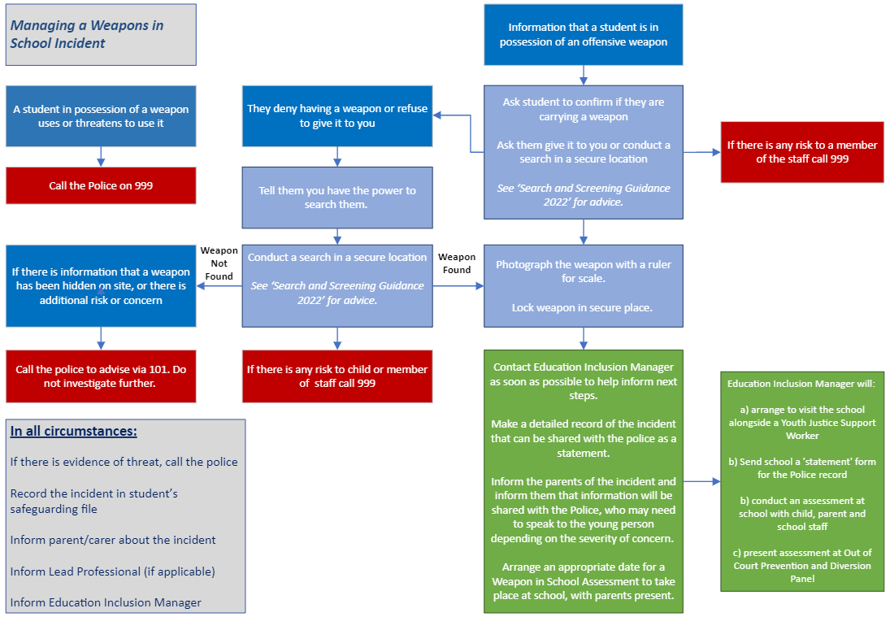
New Guidance for Schools 2024

Slide 45
Weapons and Drugs in Schools data Term 1 & 2
Weapons in Schools Data
14 WiS Assessments
100% non-criminal outcome
100% allocated support and intervention
No repeat offences
No PEXs
Drugs in Schools Data
6 DiS
Assessments
No police involvement*
100% allocated support and intervention
No repeat offences
No PEXs
Notes:
*This is in line with police guidance,

Slide 46
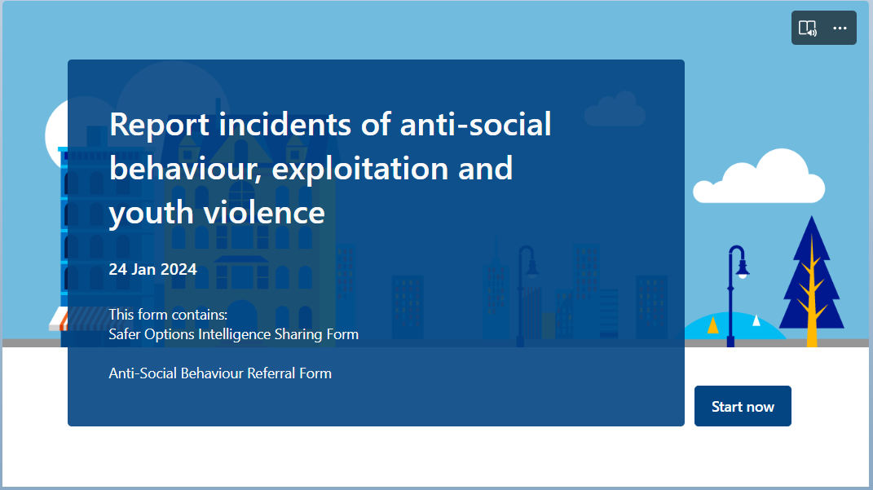
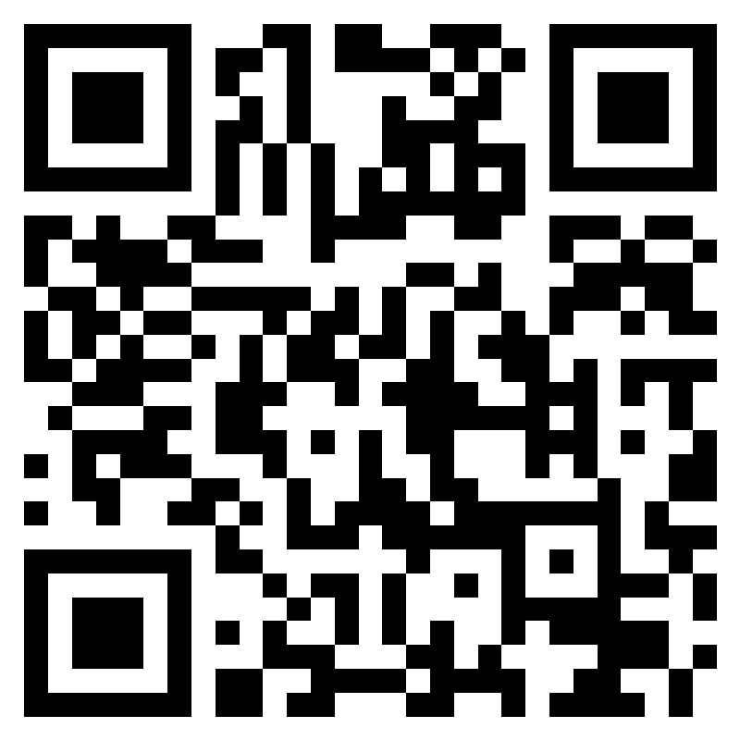
New Intelligence Reporting Form
We have developed an online form for sharing intelligence relating to Serious Youth Violence, Exploitation and Anti-Social Behaviour.
This form will enable intelligence to be sent directly to Safer Options and Youth intervention partnerships, such as the Community Intervention Group who respond to youth anti-social behaviour.
You can access the form here or using the QR code.
https://forms.office.com/e/5EpYMtY9dN

Slide 47

Families in Focus updates
Notes:
intros

Slide 48
Multi Agency Network (MAN)s Dates
A forum for practitioners working with children, young people and families to come together to:
Find out about local services and developments
Network
Share Good Practice
Attend free training/workshops
Online- Wednesday 6th March
Send theme
Agenda will be sent out to all area mailing lists WB 5th February.

Slide 49
Area Bulletins
Pulls together information about opportunities and activities in the local area
One for Parents and families and one for Practitioners.
Produced 6 times a year.
If you would like to be on the mailing list to receive this, invites to MANs or other training please contact:
FamiliesinFocusEastCentral@bristol.gov.uk
FamiliesinFocusNorth@bristol.gov.uk
FamiliesinFocusSouth@bristol.gov.uk

Slide 50
TAS Surgeries
When will they be:
South : Tuesday (fortnightly) 9.30am – 12.30pm
North : Alternate Tuesdays and Thursdays (weekly) 10am-1pm
East Central : Tuesday (fortnightly) 9:30am-12:30pm
How to book:
South TASsouth@bristol.gov.uk
North TASNorth@bristol.gov.uk
East Central TASeastcentral@bristol.gov.uk
Where:
Teams
What do you need to prepare?
As before, please send the TAS consent and mapping form – to be sent by end of Wednesday the week before your slot. As a reminder we cannot discuss a specific family situation, or share information from our systems, without parental consent (as per form required).
Should I still expect to receive a prearranged slot?
No, we have now moved to a surgery model and will no longer be sending out dates for prearranged slots that haven’t been requested by the school.

Slide 51
FIF Advice Line Information
• North: 0117 35 21499 or email familiesinfocusnorth@bristol.gov.uk (via secure email only)
• East Central: 0117 35 76460 or email familiesinfocuseastcentral@bristol.gov.uk (via secure email only)
• South: 0117 90 37770 or email familiesinfocussouth@bristol.gov.uk (via secure email only)
Contact details- Partnership managers
Laura.Deakin@bristol.gov.uk
Laura Deakin- City wide until April
Caroline.Donald@bristol.gov.uk

Slide 52

Funded drug education and training
Jo Mallinson jgmallinson@gmail.com beproject.co.uk
BOOK NOW!
Year 11 assemblies (ahead of GCSE revision) Cannabis myths including how cannabis affects study
Get in touch with Jo about other services including year 6 education, secondary school guest speaker work, and staff training (funding only for non-fee paying schools and ALPs)

Slide 53


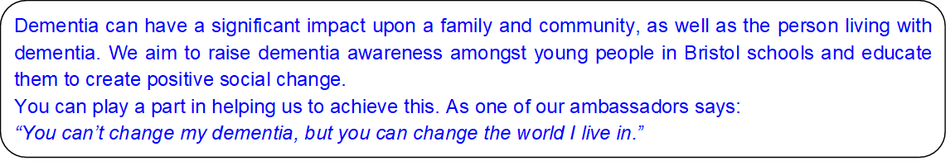
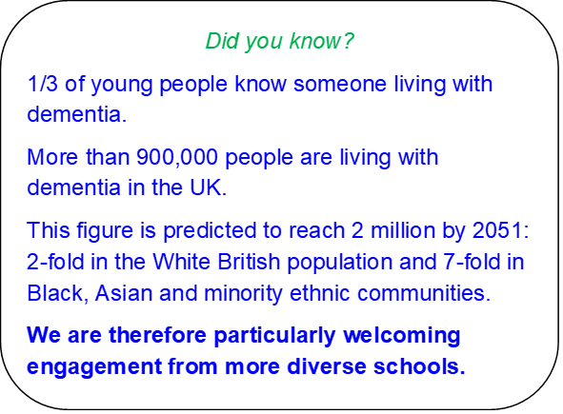
Inspiring dementia action in Bristol schools
How is this relevant to your school and wider community?
Links to the curriculum and OFSTED framework.
Improved health and wellbeing for pupils and families.
Creation of a dementia friendly workforce, now and for the future.
Reduced fear, stigma and isolation for people living with and affected by dementia.
Free opportunities for your school:
* Assemblies
* Class based sessions for pupils
* Visits by guest speakers living with dementia
* Sessions for parents
If you would like more information, please contact:
sally.townsend@alzheimers.org.uk M: 07590 884435

Slide 54

Safeguarding in Education Team updates
Upcoming training:
NEW DSL:
online over 4 half day sessions. (9:00-12:30)
22-25 April 2024
2 day (full day) which is delivered in person
18-19 March 2024 (Barton Hill Settlement)
24-25 June 2024 (Greenway Centre)
DSL Refresher:
online over two half day sessions. (09:00-12:30)
1-2 May 2024
1 full day (09:00-17:00) which is delivered in person
14 March 2024 (Barton Hill Settlement)
12 June 2024 (Bridge Professional Development Centre)
Notes:
Read out the slide

Slide 55
Safeguarding in Education Team updates
ACTION - Please do ensure contacts are up to date in line with Working Together to Safeguard Children:
Annual full survey. – if you haven’t completed or had substantive changes.
Midyear contacts changes- if you have only had one or two changed.
Early Years Contacts Update. / out-of-school setting
The letter of assurance for BCC staff – this can also be downloaded from our webpages.
Notes:
Read out the slide

Slide 56

When referrals are made to First Response they may decide to carry out Multi-Agency Safeguarding Hub (MASH) checks to gather further information from partner agencies, including education settings, who have a duty to assist as set out in ‘Working Together To Safeguard Children 2023’(paragraph 139).
It is very important that MASH enquiries are responded to within 48 Hours.
The Safeguarding in Education Team now have a dedicated ‘MASH SET Data Officer’ who acts as the representative for the entire education workforce within the MASH process. Please look out for emails or phone calls from the contact details shown above.
Joseph Meldau – MASH SET Data Officer
MASHSET@bristol.gov.uk - 07766309487

