Slide 1




Safeguarding Refresher
Training
Academic Year 2026-2027
Safeguarding is everybody’s business
Notes:
Its that time of year again – we’ve got you covered with a new Safeguarding Refresher course for the academic year 2026-2027

Slide 2

TRAINING AGREEMENT & SELF CARE
Talking about child abuse can be a distressing and sensitive issue. Please ensure that you look after yourself and colleagues if you are affected by the training.
Confidentiality.
Respect each other’s views.
Please switch your phones to silent.
Time keeping.
Please ask questions – no question is a silly one!
Notes:
Talking about child abuse can be a distressing and sensitive issue. Please ensure that you look after yourself and colleagues if you are affected by the training.
Confidentiality.
Respect each other’s views.
Please switch your phones to silent.
Time keeping.
Please ask questions – no question is a silly one!
Hopefully, you are in a group where you are have a either your Designated safeguarding lead /or a member of your safeguarding team facilitating or available. Please make sure you are able to access them if you need further support.

Slide 3
What’s coming up?
Changes in statutory guidance
Early Help and Professional Curiosity
Online Safety and AI
Child on child abuse and misogyny
Children questioning their gender
Southport recommendations
Safer Working Practice
Notes:
Let’s have a look at what is coming up.

Slide 4

Changes in statutory guidance
Notes:
We are now going to look at some of the key takeaways from statutory guidance which have come into effect this year.

Slide 5


Came into force 1st September 2026

Slide 6

Keeping Children Safe in Education (KCSIE) 2026
Key Changes in Part One
Changes to some of the definitions of abuse to bring them in line with Acts such as the Crime and Policing Act and Domestic Abuse Act.
Information on safeguarding issues have been updated for
Child-on-child Abuse (including harassment and violence)
Child criminal exploitation (CCE) and
Child sexual exploitation (CSE)
Mental Health
Serious violence
Notes:
The guidance clarifies that safeguarding issues often overlap. The information on Child-on-child abuse (including harassment and violence) has been expanded to include:
• the times when children might be at highest risk around the school day, such as immediately after school
• reference to misogyny
• reference to how this type of abuse is a safeguarding issue for all children involved
information on the preventable nature of child-on-child abuse, including the importance of recognising behaviours and indicators early.
The Child criminal exploitation (CCE) and child sexual exploitation (CSE) section highlights how:
• this type of harm can be committed or facilitated by an organised network or gang and children may identify as part of one of these groups
• most sexual abuse is committed by someone known to the victim • children are not always recognised as victims and can be criminalised for actions they take while under coercion.
The Mental health section clarifies that all staff should be aware that mental health problems can develop into safeguarding concerns. The guidance stresses that only appropriately trained professionals should attempt to diagnose mental health problems, but that education staff play an important role in recognising the warning signs and identifying children who may be struggling with their mental health. Schools and colleges should make sure that any mental health support or interventions they offer are evidenced as safe, effective and appropriate for the need and phase of education.
Under Serious violence, the guidance has been updated to highlight that:
• serious violence is an ongoing safeguarding concern and may involve physical assault, the carrying or use of weapons, and potential criminal exploitation
• concerns about a child carrying, using or intending to use a weapon should be reported to the designated safeguarding lead (DSL), who should carry out a risk assessment
• schools play a key role in protecting children from violence, and staff should be aware of the signs and risk factors
• targeted interventions such as mentoring or therapeutic support are key.

Slide 7

Keeping Children Safe in Education (KCSIE) 2026
Key Changes in Part One
New information on the process for community-based Family Help assessments, including the criteria for referrals to: Family Help support and services; and local authority children’s social care.
Support before statutory intervention
Referencing child to caregiver abuse as a form of abuse staff should be aware of and clarifies that verbal abuse can be a form of emotional abuse.
That qualified lead practitioners who are not social workers can lead work with families up to and including section 17.
Notes:
Support before statutory intervention
This section includes further examples of when a child may benefit from additional support, including: the child being pregnant and/or a parent themselves; the child exhibiting early signs of abusive, violent and/or harmful behaviours.
Abuse, neglect and exploitation
The guidance references child to caregiver abuse as a form of abuse staff should be aware of and clarifies that verbal abuse can be a form of emotional abuse.
Children in need
The guidance notes that qualified lead practitioners who are not social workers can lead work with families up to and including section 17. Local authorities, with their safeguarding partners and any relevant agencies, should set out who can act as a lead practitioner in supporting children and their families under section 17.

Slide 8
Keeping Children Safe in Education (KCSIE) 2026
Key changes to Part Two
Additional updates on:
Cover arrangements for your designated safeguarding lead.
The guidance on information sharing has been expanded to specify using professional judgement and what to share when a child is moving setting if the child is identified as a risk to others.
New guidance and resources to support schools to understand Online safety and legal requirements around their use of generative AI in teacher-facing and pupil-facing materials. Additionally, the implementation of a Mobile Phone Policy to ensure you are phone free.
Children requiring mental health support
Young carers
Safeguarding children with medical conditions
Notes:
The Designated Safeguarding Lead
The guidance sets out that schools should implement robust cover arrangements for periods when the DSL is unavailable due to illness, leave or other circumstances. Arrangements could include a confidential shared mailbox or similar system to make sure safeguarding concerns are received, monitored and acted on without delay.
Information sharing
The guidance on information sharing has been expanded to clarify that:
• when deciding what information to share, schools should consider the relevancy of the information, what the receiving setting needs to know and whether the information is clearly presented and suitably contextualised
• staff should use professional judgement to make sure that any information shared is focused and proportionate
• where a pupil is changing settings and information indicates a risk to others and/or the individual pupil, the receiving school is responsible for assessing risk and putting a safety and support plan in place; the DSLs from both settings should have a conversation where there are concerns.
Online safety
• This section includes new guidance and resources to support schools to understand safety and legal requirements around their use of generative AI in teacher-facing and pupil-facing materials.
• All schools should be mobile-phone free environments and schools are expected to have a mobile phone policy and relevant procedures making clear how this is implemented in their setting.
The section highlights that schools should carry out a review of filtering and monitoring systems at least once a year. The review should include checks that filtering is working appropriately on all devices connected to the internet. A record should be kept of these checks.
Children requiring mental health support
This section has been updated to clarify that the role of education staff is not to diagnose mental health problems, but that staff can help to fulfil four key roles:
• promoting good mental wellbeing and preventing the onset of mental illness
• observing pupils and identifying early those who may be experiencing or at risk of developing mental health problems
• making sure early targeted support is provided
• liaising with and referring to specialist services where needed. Education staff should also make use of support from their respective Mental health support team (MHST), which are being rolled out to schools and colleges.
Young carers
This new section sets out how schools and colleges should be alert to the needs of young carers and recognise that caring responsibilities can impact attendance, attainment, behaviour and wellbeing. It highlights that early identification is key to making sure young carers receive support at the right time from the right services.
Safeguarding children with medical conditions
This new section sets out information on incidents relating to a child or young person’s medical condition. The guidance highlights that a safeguarding referral would only be needed where an incident indicated that a child might be at increased risk of neglect, abuse or exploitation because of their medical condition. For example, this might occur where relevant medical information is not provided to a school or where children are repeatedly sent to school without essential medication.

Slide 9
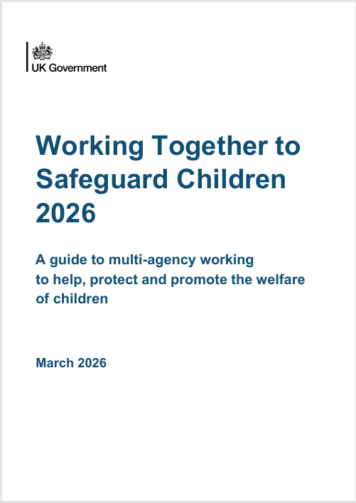
Keeping Children Safe in Education (KCSIE) 2026
Key changes to Part Two
A new section on regulations and safeguarding requirements relating to school premises sets out information on
Toilets
Changing rooms
Showers
These incorporate how to manage gender questioning children.
Came into force March 2026
A new section added – Sport
appropriate criteria for single-sex sport in line with the Equality Act 2010.
information around supporting gender-questioning children to socially transition in the context of their participation in sports and PE.

Slide 10

Working Together to Safeguard Children 2026
identifying, understanding and challenging racism and discrimination
recognising the specific needs and experiences of babies
understanding the impact of domestic abuse on children and families
consideration of children experiencing simultaneous harms or multiple harms
strengthened inclusion of children in care
the link between online harm and harm experienced in person.
Notes:
Chapter 1:
A shared responsibility
This chapter highlights how positive outcomes for children depend on strong multi agency working and good relationships between professionals and families.
Chapter 2:
Multi-agency safeguarding arrangements (MASA)
The chapter clarifies that collaborative leadership and timely decision-making are needed for effective multi-agency working and addressing system issues.
Chapter 3:
Providing help, support and protection
This chapter is split into four sections:
• universal services and community-based early help
• a new section on Family help
• safeguarding and promoting the welfare of children
• multi-agency child protection.
Chapter 4:
Organisational responsibilities
This chapter sets out the statutory duties for organisations and agencies that work with children and their families.
Chapter 5:
Learning from serious child safeguarding incidents
This chapter sets out the statutory learning process that must take place when a child dies or is seriously harmed.
There are no changes to Chapter 6: Child death reviews.

Slide 11
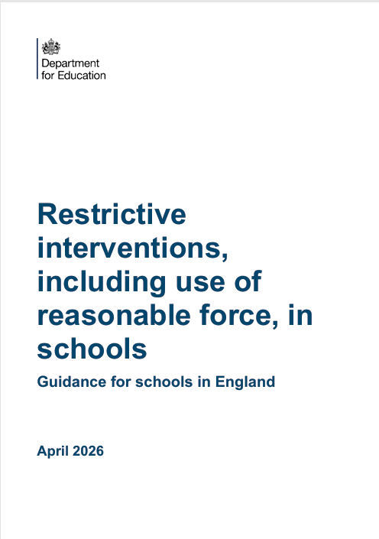
Keeping Children Safe in Education (KCSIE) 2026
Key changes to Part Two
A new section on regulations and safeguarding requirements relating to school premises sets out information on
Toilets
Changing rooms
Showers
These incorporate how to manage gender questioning children.
Came into force April 2026
A new section added – Sport
appropriate criteria for single-sex sport in line with the Equality Act 2010.
information around supporting gender-questioning children to socially transition in the context of their participation in sports and PE.

Slide 12

Restrictive interventions, including the use of reasonable force 2026
Governing bodies and proprietors must ensure procedures are in place to: ​
Record incidents as soon as practicable (same day).
Ensure all seclusion incidents are recorded
​
Report significant uses of force to parents no later than the same day, unless a permitted exception applies.​
Minimum information that must be recorded and reported is now clearly specified.
Notes:
Use this slide to emphasise the new statutory responsibilities for recording and reporting restrictive interventions. These duties became legally enforceable from April 2026, so governing bodies and proprietors must make sure that procedures, oversight and staff training are in place.
The key changes are:
• Every use of force must be recorded as soon as practicable, normally on the same day.
• Every incident of seclusion must now be recorded. Seclusion is subject to the same reporting scrutiny as the use of force.
• A significant use of force must be reported to parents or carers no later than the same day, unless a permitted exception applies.
• The minimum information that must be recorded and reported is now clearly specified, making accurate and timely documentation a statutory expectation.
Explain that the refreshed guidance also gives clearer advice on what constitutes reasonable force and when seclusion may be used. The purpose is to help staff make safe, lawful and proportionate decisions—not to encourage greater use of restrictive intervention. Seclusion must never be punitive and the required safeguards must always be followed.
Prevention remains central. Settings should prioritise early support, de-escalation and approaches that minimise the need for restriction. Leaders should review behaviour plans, individual risk assessments, recording systems and staff training before the duties take effect.
The guidance gives particular attention to pupils with SEND because restrictive interventions can affect them disproportionately. Staff should understand individual needs, triggers, communication and personalised strategies.
Close by reinforcing accountability: staff must follow the agreed procedure and record promptly; leaders must monitor practice; and governors or proprietors must assure themselves that the setting is compliant from April 2026.

Slide 13
FAMILY HELP
Early Help
and Professional Curiosity
Right support • Right time • Right route
OFFICIAL

Slide 14

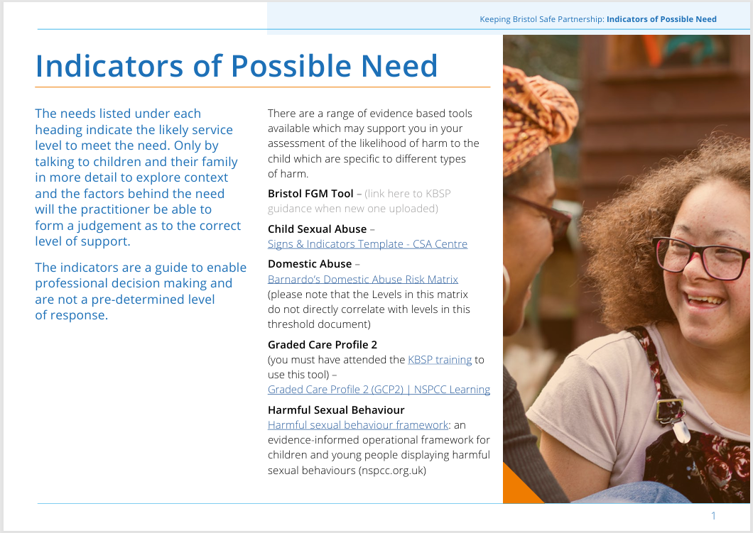
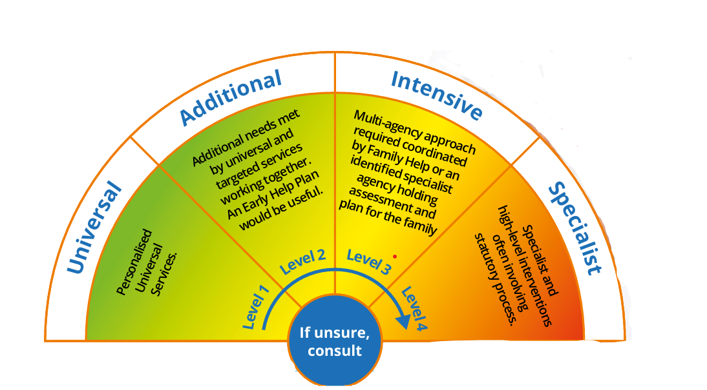
The Right Support at the Right Time
Child development needs:
Learning, education and employment
Physical health
Emotional, mental health and confidence
Behaviour and relationships
Crime and anti-social behaviour
Parents and Carers:
Parenting skills
Substance or alcohol misuse
Relationships including domestic abuse
Housing and living conditions
Adult health:
physical and emotional
Notes:
Use this slide to introduce Family Help and the principle of providing the right support at the right time.
School and college staff are well placed to notice concerns early, offer help and prevent needs from escalating. Family Help means providing support as soon as a problem emerges, at any stage of a child’s life.
Talk through the three areas shown on the slide: the child’s development needs, factors affecting parents and carers, and adult health. Emphasise that these needs often overlap and should be understood in the context of the whole family.
Any child may benefit from support before statutory intervention, whether through universal and community-based services or more targeted early help. Staff are not expected to assess or resolve every issue themselves.
Close by reinforcing the staff response: notice changes, record observations, speak promptly with the DSL or safeguarding team, and follow the setting’s local early-help route. The next slide explores the circumstances that may indicate a child needs additional support.

Slide 15
Who IS:
disabled or has certain health conditions and has specific additional needs
a young carer
pregnant and/or is a parent themselves
showing signs of being drawn in to anti-social or criminal behaviour, including gang involvement and association with organised crime groups or county lines
frequently missing/goes missing from education, home or care
at risk of exploitation, modern slavery, trafficking, including CCE and CSE
at risk of being radicalised into terrorism
in a family circumstance presenting challenges for the child, such as drug and alcohol misuse, adult mental health issues and domestic abuse
misusing alcohol and other drugs themselves
at risk of honour or faith-based abuse such as Female Genital Mutilation or Forced Marriage,
a privately fostered child.
Who has:
special educational needs (whether or not they have a statutory Education, Health and Care plan)
a mental health need
exhibited early signs of abusive, violent and/or harmful behaviours
been repeatedly removed from the classroom, experienced multiple suspensions, is on a part-time timetable, is at risk of being permanently excluded from schools, colleges and in Alternative Provision or a Pupil Referral Unit 11
a parent or carer in custody, or is affected by parental offending
All school and college staff should be particularly alert to the potential need for additional support for a child who….
KCSIE states,
All school and college staff should be particularly alert to the potential need for additional support for a child who…
Notes:
This slide expands on the previous discussion by highlighting circumstances in which a child may need additional support.
Do not read every item aloud. Instead, draw attention to the range of factors: health or additional needs, caring or parenting responsibilities, changes in behaviour or attendance, difficult family circumstances, and risks such as exploitation, criminal involvement or radicalisation.
Emphasise that this is not a checklist and one factor does not automatically mean that a child is at risk of harm. Needs often overlap, and what matters is the context, any pattern or change, and the impact on the child.
Encourage professional curiosity. Staff should notice what they see and hear, consider what may be happening beneath the surface, and avoid making assumptions or accepting explanations too quickly.
Staff do not need to diagnose the issue or wait until concerns reach a statutory threshold. Record observations clearly, discuss them promptly with the DSL or safeguarding team, and follow the setting’s early-help and safeguarding procedures.
Use the final point to transition to the next activity: ask participants to think about a family they are worried about and what further information would help them understand the child’s needs and lived experience.

Slide 16

Early Help and Professional Curiosity
Think of a family you are worried about…
We are going to focus on the Parents and Carers parenting skills where intensive support might be needed.
Using the following indicators of need, in groups identify the concerns you have and the further information and context to your concerns.
What impact might these concerns be having on the child?
Notes:
Introduce this as a short group exercise on Early Help and professional curiosity. The purpose is to move from noticing a concern to understanding the context, the child’s lived experience and what support may be needed.
Ask participants to think of a family they are worried about, focusing on parenting skills or circumstances where more intensive support may be needed. Remind them not to use names or share identifying details in the group.
Give groups around five to eight minutes. Ask them to discuss three questions:
• What concerns have you noticed?
• What further information or context would help you understand the situation?
• What is the impact on the child or children?
Encourage participants to separate fact from assumption. What have they directly seen, heard or been told? How long has the concern been present? Has anything changed or escalated? What strengths, support or barriers are already known?
Reinforce that professional curiosity means asking respectful questions and looking beyond the first explanation. It does not mean investigating or trying to prove what has happened. Concerns should be recorded and shared through the setting’s safeguarding or early-help route.
Bring the groups back together and invite a few examples of the questions they would ask or the additional context they would seek. Then move to the next slide, which provides indicators relating to parenting skills to support the discussion.

Slide 17
Scenario
A member of staff notices that a child has become increasingly tired and withdrawn during the school day. The child often arrives late, wearing clothing that is not warm enough for the weather, and regularly says they have not had breakfast. Staff also notice that homework and permission slips are rarely completed, despite reminders and previous offers of support.
Over time, the child becomes anxious at the end of the day and says they are not sure who will be collecting them. On one occasion, the child mentions that adults at home “get angry quickly” and that rules change depending on their mood. They say that sometimes there are no boundaries or routines, while at other times they are shouted at or physically punished for small things. Staff notice the child becoming increasingly watchful, unsettled and reluctant to talk about home.
Notes:
Give participants a moment to read the scenario, then ask them to discuss it in small groups.
Start with what staff have directly observed: the child is increasingly tired and withdrawn, often late, sometimes without suitable clothing or breakfast, and becoming anxious at the end of the day. There is also a pattern of incomplete work or forms despite offers of support.
Next, consider what the child has said about uncertainty over collection, changing rules and routines at home, and adults becoming angry. Remind participants to distinguish the child’s words and staff observations from assumptions about what may be happening.
Use these prompts:
• Which details concern you, and why?
• What pattern or change can you identify?
• What further information or context would be helpful?
• What impact might this be having on the child’s wellbeing, learning and sense of safety?
Draw out the importance of professional curiosity. Staff should ask open, proportionate questions where appropriate, record facts and the child’s own words, and avoid investigating or trying to reach a conclusion themselves.
Close by asking what the staff member should do next. The concern should be shared promptly with the DSL or safeguarding team through the setting’s agreed route. The next slide provides indicators that can help participants describe the concerns and their context more clearly.

Slide 18
Seeking support – Parents and Carers: Parenting skills
Poor supervision by parent or carer who is unable to consistently provide adequate supervision sufficient to protect the child
Unresponsive to identified needs
Parent or carer are unable to consistently provide adequate basic care. The child regularly does not have adequate food, warmth or essential clothing due to prioritisation of parental needs over the child
Historic context of parent's own childhood affects parenting capacity
Breakdown in relationship with child or feeling unable to continue to care for child with risk of entry into care
Parents struggle or refuse to set effective boundaries such as too loose, too tight, which may include reliance on physical chastisement
The parent or carer physically chastises the child but does not cause significant physical injury. This may result from a loss of control. The parent is willing to access professional support to learn alternatives
Child has multiple carers but may have no significant relationship to them
Identify the concerns you have and any further information and context to your concerns.
What is the impact on the children of the issues you've identified?
Notes:
Use these indicators to help participants describe their concerns about the scenario more clearly. Do not read every item aloud; ask groups to identify the indicators that appear most relevant and explain what evidence supports their view.
It is not enough simply to identify a concern. Staff need to provide context and evidence. This may include how long the concern has been present, what has changed or made it more concerning now, what support has already been offered, and any barriers preventing the family from moving forward.
Encourage participants to distinguish between fact, the child’s own words and professional interpretation. In the scenario, relevant observations might include poor supervision, unmet basic needs, inconsistent boundaries and limited response to previous offers of support. These should be considered together as a pattern rather than as isolated incidents.
Use the prompts at the bottom of the slide:
• What are the specific concerns?
• What further information or context is needed?
• What is the impact on the child’s safety, wellbeing, learning and relationships?
Remind staff that they are not expected to diagnose parenting capacity or investigate the family. Their role is to record concerns clearly, include relevant context and the child’s words where appropriate, and share the information promptly with the DSL or safeguarding team.

Slide 19
KCSIE 2026 sharpens the route to early support
The updates most relevant to Family Help, professional curiosity and parenting concerns
01
Family Help pathway
02
Earlier, wider support
03
Young carers & mental health
More detail on community-based assessments and when to refer to Family Help services or children’s social care. Locally agreed qualified lead practitioners may lead work up to section 17.
Further examples include a child who is pregnant or a parent, and a child showing early signs of abusive, violent or harmful behaviour.
Identify impact early and connect children with the right support. Staff promote wellbeing, notice concerns, secure targeted help and refer—rather than diagnose.
STAFF PRACTICE
Notice • Record • Share • Follow the local route
Use professional curiosity: describe facts, patterns, context and impact—do not investigate.
Source: DfE, Keeping children safe in education 2026 • in force 1 September 2026
18
Notes:
KCSIE 2026 sharpens the route to early support through clearer Family Help pathways,
broader examples of when help may be needed, and earlier recognition of young carers and mental-health concerns. Staff should stay professionally curious, record facts and patterns, and follow local referral routes rather than investigate or diagnose.

Slide 20

Online Safety and AI
Notes:
We are now moving into online safety and AI.
The main point is that technology can change the form of harm, but it does not change our safeguarding responsibility.
Staff do not need to be AI experts. They need to notice concerns, respond calmly, record accurately and pass concerns on through the right route.

Slide 21
Insert AI video here

Slide 22
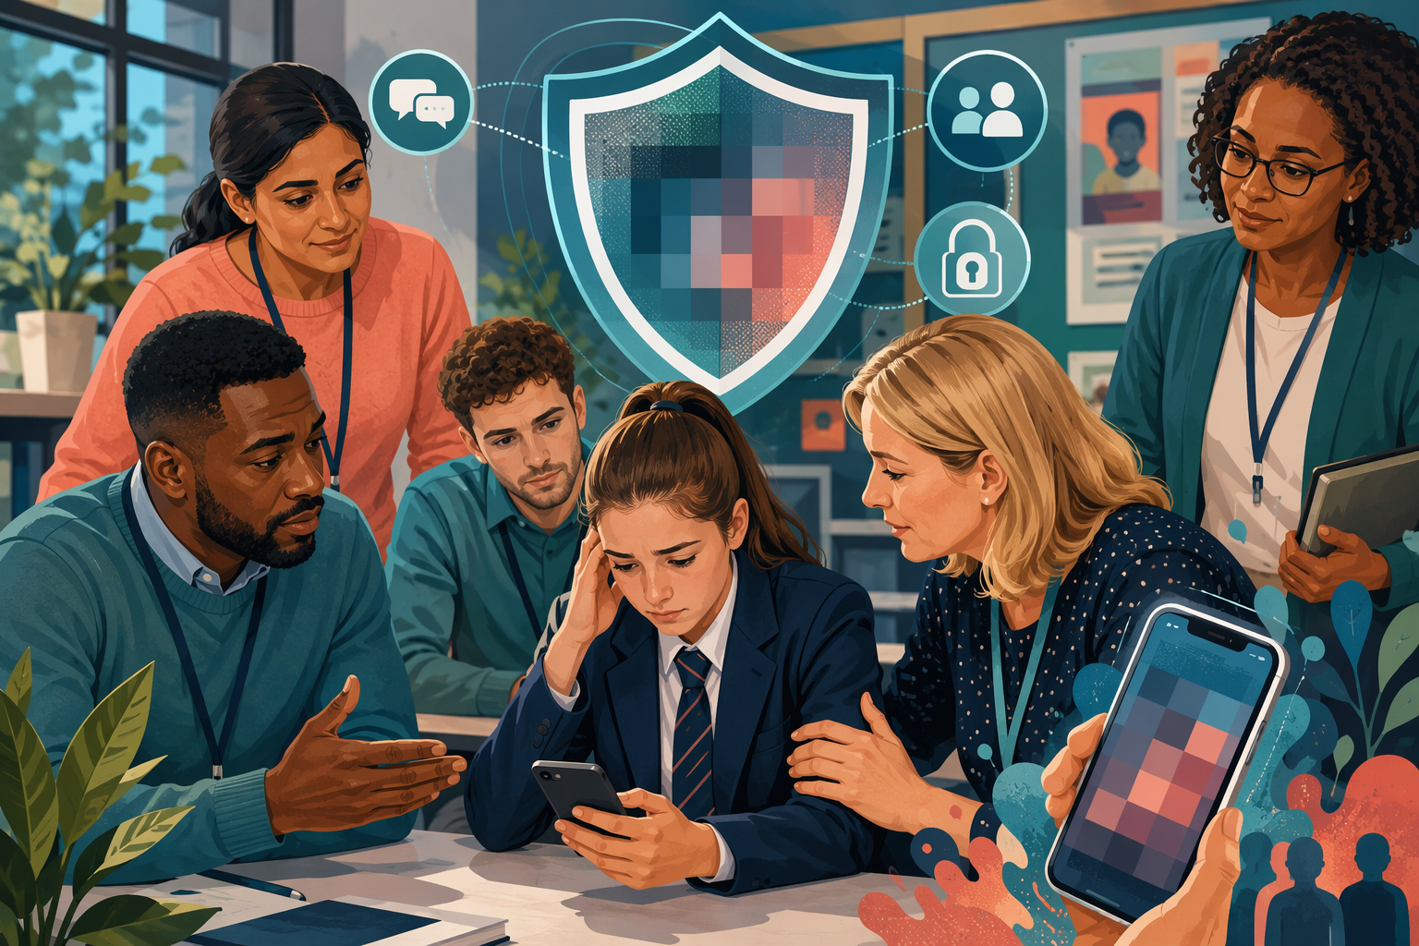
What are we talking about?
Digital harm can involve real, altered or completely fabricated content.
AI-generated content
Manipulated images
Images, video or audio created or changed using AI.
A real picture edited to misrepresent, embarrass or harm someone.
Harmful sharing
Pressure and threats
Content shared without agreement or circulated to cause distress.
Coercion, humiliation or blackmail used to control a person.
The impact can be real even when the image is fake.
Notes:
This slide sets out what we mean by digital harm.
The content might be real, edited or completely fake. Either way, the impact on the child can still be very real.
AI-generated content is becoming easier to create, so we should not assume that an image or message is genuine just because it looks convincing.
The key message is simple: if content is being used to embarrass, threaten, pressure or control a learner, treat it as a safeguarding concern.

Slide 23
What might staff notice?
One sign may mean very little. A pattern may need attention.
Changes in attendance
Changes in behaviour
Avoiding lessons, activities or spaces.
Withdrawal, distress, anger or distraction.
Phone-related worry
Peer difficulties
Repeated checking, sudden account changes or fear of notifications.
Rumours, exclusion, bullying or conflict.
Unexpected pressure
A direct disclosure
Requests for money, secrecy or further images.
A learner says an image is being shared or used against them.
Do not investigate. Share the concern with the DSL or safeguarding lead.
Notes:
This slide is about what staff might notice day to day.
One sign on its own may not mean much. What matters is a pattern, a change from the child's usual behaviour, or anything that makes you feel worried.
Look out for changes in attendance, mood, friendships, phone use or sudden anxiety about messages and notifications.
If a child tells you directly, listen carefully and do not investigate yourself. Share the concern with the DSL.

Slide 24

If a child tells you
Your calm first response can make a significant difference.
1 Listen
Stay calm. Take the concern seriously.
2 Reassure
Say they have done the right thing by telling you.
3 Do not promise secrecy
Explain that you need to share the concern to help keep them safe.
4 Pass it on
Contact the DSL or safeguarding lead promptly.
Notes:
This is the first response staff should aim for if a child tells them something.
Stay calm and listen. The child may be frightened, ashamed or worried that they will be blamed.
Reassure them that they have done the right thing by telling you.
Do not promise to keep it secret. Explain in plain language that you need to share the concern with the safeguarding lead so the right help can be put in place.
Then pass it on promptly through your setting's safeguarding route.

Slide 25
Protect the child and the evidence
Follow your setting’s procedures and avoid increasing the harm.
DO
DO NOT
Record the child’s own words.
Note what was seen or reported, when and by whom.
Keep links, usernames, dates and message details if safely available.
Follow the DSL’s instructions and your settings reporting routes.
Do not ask the child to send you the image.
Do not download, copy or forward harmful content.
Do not conduct your own online investigation.
Do not contact the alleged person responsible yourself.
Notes:
This slide is about protecting both the child and the evidence.
Record what the child says in their own words. Note what was seen or reported, when it happened, who was involved and any platform, username, link or message details that are safely available.
Do not ask the child to send you the image, and do not download, copy or forward harmful content.
Do not try to investigate online or contact the person believed to be responsible. That can increase the risk and may affect the evidence.
Follow the DSL's instructions and your setting's procedure.

Slide 26

Group exercise: Notice, respond, record, report
8 minutes in mixed-role groups. No specialist knowledge is needed.
Scenario
A child tells a member of staff that a convincing fake image of them is circulating in a group chat. The child is being threatened that it will be shared more widely unless they follow instructions. The child asks the member of staff not to tell anyone.
NOTICE
RESPOND
What facts and safeguarding risks stand out?
What would you say in the first minute?
RECORD
REPORT
What must be written down accurately?
Who needs to know, and how quickly?
Choose one person to share your group’s first three actions.
Notes:
For this exercise, ask people to work in mixed-role groups.
They do not need specialist knowledge. The aim is to practise the basic safeguarding steps: notice, respond, record and report.
Give the groups around eight minutes. Ask them to focus on the first actions they would take, not on proving what happened.
Remind them to think about what they would say in the first minute, what they would write down, and who needs to know.
At the end, ask one person from each group to share their first three actions.

Slide 27
Exercise debrief
A safe response is simple, calm and prompt.
1
2
3
4
NOTICE
RESPOND
RECORD
REPORT
Possible image-based harm, coercion and wider sharing.
Listen, thank them, reassure and explain next steps.
Use their words. Record facts, times, platforms and threats.
Tell the DSL or safeguarding lead immediately. Follow the setting’s procedure.
Staff do not need to prove what happened before reporting a concern.
Notes:
Use this slide to bring the exercise back to the core response.
A safe response is simple, calm and prompt.
First, notice the safeguarding risks: possible image-based harm, coercion, threats and wider sharing.
Second, respond by listening, thanking the child, reassuring them and explaining what will happen next.
Third, record the facts accurately, using the child's own words where possible.
Fourth, report immediately to the DSL or safeguarding lead.
Staff do not need to prove what happened before reporting a concern.

Slide 28

Smart technology: safe access and use
New devices create opportunities, but settings still need clear controls and safeguarding oversight.
Smart technology and access
Know which devices connect to the network. Use named accounts, strong authentication and least-privilege access. Remove access promptly when roles change. Include personal, wearable and Internet of Things devices in local rules.
Filtering and monitoring
Leaders, the DSL and IT support should understand their roles. Filtering should block harmful content without preventing reasonable learning. Monitoring should reflect the setting’s risks and be reviewed at least annually.
Smart glasses, including Meta
Camera-enabled glasses can take photos, record video, stream or use AI features. A small capture light may indicate recording, but staff should not rely on it alone. Set clear rules for classrooms, assessments, changing areas and sensitive conversations.
Notice • Challenge • Report
Staff action: follow the setting’s device policy, report concerns to the DSL, and never investigate or search content beyond your role.
27
Notes:
This is a practical safeguarding check: smart technology can support learning and operations, but every connected device also needs clear ownership, access controls and reporting routes.
For smart technology and access, emphasise the basics: know what is connected to the network, use named accounts rather than shared logins, apply strong authentication where possible, and remove access promptly when someone changes role or leaves.
Make the point that personal devices, wearables and Internet of Things equipment should not sit outside the policy. If a device can connect, capture, store or share information, staff need to understand the local rules for using it safely.
When covering filtering and monitoring, distinguish the responsibilities: leaders set expectations and review risk, the DSL understands safeguarding implications, and IT support implements and maintains the technical controls. Filtering should reduce exposure to harmful content without blocking reasonable learning activity.
For monitoring, stress that it should reflect the setting’s actual risks and be reviewed at least annually — or sooner if technology, usage patterns or incidents change.
Use the smart glasses example to make the risks concrete. Camera-enabled glasses, including Meta-style devices, may take photos, record video, stream or use AI features. A small recording light is not enough on its own; staff should rely on agreed rules, supervision and professional challenge.
Be specific about sensitive contexts: classrooms, assessments, changing areas, meetings with pupils or families, and any safeguarding conversation require extra caution and clear boundaries.
Close with the staff action message: notice unusual or unauthorised use, challenge it through the setting’s agreed process, and report concerns to the DSL. Staff should not investigate, search devices or view content beyond their role.

Slide 29
Key messages
What every member of staff needs to remember.
Fake content can cause real harm.
A child may be frightened, ashamed or under pressure.
Respond calmly and avoid blame.
Do not view, copy, download or forward harmful material.
Record the facts and the child’s words.
Report promptly to the DSL.
Know your setting’s route
Name of DSL:
How to report:
Out-of-hours route:
IF IN DOUBT, SHARE IT
Notes:
Fake content can still cause real harm. A child may feel frightened, ashamed or under pressure, so our response needs to be calm and non-judgemental.
Do not view, copy, download or forward harmful material.
Record the facts and the child's own words, then report promptly to the DSL.
If your setting has not already filled in the reporting route, pause here and make sure staff know who the DSL is, how to report, and what to do out of hours.
The final message is: if in doubt, share it.

Slide 30
Official guidance and further reading
Select a title to open the official GOV.UK guidance.
Keeping children safe in education 2026
Statutory guidance for schools and colleges. Comes into force on 1 September 2026.
OPEN >
Sharing nudes and semi-nudes: overview for all staff
One-page UKCIS summary explaining the immediate response expected from frontline staff.
OPEN >
Sharing nudes and semi-nudes: full guidance
Detailed UKCIS advice for DSLs, senior leaders and education settings.
OPEN >
Generative AI: product safety standards
DfE standards to help education settings assess whether generative AI products are safe.
OPEN >
Also follow your setting’s child protection policy, online safety procedures and local safeguarding arrangements.
Notes:
Explain that the links are there for further reading after the session, not for staff to memorise now.
Keeping children safe in education sets the statutory safeguarding expectations for schools and colleges.
The UKCIS guidance gives practical advice on responding to nude and semi-nude image sharing, including what frontline staff should do straight away.
The generative AI safety standards can help settings think about safer use of AI products.
Also remind staff to follow the setting's own child protection policy, online safety procedures and local safeguarding arrangements.

Slide 31
KCSIE 2026 makes online safety more explicit
The statutory updates behind safe AI, devices and filtering
01
Generative AI
02
Mobile-phone-free settings
03
Filtering and monitoring
Use new guidance and resources to understand safety and legal requirements for teacher-facing and pupil-facing AI materials.
Have a clear mobile phone policy and procedures that explain how a phone-free environment is implemented in practice.
Review systems at least annually, check filtering on every internet-connected device, and keep a record of those checks.
FRONTLINE RESPONSE
Notice • Respond • Record • Report
AI may change the form of harm—not the safeguarding route. Do not investigate; share concerns promptly with the DSL.
Source: DfE, Keeping children safe in education 2026 • in force 1 September 2026
30
Notes:
KCSIE 2026 makes online-safety expectations clearer across generative AI, mobile-phone-free settings, and filtering and monitoring.
The frontline response remains the same: notice, respond, record and report concerns promptly to the DSL rather than investigate them.

Slide 32

Part five: Child-on-child sexual harassment and sexual violence
New or strengthened in KCSIE 2026
Explicitly includes all signs, reports and concerns of harmful sexual behaviour (HSB)
Misogyny is explicitly identified as something that can escalate and should be identified early
All incidents of nude/semi-nude images require a safeguarding response, whether consensual or non-consensual
Notes:
Use this slide to introduce the strengthened focus in Part Five of KCSIE 2026.
The key change is that the guidance now explicitly covers all signs, reports and concerns of harmful sexual behaviour, alongside child-on-child sexual harassment and sexual violence.
Emphasise that harmful sexual behaviour exists on a continuum. Staff should not wait for behaviour to become severe before acting. Misogynistic language, attitudes or patterns may be an early warning sign and should be noticed, recorded and shared through the setting’s safeguarding route.
Clarify that every incident involving nude or semi-nude images requires a safeguarding response, whether the sharing appears consensual or non-consensual. Staff should not investigate, copy, download or forward the material. They should respond calmly, record the facts and the child’s own words, and report promptly to the DSL.
Close by reinforcing that every child involved may need support, including the child who has experienced the behaviour and the child whose behaviour has caused concern. The next slides explore harmful sexual behaviour and misogyny in more detail.

Slide 33

“This part of the statutory guidance outlines how schools and colleges should respond to all signs, reports and concerns of…
(KCSIE 2025 & 2026)
A change in focus?
…harmful sexual behaviour (HSB), child-on-child sexual harassment and sexual violence” (KCSIE 2026)
…child-on-child sexual violence and sexual harassment” (KCSIE 2025)
Notes:
Use this slide to compare the wording in KCSIE 2025 and 2026. Give participants a moment to read both versions, then ask: “What change in emphasis do you notice?”
Draw attention to the fact that the 2026 wording places harmful sexual behaviour first and explicitly brings all signs, reports and concerns within the response expected of schools and colleges. This broadens the focus beyond incidents already described as sexual harassment or sexual violence and encourages earlier recognition of concerning behaviour.
Emphasise that harmful sexual behaviour exists on a continuum. Behaviour should be considered in context, including the children’s ages and stages of development, the nature and frequency of the behaviour, any imbalance of power, the level of consent or coercion, and the impact on the children involved. This is particularly important in primary settings, where staff may see a wide range of behaviours and may feel uncertain about what is developmentally expected.
Avoid minimising behaviour as banter, curiosity or “just part of growing up,” but also avoid labelling a child solely by their behaviour. Staff are not expected to determine the threshold or investigate. They should record what they have seen or heard, use the child’s own words where appropriate, and share concerns promptly with the DSL or safeguarding team.
The next slide defines harmful sexual behaviour and explores the continuum in more detail.

Slide 34
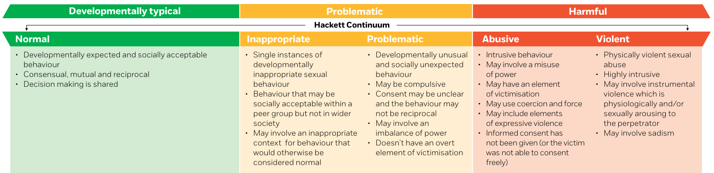
Insert Hackett video here
Harmful Sexual Behaviour
HSB can occur between two or more children of any age and sex, from primary through to secondary stage and into college. It can occur also through a group of children towards a single child or towards another group of children. HSB exists on a continuum and may escalate into sexual harassment or sexual violence, it can occur online or face-to-face (both physically and verbally) and is never acceptable
Notes:
Use this slide to introduce the KCSIE 2026 description of harmful sexual behaviour. Emphasise that it can involve children of any age or sex, occur between individuals or groups, and take place face to face or online. It may be physical, verbal or technology-assisted.
Staff may notice behaviours ranging from inappropriate or concerning language and boundary-testing through to sexual harassment or sexual violence. Behaviour can escalate, so early recognition and a proportionate safeguarding response matter.
Context is essential. Consider the children’s ages and developmental stages, whether the behaviour is repeated or escalating, any imbalance of power, coercion or pressure, the impact on those involved, and whether the behaviour appears planned, secretive or resistant to adult intervention. Staff should also remain alert to misogynistic language or attitudes as possible indicators of increasing risk.
Avoid labelling a child as “a perpetrator” or defining them by one behaviour. Every child involved may have safeguarding and support needs, including the child who has displayed the behaviour. At the same time, harmful behaviour must never be dismissed as banter, experimentation or an inevitable part of growing up.
Reinforce the staff response: remain calm, ensure immediate safety, record facts and the child’s own words, and report promptly to the DSL or safeguarding team. Staff should not investigate, question children repeatedly or attempt to determine the threshold themselves.
If useful, introduce the Simon Hackett continuum resource to illustrate how behaviours can range in seriousness and how context informs the response. Transition by explaining that the next slide considers misogyny—what the term means and how it may appear in children’s language, attitudes and behaviour.

Slide 35

Take a break and check in with each other
Notes:
Take a well-deserved break

Slide 36


What is misogyny?
feelings of hating women, or the belief that men are much better than women
Notes:
Give colleagues the opportunity to discuss the question on the slide
Where have they come across the word?
Who uses the word?
Is it helpful?
Is it new?
The image of Pandora’s Box is a prompt for discussion
There is no definition in KCSIE, or in PSHE guidance
*click*
Definition from Cambridge Dictionary

Slide 37
Insert Manosphere video here

Slide 38
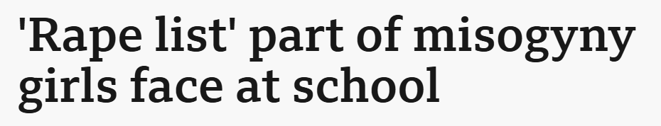
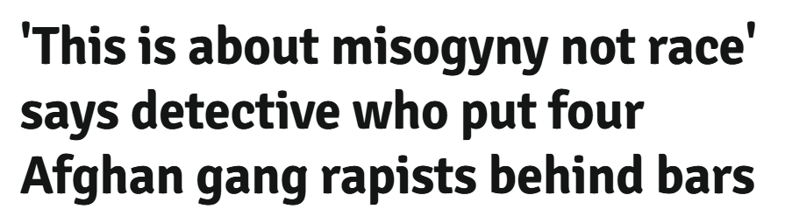
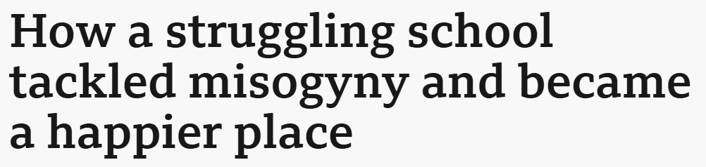
What are the early signs of misogyny we might we see with the children and the families we work with?
Notes:
Where does an incident become misogyny?

Slide 39

Task –
How might we respond as an individual or a setting?
During a group activity, the teacher asks the children to pick a team leader. When a girl volunteers, a boy says: “I’m not being in her group.” Several children laugh.
You overhear a child say to a friend “she can shut up, she looks like a bloke” under their breath after a teacher reminds them to walk in the corridor.
A child reports that they have seen a group chat involving lots of their year group. The discussion contains degrading comments such as “clapped” and “skank” about another girl. Screenshots appear to show the girl being discussed is participating in the conversation. She uses similar language about herself, joins in with some of the jokes and responds positively to comments made by others.
Notes:
How would you deal with these situations?
Discuss scenarios as appropriate – consider assigning ages suit your setting. You may have scenarios you have experienced which can be used.
Are they all misogynistic? They all need further unpicking
When considering talking with someone who has exhibited misogynistic behaviour/accessed concerning online contact referenced in the video, would the conversation be different if you were talking to family member? How do we support ourselves and our colleagues to approach these conversation with love and care?
Consider the importance of being non-judgemental and non shaming, to maintain the relationship with the children.
Resources: Misogyny – Educate Against Hate

Slide 40
KCSIE 2026 makes prevention more explicit
What changed for child-on-child abuse and misogyny
01
Misogyny is named
02
Risk around the school day
03
Recognise early; prevent harm
The expanded guidance explicitly references misogyny within child-on-child abuse, including harassment and violence.
Be alert to times when risk may be higher, including immediately after school—not only during lessons or on the premises.
Child-on-child abuse is preventable. Recognising behaviours and indicators early supports timely action before patterns escalate.
SAFEGUARDING LENS
Every child involved needs a safeguarding response
Notice patterns, record facts and share concerns promptly through the setting’s safeguarding route.
Source: DfE, Keeping children safe in education 2026 • in force 1 September 2026
33
Notes:
KCSIE 2026 explicitly recognises misogyny within child-on-child abuse and highlights risks around the wider school day, including immediately after school.
Early recognition is central to prevention, and every child involved needs a safeguarding response based on recorded facts and promptly shared concerns.

Slide 41

Children questioning their gender
Schools should consider adopting policies that maintain flexibility and avoid rigid rules based on gender stereotypes.
Decision making process around requests for support with social transition should be documented and records kept.
School should consider whether pupils would be best supported by a policy on social transition which explains the steps the school would take.
Schools and colleges must take a strong, proactive stand against all forms of bullying, and schools and colleges should tackle bullying at the earliest opportunity to prevent it from escalating.
Notes:
This is a new section of KCSIE. Summarised here. Settings should consider how they deliver LGBT inclusive spaces for their community. (Inline, at least, with the currrent Ofsted inspection framework's approach to the teaching of protected characteristics)
The 1st point here links the previous slides re. gender stereotypes and early signs of misogyny. I.e. uniform policy
Would a policy provide clarity to parents and children? If so, who should contribute?
Consider appropriate logging, in line with GDPR

Slide 42
Parental involvement
The views of the child’s parents or carers should be properly considered. In circumstances where involving parents or carers would put the child at a greater risk than not involving them, the school should involve the DSL to determine what action should be taken.
Schools should explore how best to support conversations with parents and carers, including offering for a staff member to be present or speak to parents and carers on the child’s behalf.
In cases where a child speaks to a staff member about their feelings but does not ask the school to make any changes around support with social transition, there is no reason to share this information any further unless there is a related safeguarding risk.
Notes:
Crucial 1st point for all staff. – settings may want to have their own conversation on this but child’s right to have a discussion with any member of staff without it going further needs to be protected. Settings may consider as part of their approach for staff to discuss anonymously with the DSL.
Related Safeguarding risk could be: vulnerability to transphobic bullying
Supporting the parents would enable the child to have a support network outside of school and also provide help to parents.

Slide 43
Accommodating social transition is described as “an active intervention”
The guidance expects support for full social transition in primary settings to be agreed very rarely. There is acknowledgement that older children will generally have greater agency to make their own decisions.
Notes:
Explain that the guidance describes accommodating social transition as an active intervention, so requests should be considered carefully rather than treated as an automatic response.
In primary settings, full social transition is expected to be agreed only very rarely; older children will generally have greater agency.
Use a child-centred, case-by-case approach, involve the DSL and follow the setting’s agreed policy.
Listen without making promises, avoid assumptions, protect privacy and consider the child’s safeguarding and wellbeing needs.

Slide 44

Schools and colleges have statutory duties to safeguard and promote the welfare of all children
As a first step when considering a request for support with social transition, the guidance asks that schools consider what is in the best interests of the child and other children.
In most cases, this would be carried out in conjunction with the child’s parents or carers, and relevant professionals.
Notes:
Emphasise that the statutory duty to safeguard and promote welfare applies to every child. Inclusive practice benefits all children: listen carefully, avoid assumptions, protect privacy and respond to each child’s circumstances and needs.
Address any bullying or discrimination promptly, involve the DSL where appropriate and follow the setting’s agreed policies and safeguarding procedures.

Slide 45
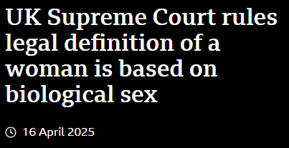
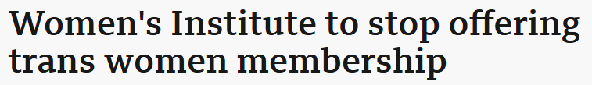

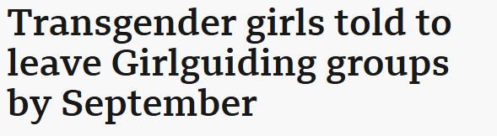
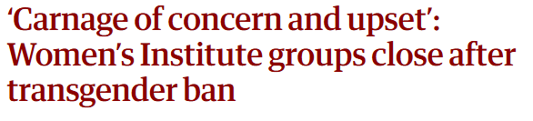
Legal constraints on social transition
Schools should sensitively discuss any constraints to social transitioning, highlighting that supporting social transitioning does not include allowing access to toilets, changing rooms or residential accommodation designated for the opposite sex.
Schools must be conscious of the rights of pupils and staff in relation to their religion or belief.
Notes:
Explain that decisions about social transition sit within a wider legal context, including the Supreme Court ruling concerning interpretation of the Equality Act 2010.
This is a legal and policy matter, not something individual staff should interpret alone. The ruling and its implications have received significant attention, including discussion involving the Women’s Institute, Girlguiding and women’s events and spaces.
Staff should follow the setting’s current policy, seek leadership or legal advice where needed, and continue to safeguard each child through a respectful, case-by-case approach.

Slide 46
KCSIE 2026 adds clearer operational guidance
The updates relevant to gender-questioning children
01
Privacy and facilities
02
Single-sex sport
03
Support in sport and PE
A new section brings together regulations and safeguarding requirements for toilets, changing rooms and showers, including arrangements for gender-questioning children.
The new sport section sets out appropriate criteria for single-sex sport in line with the Equality Act 2010.
The guidance includes information about supporting gender-questioning children where social transition is considered in sport and PE.
SAFEGUARDING LENS
Use a child-centred, case-by-case approach
Listen, avoid assumptions, protect privacy and follow the setting’s agreed policy and safeguarding route.
Source: DfE, Keeping children safe in education 2026 • in force 1 September 2026
35
Notes:
KCSIE 2026 brings together clearer operational guidance on privacy and facilities, single-sex sport, and support for gender-questioning children in sport and PE.
Apply this child-centred and case-by-case: listen, avoid assumptions, protect privacy, and follow agreed policy and safeguarding routes.

Slide 47

Southport Inquiry Recommendations for Settings
Southport Inquiry Report – Volume 2
Notes:
Context : in July 2024, a teenager attacked a children’s dance class in Southport. Three young girls died, and other children and adults were hurt or deeply affected by the trauma.
The Southport Inquiry looks at what happened before the attack, what different agencies knew, and where warning signs or information-sharing did not lead to effective action.
This section will focus on the safeguarding lessons for settings: taking concerns seriously, sharing information clearly, and planning for risk before a child arrives.

Slide 48
Insert Southport Inquiry video here

Slide 49

Schools’ insight about risk to others must be taken seriously
When a school raises concerns about a pupil posing a risk to others, those concerns must carry real weight. Teachers often know the child best because they observe them daily, including peer interactions. This is especially important where schools have specialist experience (e.g. PRUs).
Key takeaways:
Be confident in escalating concerns about risk to others
In meetings do not downplay school observations compared to other agencies
Notes:
Schools often see patterns that other agencies may not: daily behaviour, peer relationships, escalation over time, and how a child responds in structured and unstructured parts of the day.
Staff should record concerns clearly and objectively, including what was seen, heard, reported, and why it raised concern about risk to others.
In multi-agency discussions, school insight should not be treated as secondary. If concerns are being minimised, be confident to restate the evidence, ask what is being done with it, and escalate where necessary.

Slide 50

Safeguarding information must follow the child – properly and on time
When a pupil moves school (especially after permanent exclusion), safeguarding and “risk to others” information must be clearly shared, received, checked, and acted upon before the child starts.
This includes:
Clarity on who sends what (school vs local authority)
Sharing information before a place is offered if safety planning is needed
Highlighting serious concerns (weapons, intent to harm)
Ensuring EHCPs do not replace direct safeguarding information sharing
Notes:
Safeguarding information must travel with the child, especially where there has been exclusion, managed move, alternative provision, or known concerns about harm to others.
In your setting: who sends the information, who receives it, who checks it has been read, and who decides what action is needed before the child starts.
An Education Health Care Plan or admissions paperwork is not a substitute for direct safeguarding information sharing. Serious concerns, including weapons or stated intent to harm, need to be highlighted plainly and early enough for safety planning.

Slide 51
No single point of failure for safeguarding information
Safeguarding systems must not rely on one person or one email. There must be clear confirmation that information has been:
Received
Read
Understood
Acted upon
Key takeaway for DSLs:
Use systems with confirmation/sign‑off
Have cover arrangements if the DSL is absent
Notes:
A safeguarding process is too fragile if it depends on one person noticing one email at the right time.
Settings should be able to evidence four things: the information was received, read, understood, and acted upon. Confirmation and sign-off are safeguards, not bureaucracy.
Consider cover arrangements: what happens when the DSL is absent, an inbox is unmonitored, or a key person leaves? There should be a clear route for urgent information to reach the right people every time.

Slide 52

Risk assessments and safety plans before transfer
If a pupil has a known history of weapon possession or serious violence, the receiving school’s DSL must:
Complete a risk assessment
Put a safety plan in place before the pupil joins the school.
Key takeaway for DSLs:
Never wait until day one to plan for risk
Notes:
A risk assessment is not something to start after the pupil arrives. If there is known history of weapon possession or serious violence, planning needs to happen before transfer.
A practical safety plan might cover supervision, arrival and departure, peer groups, staff briefings on a need-to-know basis, search or screening procedures where policy allows, and how concerns will be reviewed and escalated.
The aim is to keep everyone safe while still supporting the pupil appropriately. The plan should be recorded, shared with relevant staff, reviewed regularly, and updated if new information emerges.

Slide 53

Prevent: understanding what happens after a referral
Staff must understand:
What happens after a Prevent referral
The importance of two‑way dialogue with Prevent officers
That safeguarding responsibility continues after referral
Key takeaway for DSLs:
Prevent is a process, not a one‑off form
Notes:
Making a Prevent referral is not the end of the setting's safeguarding responsibility. Staff need to understand what happens next and what information may still be needed from the setting.
Provide context, ask for feedback where appropriate, and keep records of advice, decisions, and follow-up actions.
Continue to monitor the child's welfare and any risk indicators. If circumstances change or concerns increase, the setting should update the relevant safeguarding partners rather than assuming the referral has dealt with everything.

Slide 54

Reflections
Spend some time reflecting on and discussing these findings.
Any key areas of concern?
Any areas of good practice to share?
Notes:
Give people a few minutes individually to read the slide, then invite discussion in pairs or groups.
Suggested prompts: where could information get stuck in our current process? How do we confirm it has been read and acted on? How confident are staff to escalate concerns about risk to others?
Ask each group to identify one area of good practice to keep and one improvement to take forward after the session.

Slide 55
KCSIE 2026 reinforces safeguards highlighted by Southport
KCSIE 2026 • SOUTHPORT LEARNING
Relevant statutory updates • in force 1 September 2026
01
Escalate weapon and violence concerns
02
Share the full safeguarding picture
Report concerns about carrying, using or intending to use a weapon to the DSL, who should assess the risk.
Information must be relevant, focused, proportionate and clearly contextualised for the receiving setting.
03
Plan before the child arrives
04
Remove single points of failure
Where information indicates risk to the child or others, assess risk, put a safety and support plan in place, and ensure DSLs speak directly.
Use robust DSL cover so concerns are received, monitored and acted on without delay when the DSL is unavailable.
KEEP THE DISTINCTION CLEAR KCSIE 2026 is statutory guidance; the Southport Inquiry recommendations are a separate source of learning.
Sources: DfE, Keeping children safe in education 2026; Southport Inquiry Phase 1 report (2026).
Notes:
This slide highlights four practical safeguards reinforced by KCSIE 2026:
escalate weapon or violence concerns, share a clear and proportionate safeguarding picture, plan risk and support before transfer, and ensure reliable DSL cover.
These statutory updates take effect on 1 September 2026; keep them distinct from the separate learning and recommendations of the Southport Inquiry.

Slide 56

Safer Working Practice

Slide 57
Regulated activity: what changes in 2026?
A guide for staff and volunteers
01
Occasional can still count
02
Supervision matters
03
Some tasks always count
The old frequency test is removed. Teaching, training, instructing, caring for or supervising children may be regulated activity even if it happens only once.
A volunteer under regular, day-to-day and reasonable supervision may be outside regulated activity. Unsupervised work may be inside it.
Relevant personal care is regulated activity even when occasional. Leaders decide the correct DBS and barred-list checks before the role starts.
WHAT STAFF SHOULD DO
Follow the agreed role and supervision plan
Do not change duties or work unsupervised without checking with the designated manager or HR.
Source: DfE, Keeping children safe in education 2026 • in force 1 September 2026
47
Notes:
From 2026, occasional teaching, training, care or supervision can still be regulated activity because the former frequency test is removed.
Supervision and the nature of the task determine the required checks, so staff and volunteers must follow the agreed role and supervision plan and confirm any change before acting.

Slide 58



How can each role make volunteer arrangements safe?
The role, checks and supervision must be clear — and reviewed when the work changes.
DECIDE
SUPERVISE
CHECK
Leaders, HR & governors
Staff & supervisors
Volunteers
Define the role. Decide the checks. Agree how supervision will work.
Keep supervision regular and visible. Report changes, gaps or unexpected one-to-one work.
Follow the agreed duties. Ask before working differently, alone or with personal care.
GROUP TASK
Discuss how your setting would respond:
Choose one
scenario
Who needs to know what?
What must happen before and during the activity?
Where could supervision break down — and who acts?
1
2
3
7 MINUTES
KCSIE 2026 • regulated activity and supervision of volunteers
48
Notes:
Purpose
Connect the 2026 regulated-activity update to everyday decisions. The key message is that safe volunteer arrangements depend on a clearly defined role, the right checks and supervision that works in practice. Staff should not try to make legal or DBS decisions themselves: pause and refer changes to the designated manager, HR or safer-recruitment lead.
How to run the activity (7 minutes)
Ask each group to choose one scenario, map the responsibilities across the three role areas on the slide, and answer the three questions. After five minutes, take one practical action from each group.
Scenario choices
1. Reading support: A volunteer who normally works in the classroom is asked to take two pupils to an empty room because the library is busy.
2. Sports activity: A volunteer offers a one-off coaching session, but the named supervisor is unexpectedly absent.
3. Personal care: A volunteer is asked to help a child with toileting or another relevant personal-care task.
4. Changing duties: A regular volunteer is asked to cover a different group, location or time without the usual supervision arrangements.
Examples by role
• Leaders / HR / safer-recruitment lead: Write down the actual duties; decide whether they fall within regulated activity; determine which DBS and barred-list checks are lawful and required; identify a named supervisor; and review the arrangement whenever duties, location, children or supervision change.
• DSL and senior leaders: Keep safeguarding risk visible, make sure concerns about arrangements are reported promptly, and escalate gaps rather than allowing an unsafe arrangement to continue.
• Governors / trustees: Seek assurance that the setting has a clear policy, consistent role descriptions, appropriate checks and an effective supervision process. They provide oversight rather than making day-to-day decisions about individual volunteers.
• Volunteer coordinator / office or admin team: Give a clear induction, record agreed duties, make the named supervisor and timetable visible, check attendance and flag unexpected changes before the activity starts.
• Teachers, teaching assistants and activity leaders: Provide the supervision that has been agreed; stay available and able to intervene; do not assume that familiarity means a volunteer can work alone; pause the activity if the supervision plan is no longer workable.
• Other staff who notice a change: Report an unexpected one-to-one situation, an unplanned task, a missing supervisor or a volunteer being asked to work outside the agreed role.
• Volunteers: Know the limits of the role and who is supervising; follow the agreed duties; do not accept unsupervised, one-to-one or personal-care work unless the setting has reviewed and approved the arrangement; ask whenever unsure.
Debrief points
• The old frequency test has been removed: teaching, training, instructing, caring for or supervising children may be regulated activity even when it happens only once.
• Supervision must be regular, day-to-day and reasonable in the circumstances. A name on a rota is not enough if supervision is not actually available.
• Relevant personal care is regulated activity even when occasional.
• A change in duties can change the safeguarding and checking requirements. The safe response is to pause, check and agree the new arrangement before continuing.
Suggested close
“Everyone has a part to play. Leaders decide and record the arrangement; staff make supervision real; volunteers stay within the agreed role; and anyone who sees a gap speaks up.”

Slide 59
Choose a scenario: what should happen next?
Use the roles on the previous slide. Focus on safe checks, duties and supervision.
01
LOCATION CHANGE
02
SUPERVISION GAP
Reading support
Sports activity
A classroom volunteer is asked to take two pupils to an empty room because the library is busy.
A one-off coaching session is due to begin, but the named supervisor is unexpectedly absent.
03
PERSONAL CARE
04
ROLE CHANGE
Personal care
Changing duties
A volunteer is asked to help a child with toileting or another relevant personal-care task.
A regular volunteer is asked to cover a different group, location or time without the usual supervision arrangements.
GROUP DISCUSSION
Who acts now? • What needs checking? • Can the activity continue safely? • What must be recorded?
KCSIE 2026 • regulated activity and supervision of volunteers
49
Notes:
Purpose
Use one scenario to practise applying the roles from the previous slide. The aim is not for staff to decide the legal status of a volunteer or choose a DBS check themselves. The safe response is to notice when the agreed role or supervision has changed, pause if needed, and refer the decision to the designated manager, HR or safer-recruitment lead.
How to run the discussion
Give groups one scenario,or let them choose. Ask them to identify:
• who needs to act immediately;
• what information the leader or HR team needs;
• whether the agreed duties or supervision have changed;
• whether the activity can continue safely; and
• what should be recorded or reported.
Allow 5–7 minutes, then take one practical action from each group.
Scenario 1 — Reading support
A classroom volunteer is asked to take two pupils to an empty room because the library is busy.
Possible discussion points:
• This changes the location and may reduce visibility or day-to-day supervision.
• The teacher or named supervisor should not assume that the usual arrangement automatically covers the new room.
• Check the volunteer’s agreed duties and supervision plan before moving. Use an observable space or keep the pupils in the supervised classroom if the change has not been approved.
• Staff should report repeated pressure to create unplanned one-to-one or secluded work.
Scenario 2 — Sports activity
A volunteer offers a one-off coaching session, but the named supervisor is unexpectedly absent.
Possible discussion points:
• A one-off session can still fall within regulated activity because the old frequency test has been removed.
• Do not replace real supervision with a name on the rota. Supervision must be regular, day-to-day and reasonable in the circumstances.
• The activity should be postponed, rearranged or supervised by another suitable person unless leaders have reviewed and approved a different arrangement.
• The designated manager or HR team decides whether the role and checks are appropriate; classroom or activity staff should not improvise an unsupervised role.
Scenario 3 — Personal care
A volunteer is asked to help a child with toileting or another relevant personal-care task.
Possible discussion points:
• Relevant personal care is regulated activity even when it happens only once.
• The volunteer should not accept the task simply because help is urgently needed.
• Pause and follow the setting’s intimate-care procedure. A suitable authorised and appropriately checked member of staff should provide the care.
• Report the request so leaders can review staffing, role descriptions and supervision arrangements.
Scenario 4 — Changing duties
A regular volunteer is asked to cover a different group, location or time without the usual supervision arrangements.
Possible discussion points:
• Familiarity and length of service do not replace a role review.
• A different group, location, time or supervisor may change the safeguarding risk and whether the activity is regulated.
• Pause the change until the named manager has confirmed the duties, checks and supervision.
• Update the role description, rota or supervision record if the change is approved.
Suggested debrief
Draw out the common pattern: define the role, check the arrangement, make supervision real, and review any change before it happens. Volunteers should stay within agreed duties; staff should speak up when the plan is not working; leaders and HR make and record the formal decision.

Slide 60

What is a low-level concern?
The threshold may be low, but the concern is not unimportant.
Any concern, however small, that an adult working in or on behalf of the school may have:
• acted in a way inconsistent with the staff code of conduct, including conduct outside work; and
• not met the harm threshold or is otherwise not serious enough to consider a LADO referral.
“Low-level” does not mean insignificant
Seen • Heard • Shared • Sensed
Notes:
A low-level concern is not necessarily minor or unimportant. The term means that the behaviour may not meet the harm threshold.
Staff do not need proof and are not expected to decide whether the threshold has been met. Their responsibility is to share the information promptly with the appropriate person.
A concern might arise from something seen or heard, information shared by someone else, a pattern, a breach of boundaries, a nagging doubt, or concern about your own conduct.

Slide 61

What might it look like?
Look for conduct that does not fit the staff code of conduct or safe professional boundaries.
Over-friendly behaviour or favouritism
Gifts or privileges without an agreed reason
Humiliating, intimidating or inappropriate language
Personal-phone photographs or private online contact
One-to-one contact in a secluded or unobservable place
Conduct outside work raising safeguarding or suitability concerns
Record facts
Report promptly
Do not investigate
Notes:
These examples are not exhaustive. Context matters, and not every concern will result in disciplinary or safeguarding action. However, the appropriate person needs to consider the information.
Reporting does not mean accusing a colleague or deciding that they have done something wrong. It enables the concern to be considered fairly, proportionately and alongside any other information held.
Reinforce the local route: record what was seen, heard or reported and share it promptly in line with the setting’s procedure. Do not investigate, confront the adult, discuss the matter informally or wait for it to happen again.

Slide 62
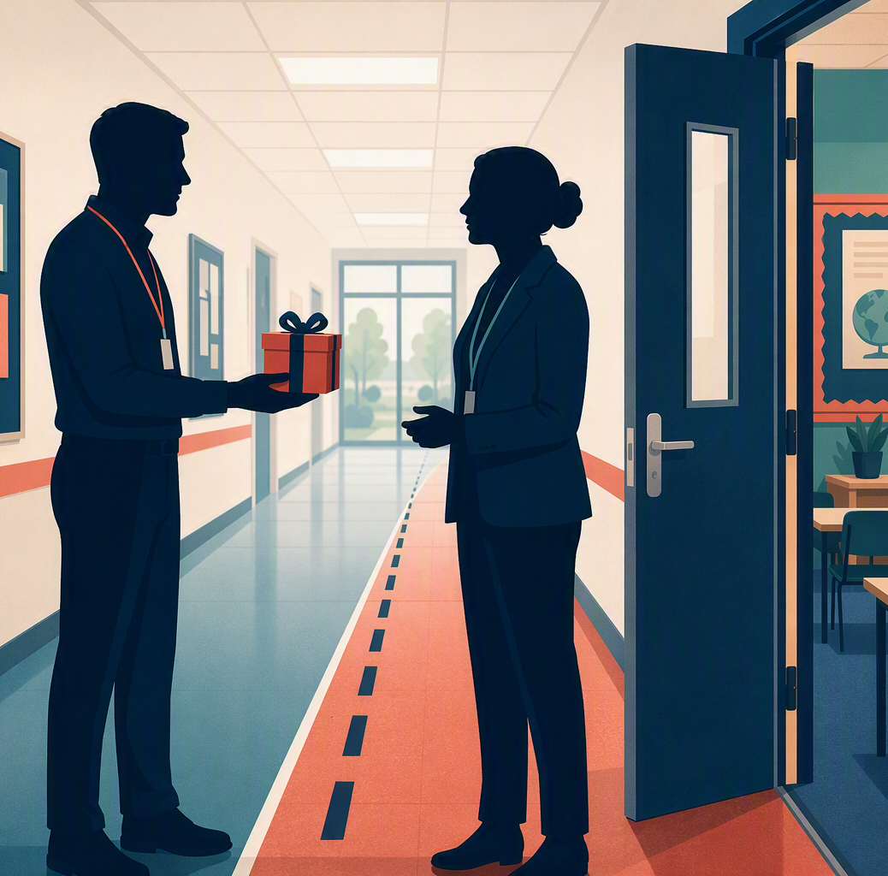
Discussion scenario
Read the scenario, then discuss the four questions in small groups.
A member of staff regularly gives one child additional privileges and small treats. The child is sometimes allowed to stay behind after activities to talk with the staff member alone. When questioned the staff member tells you…
“They have a difficult home life. I’m only trying to help.”
1
What causes concern or unease?
2
Do good intentions make the behaviour acceptable?
3
What should be recorded and reported?
4
What should the staff member avoid doing?
Notes:
Draw out these points:
• Supporting a vulnerable child is appropriate, but support should be planned, authorised and transparent.
• Favouritism, gifts, additional privileges and opportunities to be alone may indicate blurred professional boundaries.
• Good intentions provide context but do not remove the need to report.
• Record only what was personally observed or said, when and where it happened, and whether it appears repeated.
• Do not question the child, investigate, confront the adult, canvass colleagues or dismiss the concern.
• The appropriate decision-maker considers whether this is suitable conduct, a misunderstanding, a training or supervision issue, a breach of the code, part of a pattern, or a matter that may meet a higher threshold.

Slide 63

Closing message
A fair reporting culture protects children and supports professional accountability.
Low-level concerns are not about creating suspicion or encouraging gossip.
Recognise conduct that may be inconsistent with professional expectations and share it with the right person. You are not responsible for investigating or deciding which threshold has been met.
NOTICE IT • RECORD IT • REPORT IT
DO NOT INVESTIGATE IT
Notes:
Low-level concerns are not about creating suspicion or encouraging gossip. They are about recognising conduct that may be inconsistent with professional expectations and sharing it with the right person.
Staff are not responsible for investigating or deciding which threshold has been met. They should report the facts, including professional unease, so the concern can be considered fairly and appropriately.
Notice it. Record it. Report it. Do not investigate it.

Slide 64
KCSIE 2026 reinforces safer working practice
The core expectations relevant to staff conduct and low-level concerns
01
Code sets the standard
02
Share every concern
03
Records reveal patterns
Use the staff code of conduct and safe professional boundaries as the benchmark—including expectations about conduct outside work.
Report promptly, however small the concern. Staff do not need proof or decide whether the harm threshold has been met.
Record facts clearly and review concerns together so repeated or cumulative behaviour can be identified and addressed proportionately.
STAFF RESPONSE
Notice • Record • Report — do not investigate
The appropriate person decides whether it is low-level, an allegation, or needs LADO advice.
Source: DfE, Keeping children safe in education 2026 • in force 1 September 2026
54
Notes:
KCSIE 2026 reinforces safer working practice by using the staff code of conduct as the benchmark, requiring every concern to be shared promptly, and using clear records to identify patterns.
Staff should notice, record and report rather than investigate; the appropriate safeguarding lead decides the correct threshold and response.

Slide 65

True or false?
As of today, any volunteers in your setting are now free to move about the setting, unsupervised.
A DBS check is now all that is required for anyone volunteering in our setting.
As a member of staff, conduct outside work is separate to conduct inside work so is not relevant to low-level concerns procedures.
All low-level concerns should be reported to the LADO so they can monitor them.
It is not necessary to report a low-level concern if you have reported the behaviour before.
It is OK to share and/or comment on social media posts about ‘troublemakers’ in your community because you use a different name online, they won’t know it is you.
Which of the following are regulated activities?
Listening to readers
Being an adult leading a group on a class trip
Assisting with personal care such as changing after swimming
Notes:
QUIZ ANSWERS
1. Volunteers may now move around unsupervised — FALSE.
Volunteers must follow the agreed role and supervision plan. They should not work unsupervised or change duties unless this has been checked and authorised.
2. A DBS check is all that is required for every volunteer — FALSE.
The setting must assess the role and decide the correct checks before it starts. Regulated activity may require an enhanced DBS check with a barred-list check; supervision arrangements also matter.
3. Which examples are regulated activities?
• Listening to readers — CAN BE, when the adult is teaching, training, instructing, caring for or supervising children without qualifying day-to-day supervision. Occasional activity can still count.
• Leading a group on a class trip — CAN BE, when this involves unsupervised care or supervision of children.
• Assisting with personal care, such as changing after swimming — YES. Relevant personal care is regulated activity even when occasional.
Emphasise that leaders must assess the exact duties and supervision arrangements rather than rely on the job title alone.
4. All low-level concerns should be reported to the LADO — FALSE.
Staff report them promptly through the setting's internal procedure. The appropriate person decides whether the matter is low-level, meets the harm threshold, or requires LADO advice or referral.
5. Conduct outside work is irrelevant to low-level-concern procedures — FALSE.
The staff code of conduct may cover behaviour outside work where it raises safeguarding, professional-boundary or suitability concerns.
6. A repeated concern does not need reporting — FALSE.
Report every concern, even if similar behaviour was reported before. Separate records help the setting identify patterns or cumulative risk.
7. Using a different name makes it acceptable to comment online about community 'troublemakers' — FALSE.
Online conduct can still be identifiable and may breach professional standards or raise safeguarding and suitability concerns. Do not post or engage in this way; follow the staff code of conduct.

Slide 66

What’s your takeaway?
Notes:
In small groups, discuss the training and agree on:
Keep: one thing your setting already does well and should continue.
Start: one new action or habit that would improve safeguarding practice.
Strengthen: one existing process that needs to be clearer, more consistent, or better evidenced.
Ask each group to choose one priority action they would take back to their setting.
Bring everyone back together and ask each group to share:
their priority action,
who needs to be involved,
and what the first step would be.

Slide 67
Insert Are you Listening? video here

