Slide 1
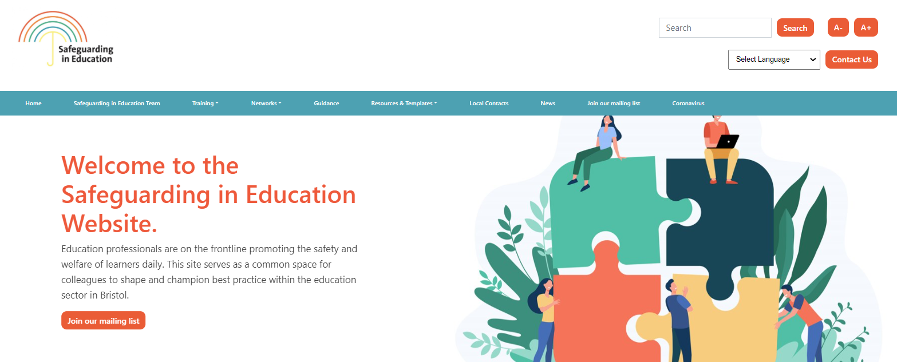
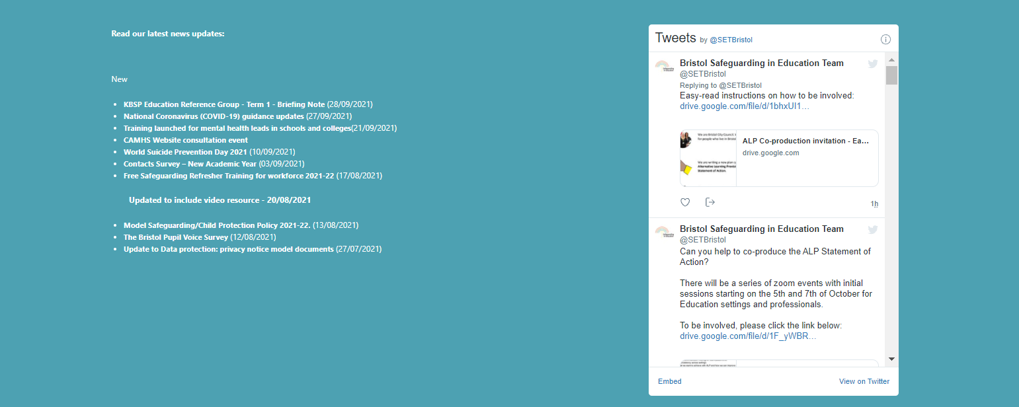


Welcome to the DSL Network Meeting
If you haven't already done so, bookmark our website https://www.bristolsafeguardingineducation.org/
The session will start promptly at: 3.00pm
Facilitated by: Elisabeth Clark
If you have any technical difficulties please email the safeguardingineducationteam@bristol.gov.uk
If you have the functionality, please can
you put your cameras on out of respect for colleagues.

Slide 2

Designated Safeguarding Lead Network
Term 3 - 2024-25
Notes:
If you have any questions whilst the meeting in running please do put them in the chat and we will answer them throughout the meeting or at the end. Please be mindful of confidentiality if you do have any specific concerns.
The slides will be uploaded to the safeguarding in education team website

Slide 3

Agenda
Schools Supporting Refugees and Asylum Seekers
Local & National news
Keeping Bristol Safe Partnership updates - S.175 Audit update and Data Drop
Supporting children who experience sexualised child on child harm (The Green House Centre and Be Safe)
Multi-agency updates
AOB
Notes:
These are the areas we plan to cover today.
Greenhouse/Be safe
Police for locality updates.
Updates from CSC
Audit talk - exercise
Children’s wellbeing and schools bill.
UK National Child Abuse Image Database (CAID).
Training opportunities.
CSPR publications
KBSP conference.
Young carers action day
Prevent updates
Operation encompass.

Slide 4
Take a minute to remember those children who have lost their lives in Bristol
Notes:
27th Jan - Max and Mason
14th Feb – Darrien Williams
18th Feb – the Bash children. We are mindful that other children died last year and this year will be very difficult for all those families, communities and those that worked with them.
Remember me when I am gone away,
Gone far away into the silent land;
When you can no more hold me by the hand,
Nor I half turn to go yet turning stay.
Remember me when no more day by day
You tell me of our future that you plann'd:
Only remember me; you understand
It will be late to counsel then or pray.
Yet if you should forget me for a while
And afterwards remember, do not grieve:
For if the darkness and corruption leave
A vestige of the thoughts that once I had,
Better by far you should forget and smile
Than that you should remember and be sad.

Slide 5
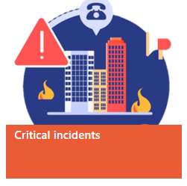
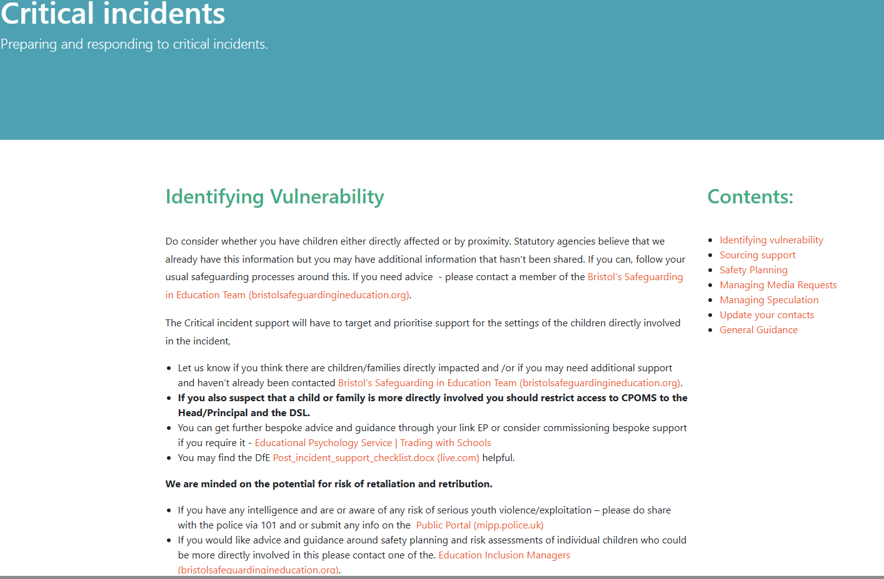
Responding to Critical Incidents training (FREE)
Guidance for Senior Leaders in schools and education settings
17th March – CLF Institute (East/Central)
17th June – Knowle DGE (South)
Notes:
There are still places on the Critical Incident training in March and June.
We have also put useful resources onto our web pages.

Slide 6

Creating Healing Environments – Evidence-Based Principles for Recovery after Trauma webinar
Is a child you support struggling after trauma such as violence, abuse, or disaster? This free webinar from the UK Trauma Council - a project of Anna Freud - offers evidence-based advice for professionals, parents, and carers.
The discussion will be hosted by Prof. Rachel Hiller, with insights from Consultant Clinical Psychologist David Trickey and a young person from the Grenfell Health & Wellbeing Service. It will cover the potential impact of trauma on children, effective recovery strategies, and how to help young people get back on track.
Register now >>
Notes:
Sign up for this training which is on 13 February.

Slide 7

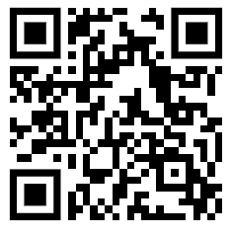

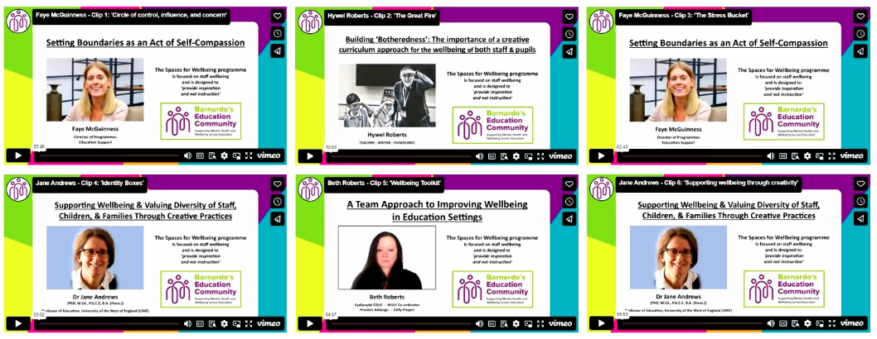
FREE resources – funding until 2026.
Taking Care of People You Lead - Leadership and management programme that support and champions efforts to promote emotional health and wellbeing.
The Invisible Backpack Package – focuses on developing a relational approach in our work with babies, children and young people.
Barnardo's Education Community Booklets - Exploring grief as well as more general wellbeing strategies.
BEC Podcast - conversations with young people discussing topics relating to mental health and wellbeing that are important to them.
Therapeutic Games and Activities Resource – support staff to targeted interventions with individual and groups.
Join the BEC mailing list
BECommunity@barnardos.org.uk
Spaces for Wellbeing Programme - Short clips -
Notes:
Barnardo’s Education Community (BEC) was launched in January 2021 as part of our mental health support services in response to the Covid-19 pandemic with a focus on loss, grief, bereavement, and trauma.
Our scope since becoming Zurich Community Trust’s new National Mental Health Partner in July 2022 has widened enabling us to support mental health and wellbeing in general. We can now also offer additional targeted support to educational establishments.
The aim of BEC is to improve the mental health of babies, children and young people by providing staff working in education with the knowledge, understanding and tools to support them.
BEC provides a range of resources, training, and support:
for you and your staff (Staff Wellbeing)
for you in your work with babies, children and young people (Training and CPD; Resources)
including links to Barnardo’s MHWB Support.

Slide 8


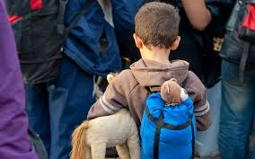


Safeguarding Refugee and Asylum Seeker pupils and their families
Safeguarding Sanctuary Seeking Pupils (refugees and asylum seekers) in our Schools
Ruth Pickersgill

Slide 9
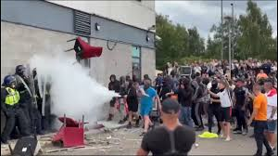
Context
Changing demography in schools (AI hotels).
Rapid Review - Working Together to Keep Children Safe. (Will be updated in S. 175 moving forward).
Issues with admissions, induction, attendance, transitions, Bristol has a high level of children affected with negative outcomes.
Additional vulnerability to safeguarding concerns, compounded by existing trauma and social status.
Accessibility of processes/ barriers to disclosure.
Lack of specific pupil and parent/carer voice.
Generic approach to safeguarding not effective – needs recognising additional trauma and cultural competence.
Politics and far right riots, hate crime and
racist incidents.

Slide 10
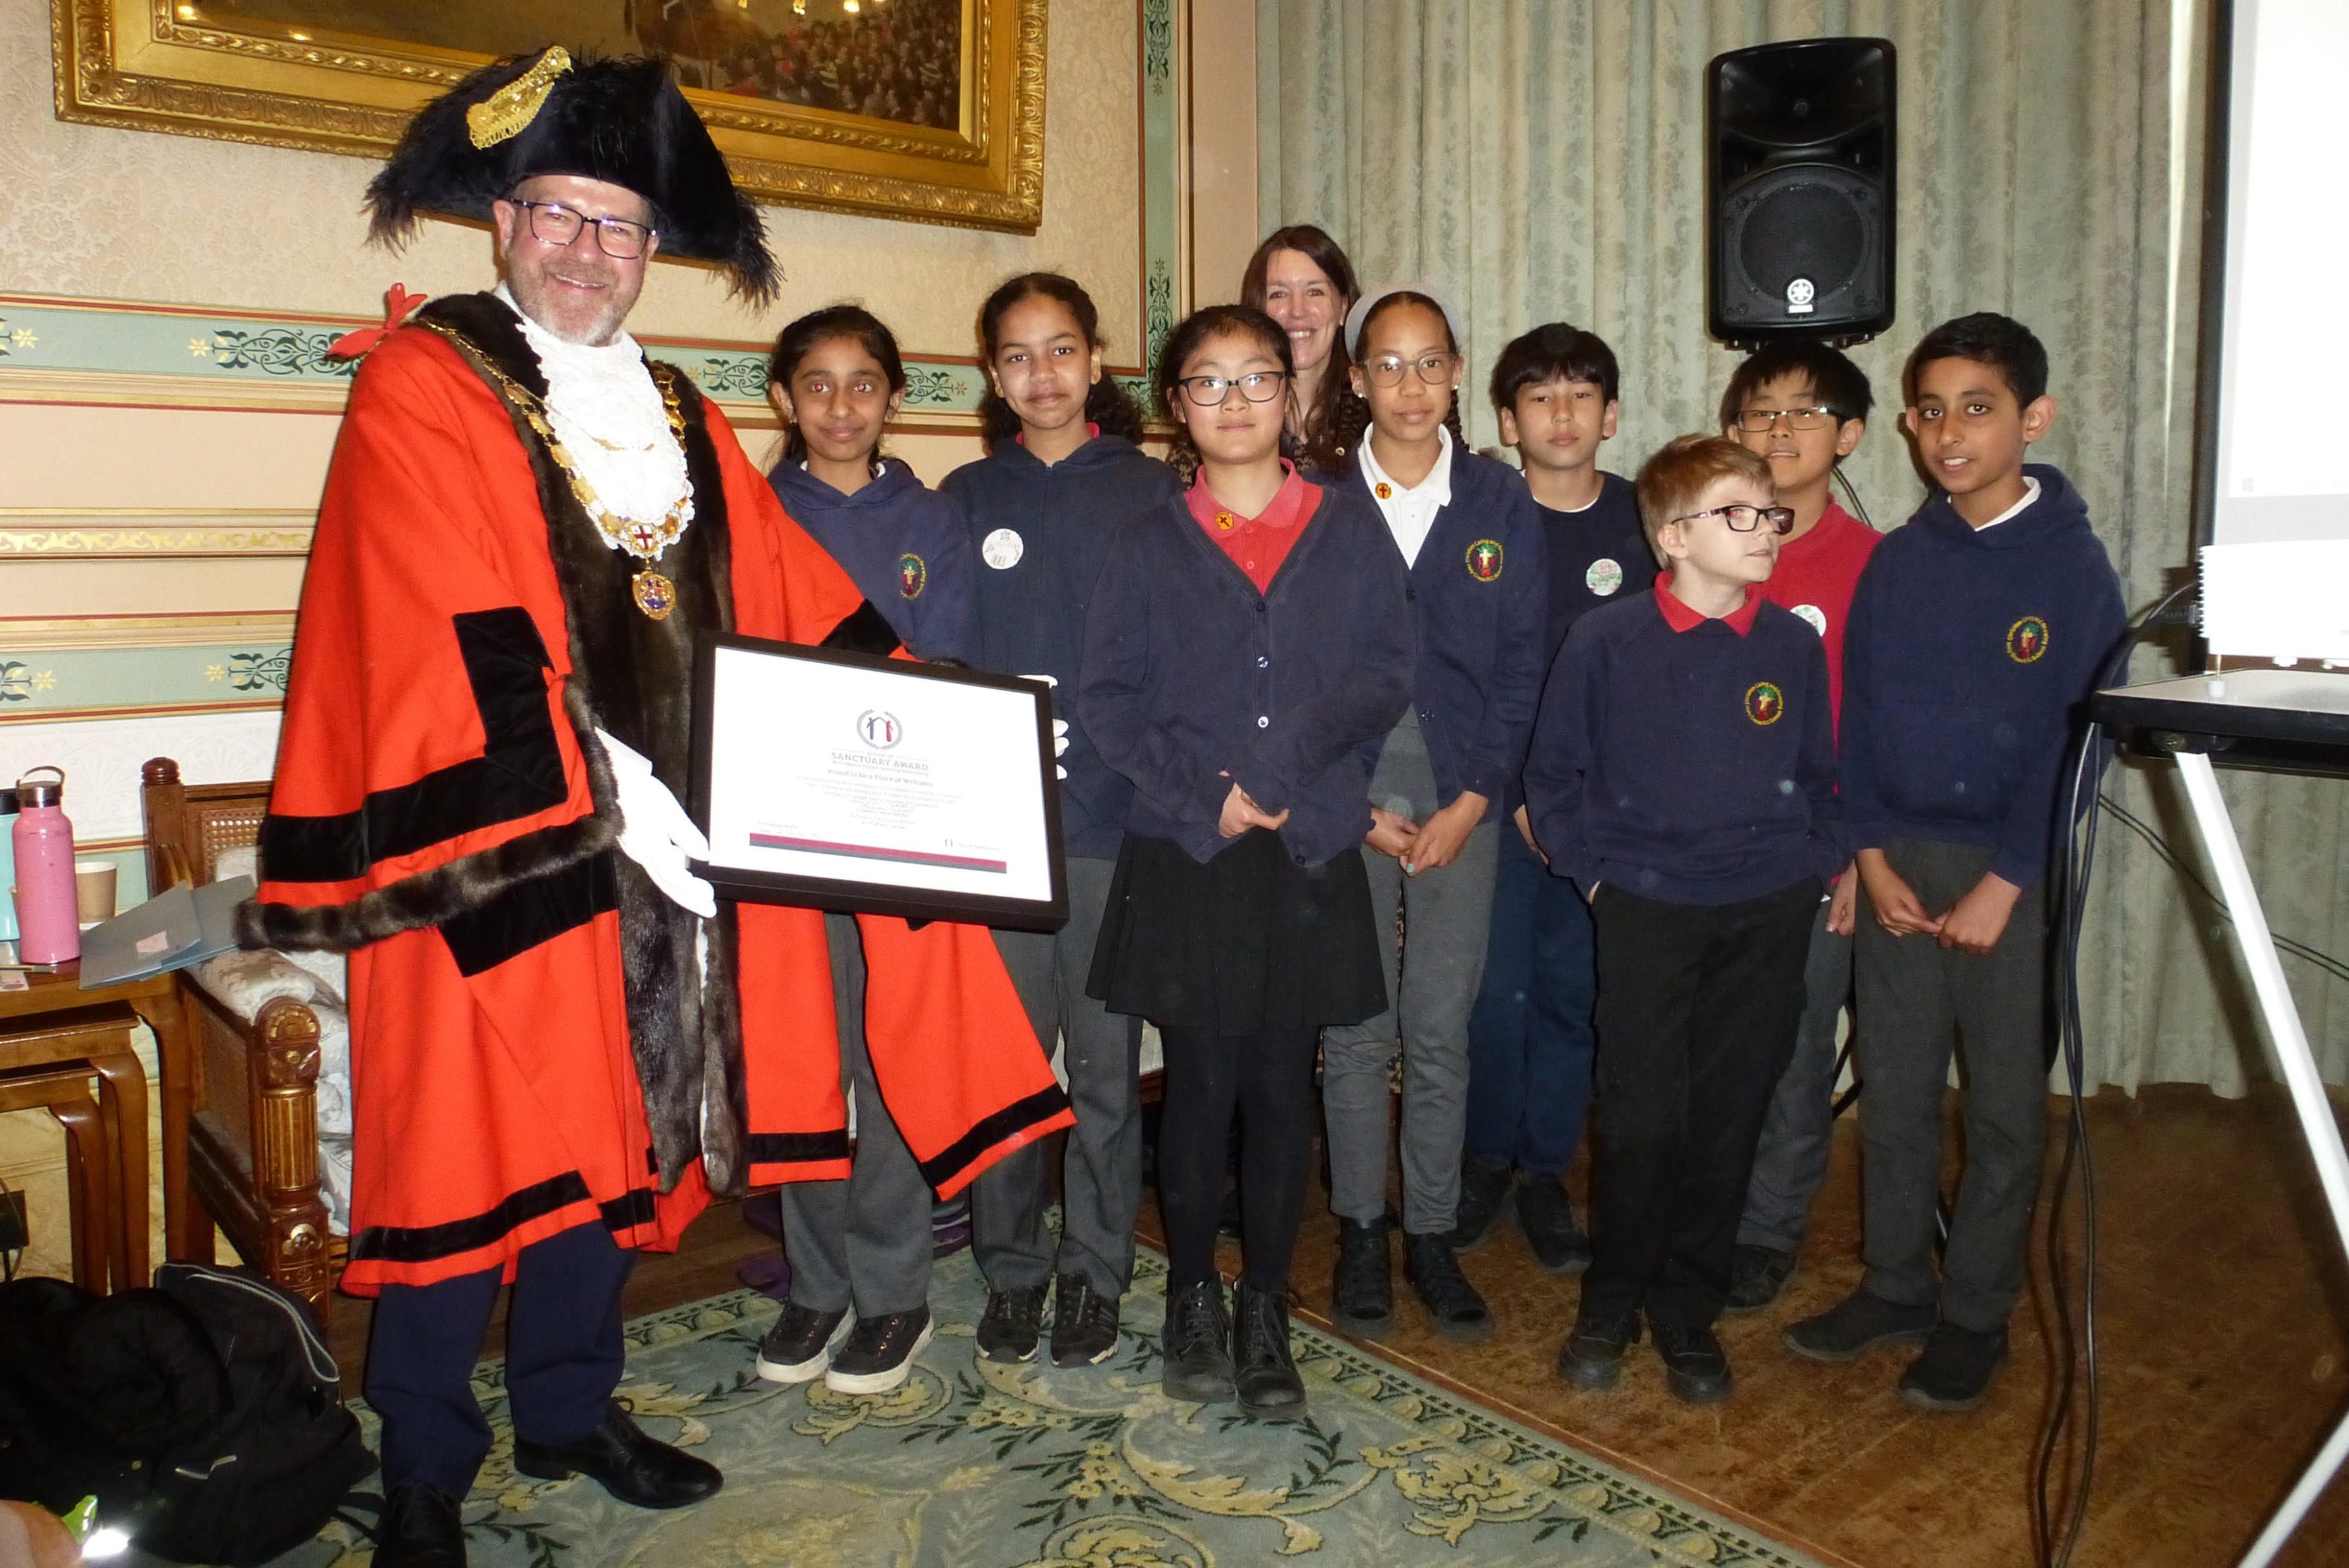
How to engage in the work
Supporting Refugee and Asylum Seeking Pupils in schools (SRAPS )- Network looking at best practice.
Attendance and Belonging Team support and resources.
Schools and Colleges of Sanctuary award, newsletter and bespoke training.
7 minute briefing: Issues, points to considers and actions to take.
Support from Attendance and Belonging Team, Sanctuary Services Team (including Asylum Support and Resettlement Scheme).

Slide 11
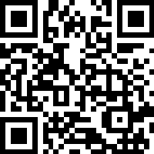

What are you doing specifically to support children who are seeking sanctuary?
Do you have good practice to share?
What do you need support with?
education@bristol.cityofsanctuary.com
Notes:
Spend 10 minutes on this exercise

Slide 12


Uniform Intelligence Hub - roll out The Uniform Intelligence Hub is a system that has been designed by Camera Forensics (a company commissioned by the Home Office). The UIH has been produced as a searchable database of all schools uniforms in the UK. This could assist police forces in identifying victims so safeguarding action can be taken. Further information to come around how this will be coordinated locally.
Children’s Welfare and Schools Bill has passed the House of Commons The ambitions of the Bill are set out in seven key parts: • Making a child-centred government; • Keeping families together and children safe ; • Supporting children with care experience to thrive; • Cracking down on excessive profit making ; • Driving high and rising standards for every child • Removing barriers to opportunity in schools ; • Creating a safer and higher quality education system for every child Read - Children's Wellbeing and Schools Bill 2024: policy summary - GOV.UK
Association of Directors of Children Social on safeguarding pressures report on Childrens Services (Research In Practice) The mixed methods research brings rich evidence on the current safeguarding pressures on Children’s Services. Multiple housing concerns, health challenges such as delayed access to assessment or treatment plans, and the lasting impact of COVID-19 is impacting children, young people and families. READ: Latest research shows changes in safeguarding pressures | Research in Practice
Bristol City Council formally recognise care experience as a protected characteristic. On the 14th January - the Full Council unanimously approved the recommendation in line with other LAs around the country

Slide 13


February 1 -28 – LGBTQ+ History Month: LGBT History Month is an annual observance that celebrates the rich history and achievements of the LGBTQ+ community. It provides a platform to highlight key figures, events, and milestones in the ongoing fight for LGBTQ+ rights and acceptance.
February 3 - 9 - Sexual Abuse & Sexual Violence Awareness Week : Sexual Abuse & Sexual Violence Awareness Week is a dedicated week-long campaign that focuses on addressing sexual abuse and sexual violence. It aims to challenge societal norms, stereotypes, and misconceptions surrounding these issues while providing a platform for survivors to share their stories and find support. Sexual violence awareness week
February 3 – 9 Children’s Mental Health Week: Everyone can take part in Children’s Mental Health Week! Download free resources for schools and families and find out how you can take part to raise vital funds and awareness for children’s mental health.
February 11– Safer Internet Day: The UK Safer Internet Centre promotes celebrations and learning based around the theme ‘too good to be true? Protecting yourself and others from scams online’. Education resources available
March 8 - International Women’s Day: Celebrate women’s achievements, raise awareness, take action to forge gender parity. This year’s theme is ‘Accelerate Action’. resources for schools
March 12 – Young Carers Action Day: Young Carers Action Day is an annual event organised by Carers Trust to raise awareness of the pressures placed on so many young people. This year’s theme is ‘Give Me A Break’, focusing on the importance of rest and respite for young carers. Young Carers Action Day Resources
March 17 – 23 - Neurodiversity Celebration Week : Regardless of labels, neurodiversity is about recognising those who think differently. And no matter whether you are a school, university or organisation you can benefit from different thinkers! Resources
DATES FOR THE DIARY
Notes:
Some dates for your diaries in the coming months. Do take a look at the resources linked to the dates highlighted.

Slide 14

Consultations
RE-STAR Regulating Emotions-Strengthening Adult Resilience - School staff priorities, enablers and barriers for school action on emotion regulation and mental health: a survey looking at what priorities, enablers and barriers school staff see as important when promoting the mental health of autistic and/or ADHD students and all staff in schools
Closes 17th Feb 2025
Bristol Sanctuary Strategy 2025-2030
We want to hear from people who work with sanctuary seekers (refugees, asylum seekers and people with insecure immigration status) and people with expertise by experience, to help us to develop the Bristol Sanctuary Strategy 2025 to 2030. The strategy will set out what is most important to sanctuary seekers in our city and explain the council’s goals over the next five years to support them.
Closes 16th March 2025
Keep informed
Sign up to the ASK Bristol ebulletin for a fortnightly email about new consultations and other opportunities to have your say.

Slide 15

Local Safeguarding Partnership Updates

Slide 16

Measles Guidance and Advice
There have been 21 new cases of measles in Bristol since 16 December 2024.
Measles can spread very easily among those who are unvaccinated.
Approximately 17% of 5-year-old children in Bristol have not had the MMR vaccination. There are also a significant number of children aged 5-18 who have missed their MMR vaccination.
Find out more about the MMR vaccination visit NHS MMR vaccine
We are asking all settings to send the parents/carers letter out which can be found on our webpage and is also being circulated through the Headteachers Bulletin.
Leaflets and posters in a several different languages can be downloaded here: Measles outbreak resources - GOV.UK
Notes:
Absence code handling
For confirmed cases, schools should continue to use usual register codes for absence due to illness. I (illness) code would apply if the pupil is unwell with measles.
If a child needs to isolate following public health advice, the new Y6 code would apply if the pupil is well, but is prohibited from attending school, as they are required to isolate in line with public health requirements relating to the incidence or transmission of infection or disease (in this case measles).

Slide 17

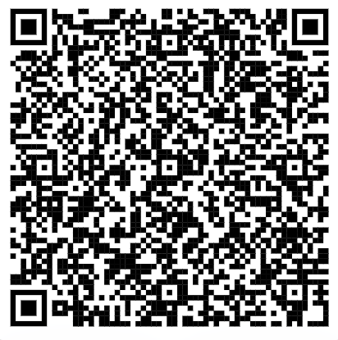
Other originations involved were:
Aspiration Creation Elevation (ACE)
Babbasa
BRICKS
Bristol Robins Foundation
Children’s Scrapstore
Creative Youth Network (CYN) (City Wide)
Docklands Youth and Community Centre.
Hartcliffe Girls Group
Hartcliffe Club for Young People
Knowle West Media Centre
Listening Partnership (WECIL)
Learning Partnership West (LPW)
Oasis Hub (City Wide)
Southmead Development Trust
Street Space
The Vench
Wellspring Settlement
Young Bristol (City Wide)
Young Carers Voice (City Wide)
Youth Moves.
Bristol Youth Voice Conference.
The Bristol City Youth Council have worked with other youth organisations across the city to talk about what they want adults around them to focus on for the next year.
Priorities for the next year
North Area: Safety
South Area: Knife Crime
East Central Area: Youth Services
Over the next year, during the upcoming area youth forums we will focus on discussing these topics with attending young people in each area.
Notes:
The priorities are what the children are saying.
North Area: Safety
South Area: Knife Crime
East Central Area: Youth Services
Over the next year, during the upcoming area youth forums we will focus on discussing these topics with attending young people in each area

Slide 18


Shadow Board - Having conversations with your child about knife crime
Notes:
This has been sent out through Operation Bond. It may be useful to put on your website and remind parents about it before the holiday period.
We are looking for more young people with lived experiences to join the shadow board.
Please print these posters off – they will be available on our website.

Slide 19
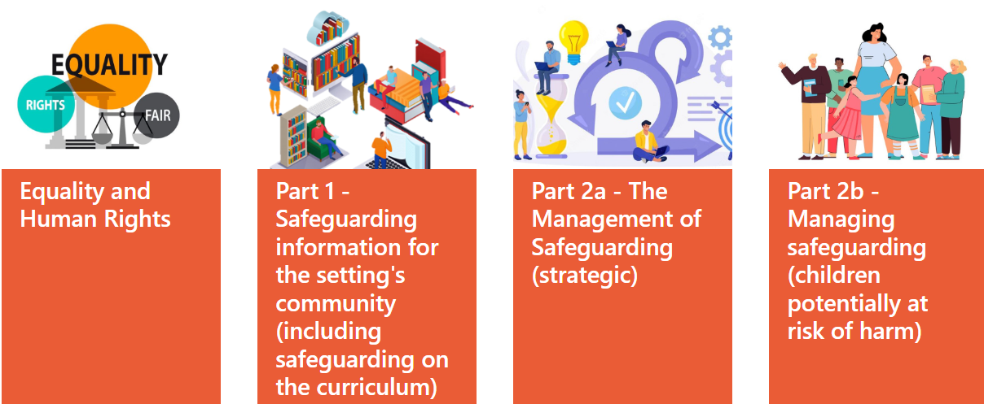
Section 175 Audit

Slide 20
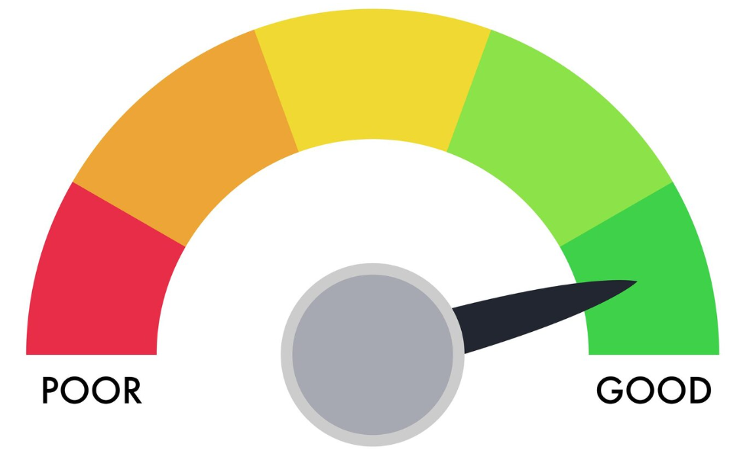
S.175 Audit
The period of audit is from 2024-2026.
The tool is hosted on SharePoint as an Excel Spreadsheet.
Please email the team if you are having trouble accessing this.
We have created a video resource to help you
Notes:
How would you like the next audit support session?

Slide 21
Equality and Human Rights - Anti-oppressive and Anti-discriminatory practice
In groups consider what practice in your setting you can use to answer the question, use the descriptors to help you RAG rate the response.
0.1 ‘The setting is compliant with the Public Sector Equality Duty and the Equality Act 2010.’
Red: Knowledge of the public sector equality duty is not known about by leadership or governance.
Amber: Knowledge of the public sector equality duty is limited to the governing body and some members of the senior leadership team. The public sector equality duty is tokenistically reflected in the setting’s values and ethos.
Green: The public sector equality duty is well embedded in practice and known about by all members of staff. All staff can connect and identify this duty in relation to their day-to-day work.
Notes:
Share good practice on your tables.
How would you like us to help you in the next session?

Slide 22

Break time

Slide 23
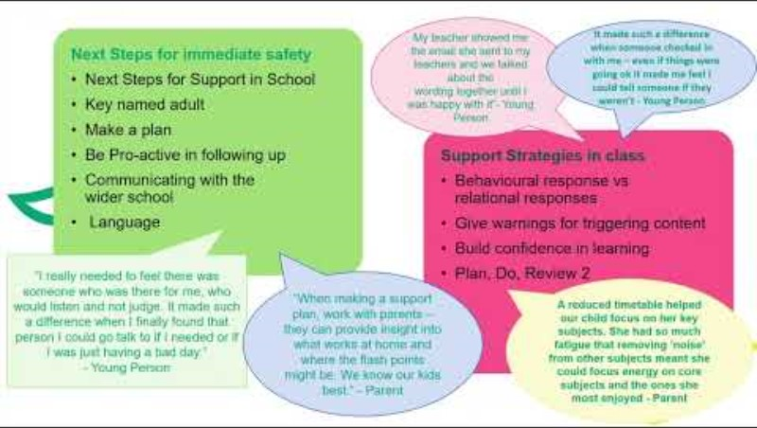

The Green House
Notes:
Support for children who have been sexually harmed.

Slide 24


Be Safe
Notes:
Support for children who exhibit sexually harmful behaviours the service is aimed at management and support.

Slide 25
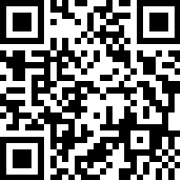
Green House Centre and Be Safe guidance feedback
Thinking about young people you work with that have shown harmful sexual behaviour, experienced sexual abuse, or you think may have experienced it:
How would these materials have been helpful?
What are two things you could have done differently?
How are you going to share this with your wider school team?
Is there anything you think would be helpful to add?
Notes:
https://www.smartsurvey.co.uk/s/0SKRUW/
Have a 10 minutes conversation about how you are going to use the guidance.
We have lots of complaints from Ofsted about child-on-child harm and I am sure that you are aware of many more incidents that happen within your settings.

Slide 26

Multi-Agency Updates

Slide 27
Avon and Somerset police
  Youth Walk and Talk
  Aimed to facilitate communication between female students aged between 11 to 17 and local police officers.
  To address and mitigate any safety concerns within the community.
  To empower female students by providing a safe platform for expressing their concerns.
  The “Consequence of Joint Enterprise”
  A&S police are developing an educational package on the “Consequence of Joint Enterprise”
  We are inviting DSL leads to be part of this program.
  To find out more please contact stephanie.mckenna@avonandsomerset.police.uk
Notes:
Police to deliver

Slide 28
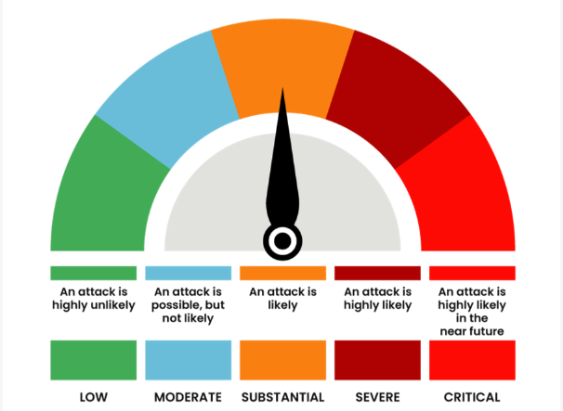
Prevent updates – information for your risk assessment
National and regional updates
December 2024
The threat of a terrorist attack in the UK is currently assessed as SUBSTANTIAL, meaning an attack is likely.
The predominant ideologies seen in the SW in both Single-Issue referrals and police investigations are Extreme Right-Wing Terrorism (ERWT) and Islamist Terrorism (IT) and to a lesser extent Left Wing and Single Issue Terrorism (LASIT).
Bristol specific
Within the last year, all cases that have met the criteria for a Channel Panel were related to Extreme Right-Wing concerns.
-----------------------
Terrorist and extremist groups use signs and symbols to attract attention, propagate their ideologies and intimidate targeted communities. They also use signs and symbols to promote membership and solidarity similar to gang symbols.
      You can check signs and symbols here:
Notes:
Bristol specific:
Despite Extreme Right Wing being the most common ideology to make it to Channel, we still need to be vigilant to all forms of extremism.
The case of Axel Rudakobana raised some questions about the fact that he had been referred to Prevent 3 times and this had not been picked up. The reviews into the referrals have confirmed that this was in line with referral criteria at the time (he was last referred in 3 years ago).
Additional questions have arisen about where these types of cases should sit if there are concerns that don’t meet the very specific criteria for Prevent/ channel. This has been raised as a query within the KBSP.

Slide 29


Prevent Workshops:
Tuesday 1st July 2025 9.45am
All sessions will be held in person ………………………………………………………………………………………………………………………………
Prevent Awareness Training for New Staff (Virtual):
Friday 9 May 2025 - 8.45 - 11.00
………………………………………………………………………………………………………………………………
Autism and Prevent Training- National Autistic Society
Wednesday 26 February 2025 (12pm - 4.30 pm)
All sessions will be held in person at City Hall, College Green, Bristol BS1 5TR.
………………………………………………………………………………………………………………………………
Book free whole staff Prevent training through the safeguarding in education team.
Notes:
Prevent- south updates
Prevent updates- general

Slide 30
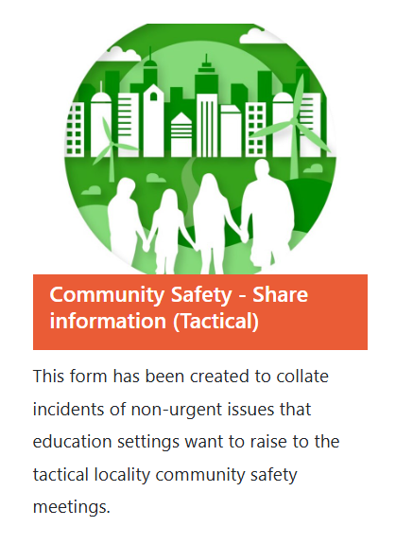
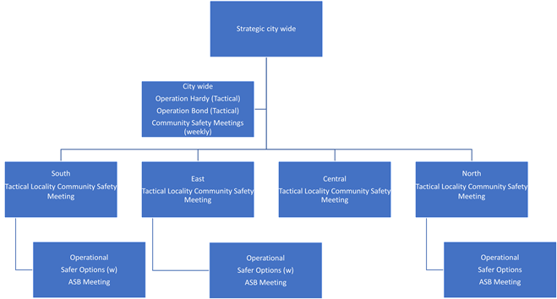
Don’t forget to share information and intelligence with the partnership.
Notes:
Reminder that communication with us is key. If you suspect a crime has taken place, then please report it to the police.
Operation Bond – for child- on- child harm – look at the community safety page on our website.

Slide 31
First Response
Bristol’s front door to children’s and Young people’s services
(CYPS)
First Response
0117 903 6444
Make a referral (bristol.gov.uk)

Slide 32

Transformation
Things are in process of changing at FAS with an Extra Familial team joining us in April 2025
Extra familial harm Service
Children exploited in the community
CCE
CSE
Group/gangs
Drugs and Young People Project

Slide 33
Area Social Work Teams Update

Slide 34
Workload
The workload pressures on Social Workers reflect-
The challenging social situations our children and families live under, due to increased levels of inequality and poverty.
Reduced funding and availability of universal services that support children and families at an earlier stage.
National challenges in relation to Social Work recruitment and retention, particularly within Child Protection.

Slide 35
Families First
In response to the pressures which our Social Work teams are working under Children’s Services are currently undergoing a transformation programme called Families First.
We are currently in phase 4 of this transformation. This focus is on our area Social Work services and Early Help offer.
The aims of phase 4 of the transformation is to increase the capacity of our Social Work units and the level of specialist support which they can access particularly in relation to extra familial harm, reducing entries into care and permanency.
Phase 4 is now underway; consultations have been completed and it is hoped that all appointments for new roles will be in place by April. The new areas of the service will be developed over the months following this and further information will be shared as these changes are implemented.
Notes:
This focus is on our area Social Work services and Early Help offer – FiF and social work are combining
People are being recruited into posts and we will be in a better position by the next DSL networks.

