Slide 1
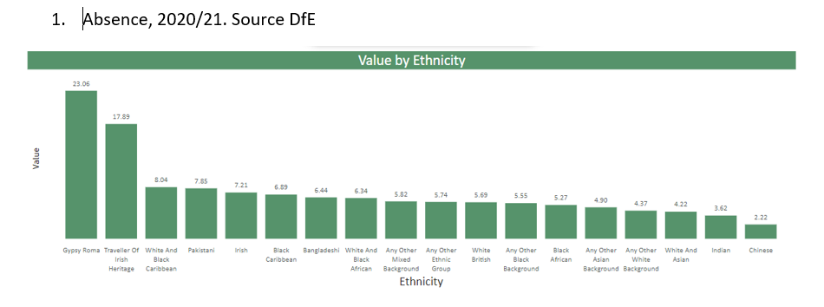
Absence
Nat: 4.6%
Highest absence (above 6%):
Gypsy Roma, Traveller Irish Heritage, White and Black Caribbean, Pakistani, Irish, Black Caribbean, White and Black African

Slide 2
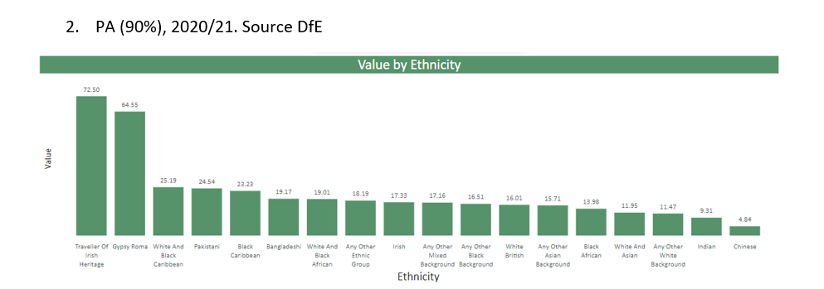
Persistent Absence
Nat: 12.1%
Highest persistent absence (above 19%)
Travel Irish Heritage, Gypsy Roma. White and Black Caribbean, Pakistani, Black Caribbean, Bangladeshi, White and Black African

Slide 3
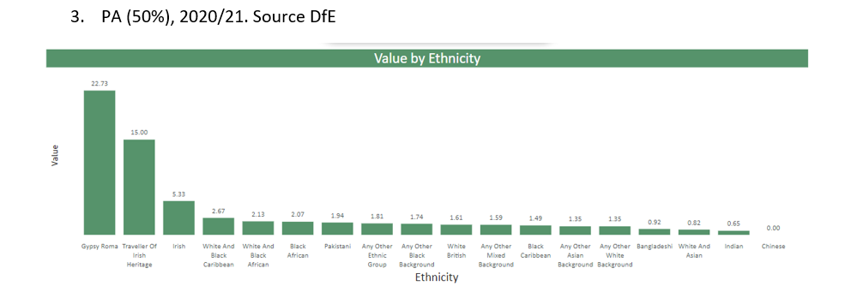
Persistent Absence (50%)
Nat: 1.1%
Highest persistent absence (above 2%)
Gypsy Roma, Traveller Irish Heritage, White and Black Caribbean, White and Black African, Black African

Slide 4
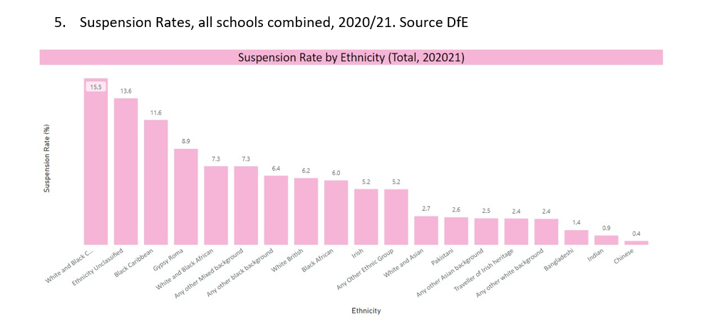
Suspensions 2020/21
Nat: 4.5%
Highest suspensions as a proportion of the cohort 2021:
White and Black Caribbean, refused, Black Caribbean, Gypsy Roma, Traveller Irish Heritage, White and Black African, Other mixed background

Slide 5
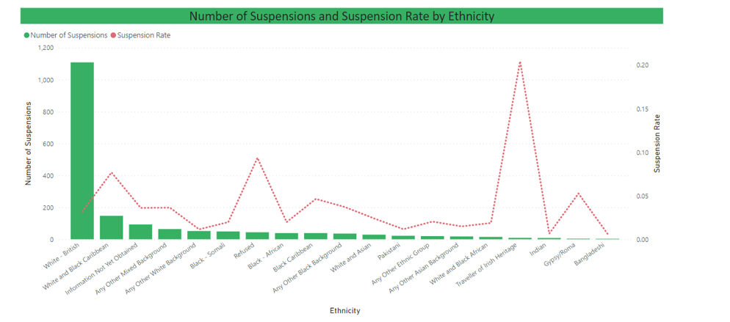
Suspensions – year to date
Highest suspensions as a proportion of the cohort:
White and Black Caribbean, refused, Black Caribbean, Traveller Irish Heritage, Gypsy Roma

Slide 6
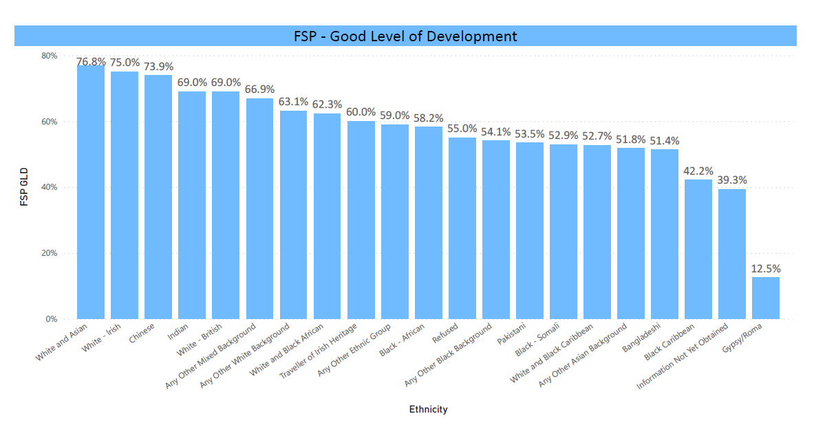
Good Level of Development
Lowest outcomes:
Pakistani, Black-Somali, White and Black Caribbean, Other, Bangladeshi, Black Caribbean, no information, Gypsy/Roma

Slide 7
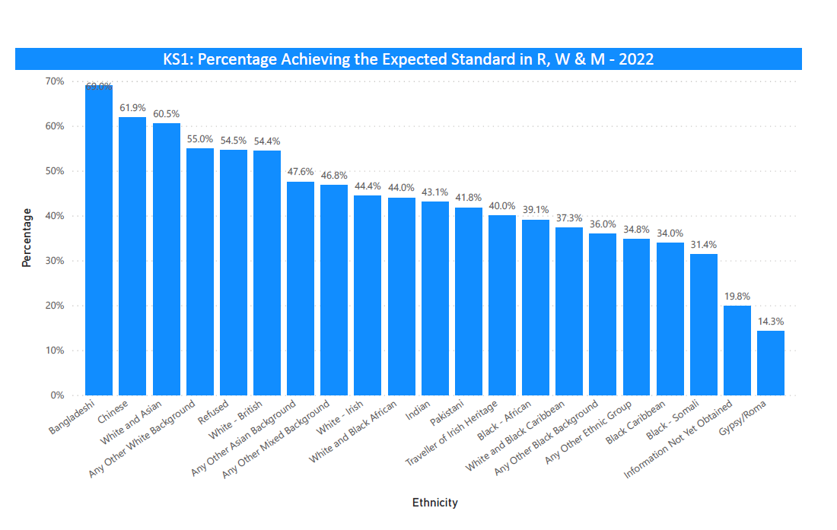
Expected Standard KS1
Bristol 50.8%
Lowest outcomes (below 40%):
Black African, White and Black Caribbean, Other Black background, Other ethnic group, Black Caribbean, Black Somali, No info, Gypsy Roma

Slide 8
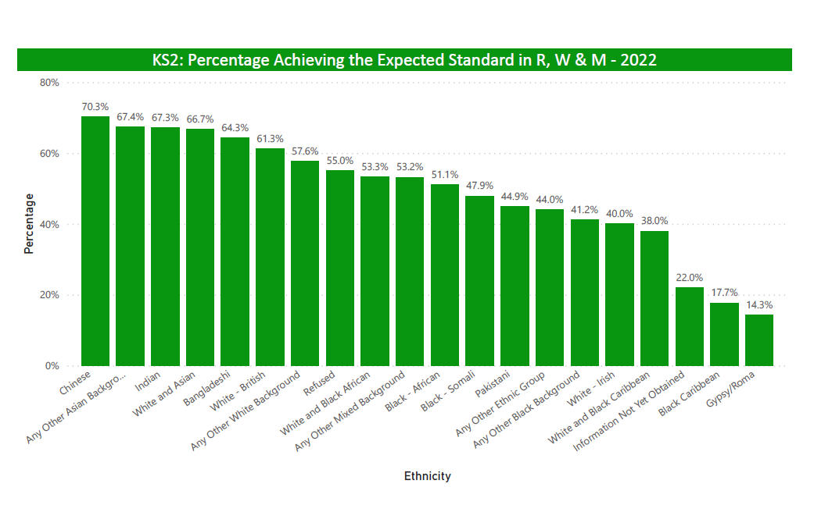
Expected Standard KS2
Bristol 57.1%
Lowest outcomes (below 40%):
White and Black Caribbean, no information, Black Caribbean, Gypsy Roma

Slide 9
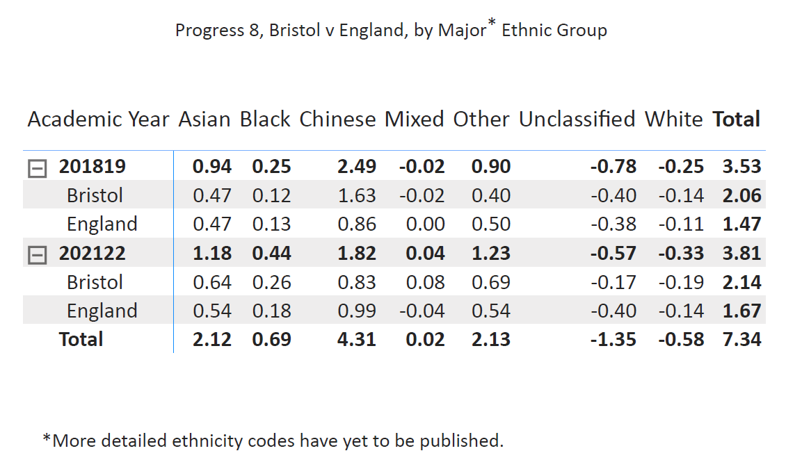
Progress 8 2020/21
More detailed ethnicity breakdown is not available at this time.
Progress for most ethnic groups is positive at KS4

Slide 10
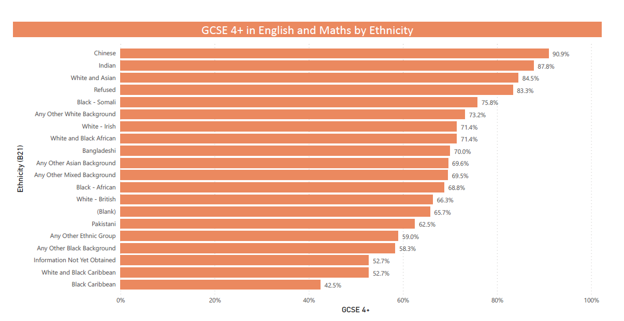
English and Maths Grade 4+
Bristol 66.6%
Pakistani, other, no information, White and Black Caribbean, Black Caribbean

Slide 11
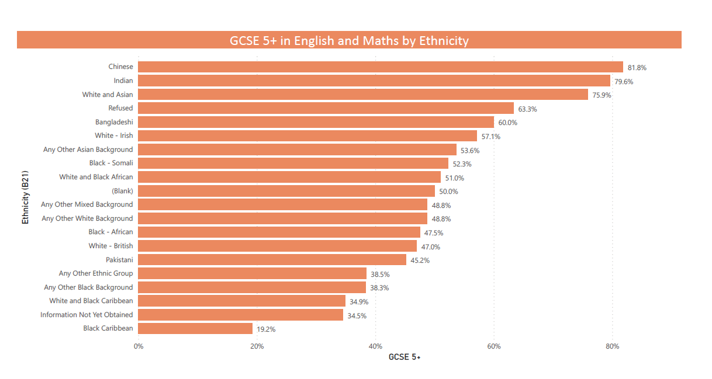
English and Maths Grade 5+
Bristol 49.8%
Black African, White British, Pakistani, other, White and Black Caribbean, no information, Black Caribbean

