Slide 1
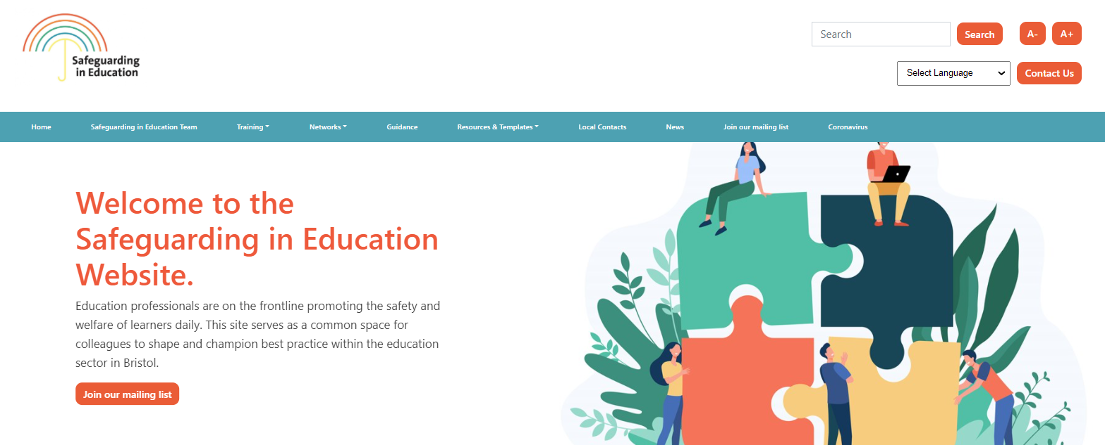
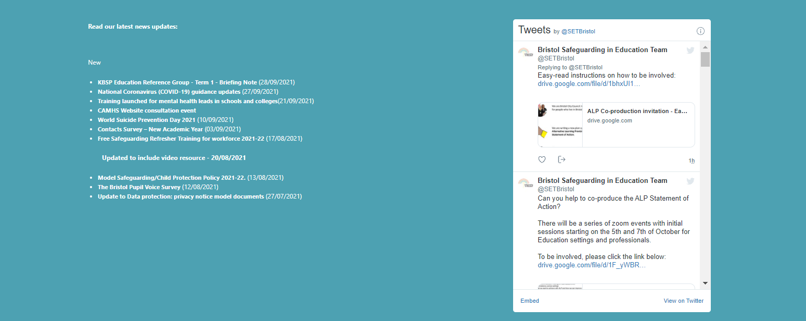

Welcome to the DSL Network Meeting
If you haven't already done so, bookmark our website https://www.bristolsafeguardingineducation.org/
The session will start promptly at: 15:00 where we will be joined by the Centre for Studies on Inclusive Education (CSIE) to offer a CPD session on developing your practice on the explicit duties around Equalities Act and Human Rights Act.
Slides will be scrolling whilst we wait for the session to beginning.
These slides will be available on the news section on our website after the event
Follow us @SETBristol

Slide 2

These slides will be available on the news section on our website after the event
Designated Safeguarding Lead Network
Term 5 - 2022-23
Notes:
Welcome to the first DSL network meeting of 2023.
If you have any questions whilst the meeting in running please do put them in the chat and we will answer them throughout the meeting or at the end. Please be mindful of confidentiality if you do have any specific concerns.
The slides will be uploaded to the safeguarding in education team website

Slide 3





These slides will be available on the news section on our website after the event
Meeting digital and technology standards in schools and colleges - Filtering and monitoring standards for schools and colleges - Guidance - GOV.UK (www.gov.uk) The Department for Education (DfE) has created filtering and monitoring standards for schools and colleges in England to help protect children online.
Strip search of children in England and Wales The Children’s Commissioner for England has published an analysis of strip searches of children conducted by police under their stop and search powers across England and Wales.
Child sex offender disclosure scheme guidance – Updated in April 2023 - Guidance and tools for the implementation of the child sex offender disclosure scheme, also known as Sarah’s Law.
Emergency planning and response for education, childcare, and children’s social care settings – How educational and childcare settings should plan for and deal with emergencies, including significant public health incidents and severe weather.

Slide 4
These slides will be available on the news section on our website after the event
May 2023
May 2 - May 8 - Deaf Awareness Week 2023 The aim of this year’s Deaf Awareness Week is to promote greater awareness and understanding of the challenges faced by the deaf community in accessing communication.
May 15 - National Children's Day UK 2023 is all about the importance of a healthy childhood, and how we need to protect the rights and freedoms of children and young people.
May 15 - May 21 - Mental Health Awareness Week 2023 the official theme for 2023's Mental Health Awareness Week is anxiety.
May 16 - May 20 - Walk To School Week 2023 the mission is to achieve a better walking environment and inspire people to walk more.
June 6 - June 12 - Child Safety Week 2023 Child Safety Week is an annual community education campaign run by the Child Accident Prevention Trust (CAPT), acting as a catalyst for thousands of safety conversations and activities UK-wide.
June 10 - Brake's Kids Walk 2023 Brake’s Kids Walk involves thousands of primary schoolchildren walking at the same time to promote the health and planet-saving benefits of walking and shout out for their right to make safe and healthy journeys.
June 13 - June 17 - BNF Healthy Eating Week 2023 Healthy Eating Week is all about supporting and promoting healthier lifestyles and this years’ theme is Healthy Eating Week - For Everyone!
June 18 - June 25 - Drowning Prevention Week 2023 The campaign is designed to explore a multitude of opportunities to proactively raise awareness of water safety ahead of a summer outdoors.
June
2023
DATES FOR THE DIARY
Notes:
Some dates for your diaries in the coming months. Do take a look at the resources linked to the dates highlighted.

Slide 5

Safeguarding in Education Team updates
These slides will be available on the news section on our website after the event
Welcome back to Helen Macdonald – returning to her role as the South Safeguarding Advisor
Farewell and good luck to Sarah Wooding – who has gone on maternity leave.
Elisabeth Clark will be moving across to the North Area - to cover for Sarah’s maternity leave.
ACTION - Please do ensure contacts are up to date in line with Working Together to Safeguard Children:
Annual full survey. – if you haven’t completed or had substantive changes.
Midyear contacts changes- if you have only had one or two changed.
Early Years Contacts Update. / out-of-school setting
Notes:
Read out the slide

Slide 6


Tackling Domestic Abuse Video – Speaking out
These slides will be available on the news section on our website after the event
The Bristol Domestic Abuse Victim and Survivor forum group have recently created a video about domestic abuse which can be shared for employee training:

Slide 7

KBSP Education Reference Group
These slides will be available on the news section on our website after the event
We are looking for colleagues to support systemic change around the following areas:
City Wide Safeguarding Data task and finish
Operation Encompass - Police Safeguarding Notifications
Online Safety Working Group
Click on hyperlinks to find out more info

Slide 8

Understanding disposable e-cigarette use amongst young people in the Southwest of England
These slides will be available on the news section on our website after the event
We are seeking your support to look for children and young people and members of staff to consider the use of nicotine and e-cigarettes in and around Bristol.
https://www.bristolsafeguardingineducation.org/news/school-vaping-and-other-nicotine-research-bristol/

