Slide 1

KBSP Education
Year 11/Post 16 Safeguarding
This session will start @ 9.00am.
Please can you just put your name/setting into the chat so we have a record of your engagement.

Slide 2
Agenda
Introduction
Context/Feedback
- Transitions – Age and status
- Learning from statutory reviews/ belonging strategy
- Information sharing
What next?

Slide 3

Introductions
KBSP Education Reference Group
Statutory agency reps– Education and Skills and Children and Families Teams, Youth Offending. Police,
Post 16 settings - colleges, AP providers, Sixth Form
Secondary settings – academies, AP providers

Slide 4

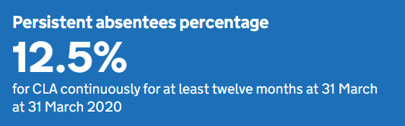

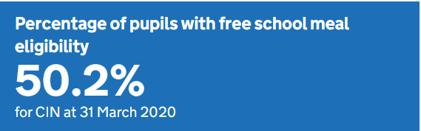
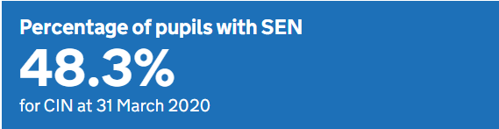
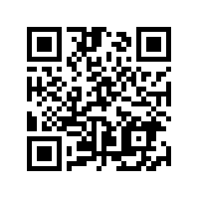
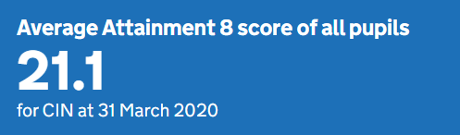
Context - Age/Status and Transitions
Adolescents/Children/young people
Child protection vs. Making Safeguarding Personal
CLA/SEN – 0-25
Children who have, has had or are in need of a social worker
10 mins in break out rooms
In your experience where do you think the areas of vulnerability are for….
Professionals?
Systems/Organisations?
Children/Young people/ Adolescents?
Notes:
https://www.smartsurvey.co.uk/s/R7CM8J/

Slide 5

Context
7 x Rapid reviews – involving school aged children and young people. (6 criminal exploitation/serious youth violence, 1 honour based abuse/forced marriage)
1 non-statutory review (harmful sexualised behaviour)
Practice concerns raised across the city around increased incidents of serious youth violence, exploitation, mental health and peer on peer harm.
Learning Event for Bristol Practitioners - Monday 13th December 2021 13:30 – 14:30
Join Zoom Meeting
https://zoom.us/j/97660929052?pwd=UDBOQ0JwVWxQd2NXWFNIeFJvdXJBUT09
Meeting ID: 976 6092 9052
Passcode: 491006

Slide 6

Develop competency around managing issues relating to BAME/ SEN/Post 16/ contextual risk/ wider family and putative relationships
EHCPs do not contain contextual or safeguarding information- how do we effectively share information about risk and historical harm?
Risk assessments are varied in quality and effectiveness leading to risk averse decisions
Emergency SEN reviews did not take place following a significant incident. SEN and Safeguarding were seen as separate processes.
Need for LA teams (social care, SEN) to develop safeguarding knowledge around attendance, education entitlement and safeguarding systems in education (E.g, record keeping and police safeguarding notifications)
Notes:
7 rapid reviews – 6 were re: CCE/Serious Youth Violence - disproportionately black males with SEND needs
Honour based Violence – assumed no action could be taken as abroad – always make referrals as usual despite whether in the UK or not
Draw back to quality duty – moral duty to refresh how looking at equality objective. Not always considering what “family” is in terms of significant relationships – need to be valued alongside PR – the lived experience of the family.
SENCOS – throw down the gauntlet – Educational Health and Care Plan for a reason – Health and Care need to be part of that – Children and Families Act 2014 – social care act, not education – how are we supporting colleagues in social care and health to contribute towards that intervention.
Risk assessments – term potentially negative - safety plan. “can’t meet needs” – children pushed from pillar to post – what makes you think another setting can? Schools alone cannot solve society’s issues, need multiagency assessments.
Encourage the use of emergency SEN review, particularly at point of risk of exclusion.
LA colleagues don’t necessarily know about SEN processes and attendance issues – but this does have an impact. Strengthen that training for colleagues in social care. FIF are working very closely with schools to understand all systems.
Case in point – will come to later – Police tend to issue advice, but not based on education legislation – eg encourage to move a child seen as a risk to another setting – there is education legislation and human rights you might need to push back on other agencies.
If resonates, looking for colleagues across phases and areas of education sector – please contact Helen – contribution towards systems change.

Slide 7



Inclusion and belonging

Slide 8
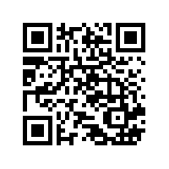
Long-term outcomes and measuring progress 2021 - 2030
An improvement in our attendance rates
Fewer suspensions
Continued low rates of permanent exclusions
More diversity in our education workforce
More children/young people from underrepresented groups engaging in active citizenship
Better attainment for all our children/ young people and a rapid improvement in the attainment of those with SEND and those entitled to Free School Meals
In break out rooms, for 15 mins discuss;
How can you ensure the belonging strategy is known about in your setting/team?
What can you do in your role to ensure that this isn’t just a ‘tick box exercise’?
Do you have any good practice to share? Let us know who you are.
Notes:
https://www.smartsurvey.co.uk/s/URWMHZ/

Slide 9

Information sharing
Changes and development of local and national policy and practice around information sharing.
National policy didn’t come into effect until September 2021.
Local guidance was created and cascaded in preparation of changes and reflection of vulnerability in the cohort given the pandemic and lockdown.
You can’t share what you don’t know. Are there vulnerabilities around sharing information between statutory agencies to schools?

Slide 10

Statutory Guidance
105. Information sharing is vital in identifying and tackling all forms of abuse and neglect, and in promoting children’s welfare, including their educational outcomes. Schools and colleges have clear powers to share, hold and use information for these purposes.
106. As part of meeting a child’s needs, it is important for governing bodies and proprietors to recognise the importance of information sharing between practitioners and local agencies. This should include ensuring arrangements are in place that set out clearly the processes and principles for sharing information within the school or college and with children’s social care, the safeguarding partners, other organisations, agencies, and practitioners as required.
Notes:
KCSIE changes in threshold and timeliness
Details of information sharing protocols –
Feedback from workforce
Information from LA teams

Slide 11
112. Where children leave the school or college, the designated safeguarding lead should ensure their child protection file is transferred to the new school or college as soon as possible, to allow the new school or college to continue supporting children who have had a social worker and been victims of abuse and have that support in place for when the child arrives, also ensuring secure transit, and confirmation of receipt should be obtained. For schools, this should be transferred separately from the main pupil file. Receiving schools and colleges should ensure key staff such as designated safeguarding leads and special educational needs co-ordinators (SENCOs) or the named persons with oversight for SEN in a college, are aware as required.
113. In addition to the child protection file, the designated safeguarding lead should also consider if it would be appropriate to share any information with the new school or college in advance of a child leaving. For example, information that would allow the new school or college to continue supporting children who have had a social worker and been victims of abuse, or those who are currently receiving support through the ‘Channel’ programme and have that support in place for when the child arrives. More information on the child protection file is in Annex C.

Slide 12
Annex C – Role of the Designated Safeguarding Lead –
Information sharing and managing the child protection file
Where children leave the school or college (including in year transfers) the designated safeguarding lead should ensure their child protection file is transferred to the new school or college as soon as possible, and within 5 days for an in-year transfer or within the first 5 days of the start of a new term. This should be transferred separately from the main pupil file, ensuring secure transit, and confirmation of receipt should be obtained. Receiving schools and colleges should ensure key staff such as designated safeguarding leads and SENCOs or the named person with oversight for SEN in colleges, are aware as required
Lack of information about their circumstances can impact on the child’s safety, welfare and educational outcomes. In addition to the child protection file, the designated safeguarding lead should also consider if it would be appropriate to share any additional information with the new school or college in advance of a child leaving to help them put in place the right support to safeguard this child and to help the child thrive in the school or college. For example, information that would allow the new school or college to continue supporting children who have had a social worker and been victims of abuse and have that support in place for when the child arrives.

Slide 13
Sharing information in advance of enrolment
Term 5 | Secondary settings review their cohort who will be moving on to further education. Children with active involvement and high levels of concern are highlighted (RAG rated)
 | Highlight any students who have safeguarding information that is relevant to share in advance. This is at the discretion of the Designated Safeguarding Lead but consideration should be given to proportionate sharing of relevant information that will allow post 16 settings to put advance and/or continued support in place.
 | Secondary settings identify the main intended destination for students with relevant safeguarding information and contact this provider to arrange a meeting.
Before the end of June | Meetings have taken place between secondary and post 16 settings to share relevant and proportionate information that will promote the safety and welfare of children undertaking this transition.
 | The information shared is recorded and stored securely by the post 16 provider and added to the child protection/safeguarding file once the child enrols.
New academic year | If the child does not enrol in the new academic year the information is deleted and the post 16 provider informs the secondary setting

Slide 14
Transfer of the child protection/safeguarding file
July | Secondary settings – Designated Safeguarding Lead coordinates the downloading and secure storage of child protection/safeguarding information as an encrypted PDF ready for transfer in new academic year. Paper files are cross referenced to ensure all information is included
Start of new academic year | For Red RAG rated students with child protection and safeguarding information, secondary settings contact the p16 provider when enrolment has taken place and arrange file transfer within 5 days
New academic year – by end of week 2 in September | Post 16 settings run a report using the MiS to establish the details of enrolled learners and their previous settings. Master spreadsheet produced and filtered by setting to produce individual spreadsheets of enrolled learners for secondary settings.
By end of week 3 in September | Post 16 settings have sent encrypted spreadsheets of all enrolled learners to secondary Designated Safeguarding Leads.
On receipt of spreadsheet | Secondary DSLs coordinate the cross referencing of post 16 spreadsheets with their year 11 cohort lists and initiate any remaining information transfer.
If the file is not received after 5 days | Designated Safeguarding Lead at post 16 setting contacts the Designated Safeguarding Lead at secondary setting to prompt immediate transfer.
If the file remains outstanding | Local authority Safeguarding In Education team are notified for support.
Notes:
It is acknowledged that the enrolment process in the new academic year is complex. The framework below addresses issues of notification to secondaries of who has enrolled and the compatibility of digital safeguarding systems.

Slide 15
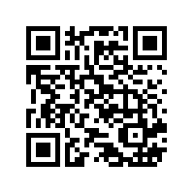
Evaluate
15 mins - in groups
What went well,
What didn’t go well
What could be done differently?
Any other points?
Notes:
https://www.smartsurvey.co.uk/s/R81CQH/

Slide 16
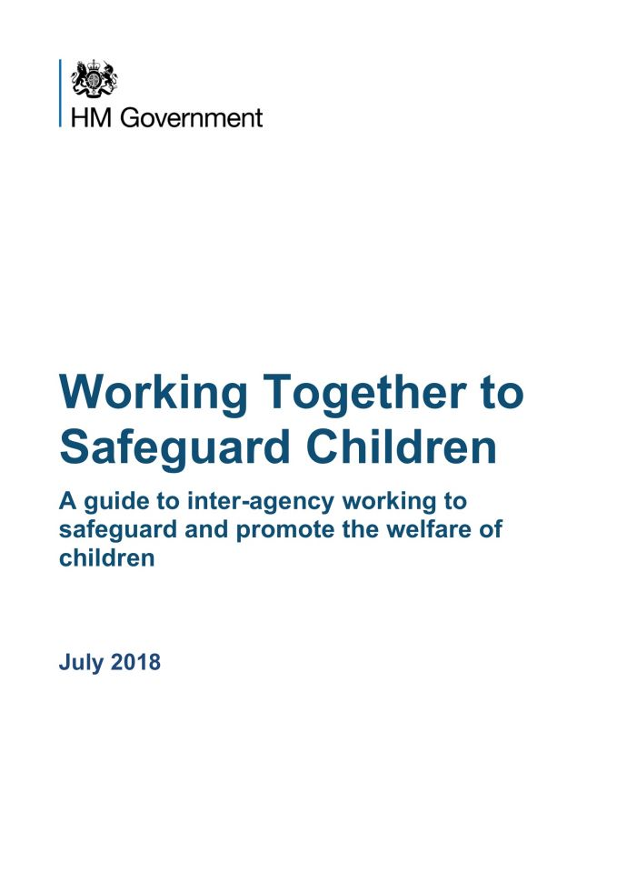

Risk aversion or management
Child/Young person’s needs vs. system’s needs? Why not both?
19. Early intervention to address underlying causes of disruptive behaviour should include an assessment of whether appropriate provision is in place to support any SEN or disability that a pupil may have. The head teacher should also consider the use of a multi-agency assessment for a pupil who demonstrates persistent disruptive behaviour.
Such assessments may pick up unidentified SEN but the scope of the assessment could go further, for example, by seeking to identify mental health or family problems.
Do you work together with other agencies around their contribution to managing risk?

Slide 17

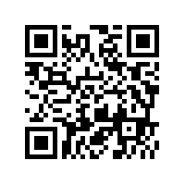
What next?
Systems change:
What would you think could be done to ensure collective ownership?
What are your priorities?
Are there gaps in awareness/ knowledge? What CPD/Training does the workforce require?
Notes:
https://www.smartsurvey.co.uk/s/URWMHZ/

