Slide 2
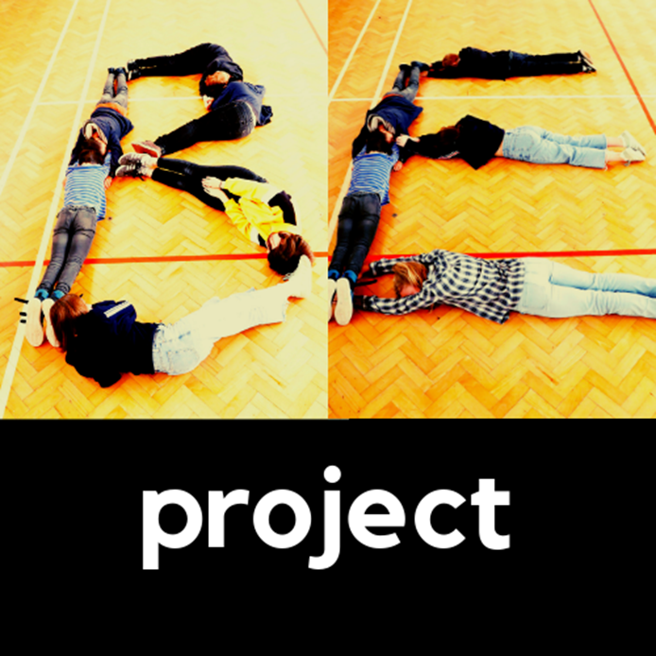

Joanna Mallinson
Drug education and training jgmallinson@gmail.com www.beproject.co.uk

Slide 3
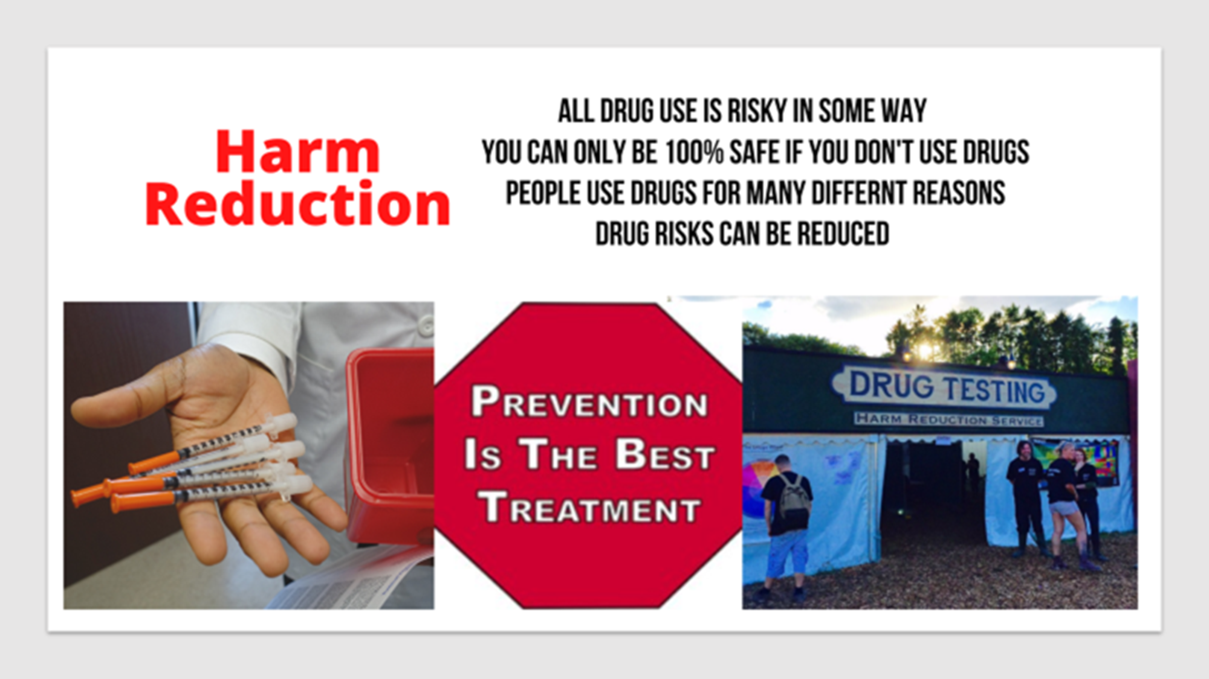

Slide 4




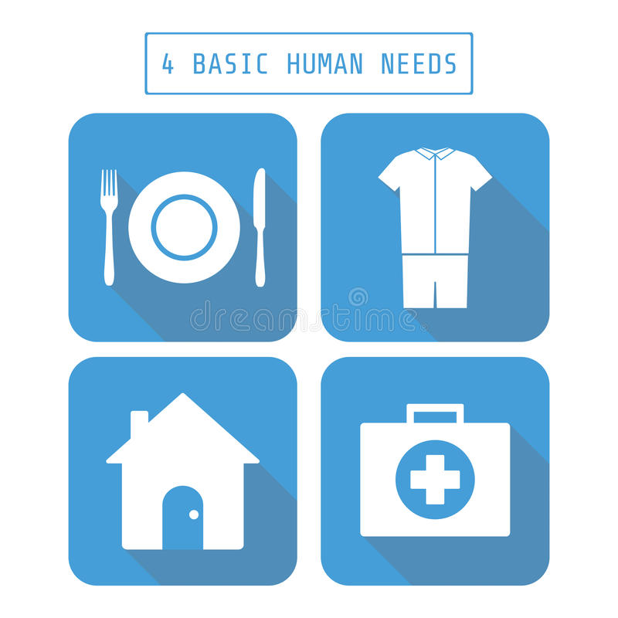

The ‘keeping kids safe’ 2019 children’s commissioner report made it clear that several factors greatly increase the risk of Child Criminal Exploitation:

Slide 5
‘Still Not Safe’ 2021 found:
“Few Local Authorities were using public health infrastructure effectively to address the issue of gang-involvement and youth violence and bring intervention upstream to prevent future harm…”

Slide 6

Primary schools
Training for your pastoral and safeguarding staff to support and strengthen work with children and families affected by substance misuse.
Year 6 lesson for targeted schools where there are high rates of family substance misuse.

Slide 7

Secondary schools
PSHE/ drugs awareness year 9 & 10
Staff training
Parent work

Slide 8
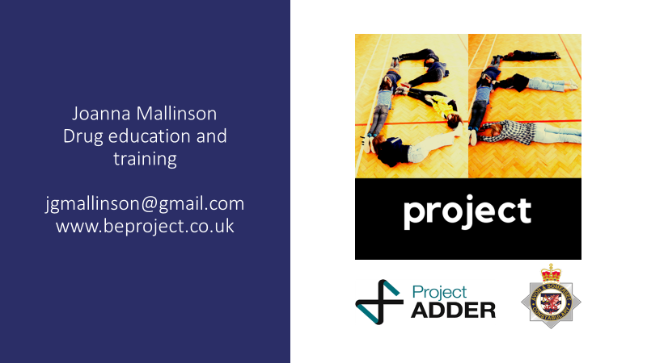

Slide 9


Preventing individuals from becoming involved in cyber dependent crime
Helping them make the right #CyberChoices
J Thompson
South West Region Cyber Choices Team
www.cyberchoices.uk
Notes:
Introduction:
Hello, I/we are here to talk to you today about Cyber Choices, what we do and the opportunities that are available to your young people. Cyber Choices is a programme delivered by the Regional/Local Cyber Choices Network, co-ordinated by the National Crime Agency.
We are from the ….. Team and cover……..region.

