Slide 1





Keeping Children Safe in Education 2023
Governing Body Duties
Safeguarding is everybody’s business
Notes:
Welcome and introduce yourself.

Slide 2


KCSIE role of governing body/proprietors
Compliance with legislation & guidance:
Ensure that policies, procedures and training in settings are effective and always comply with the law.
Appoint someone at senior board level to take leadership responsibility for setting’s safeguarding arrangements.
Attend governor specific safeguarding training.
Human Rights Act 1998, Equality Act 2010, and the Public Sector Equality Duty and their Local multi-agency safeguarding arrangements.
Whole school approach to safeguarding:
Safeguarding and child protection are at the forefront and underpin all relevant aspects of process and policy development.
All systems, processes and policies should operate with the best interest of the child at their heart. The child’s wishes and feelings are taken into account.
Systems should be in place, well promoted, easily understood and easily accessible for children to confidently report abuse.
Concerns will be treated seriously, where learners can express their views and give feedback.
Notes:
KCSIE specifically mentions the expectations of the role of a governor. So how can you make sure you are fulfilling this role? Undertaking this training is part of your requirement in KCSIE 2023 to fulfil as governor. You need to have a strategic overview of safeguarding and undertake training which is specific to your role as a governor.
Ensure you have read the Bristol Belonging Strategy.
The Belonging in Education Strategy is one of four pillars of belonging (Beginning, Families, Education and Community) that will inform the way Bristol works with, and for, children and young people in the city.
The strategy aims to create an inclusive, safe and inspiring environment for children and young people to grow up in and to experience a sense of belonging.
Bristol’s One City Belonging Strategy for Children and Young People sets out how the city will begin that journey of recovery and what it aims to achieve.
Looking at the whole school approach to safeguarding it’s really important to remember that the child is at the centre of everything and all processes and policies should operate in the best interests of the child. The safeguarding practice review around Child Q identified that government guidance in use at the time around searching screening and confiscation was not written with this in mind and has since been revised to ensure safeguarding is a priority.

Slide 3
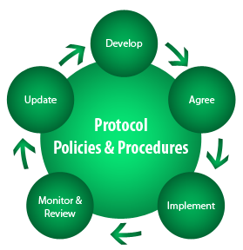

Safeguarding Policies and procedures which must be in place
Safeguarding and child protection policy.
Behaviour Policy
Staff behaviour policy.
Children who go missing – safeguarding arrangements.
Other considerations
Have a risk-based approach to the level of information provided to temporary staff
How are safeguarding and child protection files maintained
Appropriate safer recruitment policies.
More than 1 emergency contact number for each learner.
The Designated Safeguarding Lead:
An appropriate senior member of staff from the setting’s leadership team is appointed to the role of the DSL.
DSL should have appropriate status and authority, be given the additional time, funding, training, resources, and support needed to carry out the role effectively
More information in Annex C - (including online safety and understanding the filtering and monitoring systems and processes in place)
Notes:
Things to be mindful of around safeguarding and as a safeguarding governor these are things you should be aware of and challenging to ensure the correct practice is in place in your setting.

Slide 4




Multi-Agency Working
Ensure that settings contributes to multi-agency working in line with statutory guidance Working Together to Safeguard Children.
Should make themselves aware of and follow their local arrangements.
Governance should understand the local criteria for action and the local protocol for assessment and ensure that they are reflected in their own policies and procedures.
They should be prepared to support information sharing as requested by safeguarding partners.
Notes:
How would you consider undertaking these actions?

Slide 5



Information Sharing
Recognise the importance of information sharing between practitioners and local agencies. The Data Protection Act & UK GDPR to process personal information fairly and lawfully.
Ensuring safe and secure storage of information.
Ensure relevant staff have due regard to share and withhold personal information.
Staff training and opportunities to teach safeguarding
Ensure that all staff undergo safeguarding and child protection training at induction and regularly updated (at least annually) including online safety which, amongst other things, includes an understanding of the expectations, applicable roles and responsibilities in relation to filtering and monitoring.
Children are taught how to keep themselves and others safe including online, and safeguarding on the curriculum is integrated.
Recognise the expertise staff and provide opportunities for staff to contribute to and shape safeguarding arrangements and child protection policy.
Teachers' standards expectations for managing behaviour effectively requires teachers to have a clear understanding of needs of all pupils.

Slide 6

Child on child harm
Your safeguarding and child protection policy should contain:
Procedures to minimise child on child abuse,
The systems in place for children to confidently report abuse
how incidents are recorded, investigated and dealt with,
Clear processes of how victims, perpetrators, and other children affected by child-on-child abuse will be supported,
A recognition that even if there are no reported cases of child-on-child abuse, abuse may still be taking place.
Zero tolerance approach to abuse - should not be passed off as ‘banter’, or ‘part of growing up’…..
Gender – girls more likely to be victims – (cultural competency)
Different forms that child-on-child harm can take.
Notes:
Knowledge of filtering and monitoring systems for all staff has been included in KCSIE 2023 which came into force in Sept 2023.

Slide 7
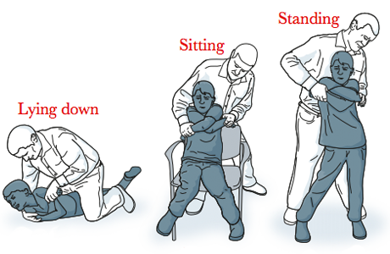
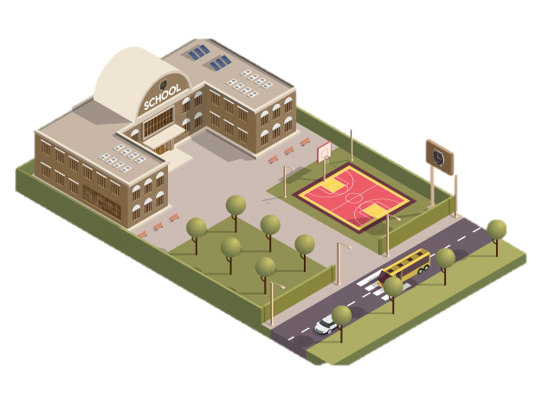

Use of ‘reasonable force’
Headteachers and governance to adopt sensible policies which allow and support their staff to make appropriate physical contact.
Use of school/college premises for non-school/college activities.
Ensure that there appropriate arrangements for keeping children safe
Seek assurances that the provider concerned has appropriate safeguarding and child protection policies and procedures in place.
Ensure safeguarding requirements are included in any lease/hire agreement.
After-school clubs, community activities and tuition: safeguarding guidance for providers - GOV.UK (www.gov.uk)
Alternative Provision
Governance should be aware of the additional risk of harm that their pupils maybe vulnerable to.
Notes:
Undertaking due diligence is important and should be recorded by the setting to evidence it has occurred.

Slide 8



Children at potentially a greater risk of harm
Children who need a social worker
New duties around promoting the educational outcomes and making reasonable adjustments to ensure a culture of high aspirations are maintained for this cohort.
Duties around Children missing education and Elective Home Education.
Mental health
Should ensure that they have clear systems and processes in place for identifying possible mental health problems, including routes to escalate and clear referral and accountability systems.
Looked after Children (Children in Care) and previously looked after children
Should ensure that staff have the skills, knowledge and understanding to keep looked after children safe.
Appoint a designated teacher to promote the educational achievement of Children in Care and those who have left care through adoption, special guardianship or child arrangements orders.
Notes:
Whilst all children should be protected, it is important that governing bodies and proprietors recognise (and reflect in their policies and procedures) that some groups of children, are potentially at greater risk of harm than others (both online and offline).

Slide 9

Children with Special Educational Needs (SEN)
Ensure that the safeguarding and child protection reflects the fact that additional barriers can exist when recognising abuse and neglect in this group of children.
Ensure that the safeguarding and child protection policy and practice addresses additional challenges (consider what provision is in place for extra pastoral support and attention for these children).

Slide 10


Part 3 - Safer Recruitment
Create a culture of safeguarding and promote the welfare of learners in their setting (safer working practice).
Ensure that those involved with recruitment and employment have received appropriate safer recruitment training.
It is a legal requirement that governing bodies need to understand pre-appointment vetting checks, regulated activity and recording information and must ensure that these checks are carried out.
Governing bodies and proprietors should ensure they have processes in place for continuous vigilance, maintaining an environment that deters and prevents abuse and challenges inappropriate behaviour.

Slide 11

Part 4 - Managing allegations made against/concerns raised about staff
(including supply teachers, volunteers and contractors
Ensure that policies and procedures make clear who allegations should be reported and that this should be done without delay.
Discuss concerns around supply staff with agency/agencies.
Ensure that policies and processes are in place to deal with concerns that do not meet the harm threshold – referred to as ‘low-level concerns’.
This process should be reflected in the staff code of conduct and safeguarding policies and implemented effectively.
Notes:
Governing bodies and proprietors should have policies and processes to deal with any concerns or allegations which do not meet the harm threshold, referred to in this guidance as ‘low-level’ concerns.
As good practice governing bodies and proprietors should set out their low-level concerns policy within their staff code of conduct and safeguarding and child protection policies.
The governing body or proprietor should ensure their staff code of conduct, behaviour policies and safeguarding policies and procedures are implemented effectively and ensure that appropriate action is taken in a timely manner to safeguard children and facilitate a whole school or college approach to dealing with any concerns.

