Slide 1
S. 175 Audit 2020-21
Preliminary Report
The S.175 audit is the LA’s statutory duty that all settings within the LA boundary.
This has been interpreted in a number of ways due to the academisation of schools and perception that they do not have a duty to respond.
Legally, we have impressed on colleagues their duties under the Local Safeguarding Partnership and duties under the Children Act 2004.

Slide 2
Context
Published the audit in November 2020 (via heads briefings, Safeguarding briefings and via Ed reference group briefing note) with an initial deadline of January 4th 2021 to allow settings to have longer to implement their action plans (the rest of the academic year).
Shared guidance on how to manage the audit within safeguarding teams.
Provided a list of the questions to enable settings to prepare for the completion of the audit and delegate sections as appropriate
Offered support from the advisors around the completion of the audit. Less than 10 settings took up this offer.
Extended the deadline to February 14th, end of term 3, further extended to the deadline to 1st April, end of term 4.

Slide 3
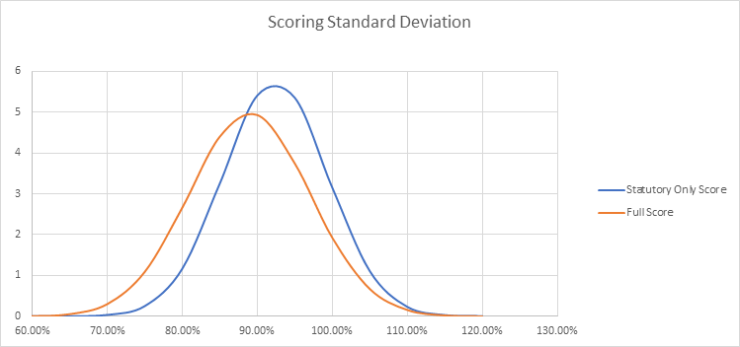
Completion and compliance to statutory duties
Type | Yes | No | Total | Percentage
Primary | 81 | 17 | 98 | 83%
Secondary | 19 | 5 | 24 | 79%
Special | 8 | 4 | 12 | 67%
Through Phase | 7 | 1 | 8 | 88%
ALP (including PRUS)* | 10 | 2 | 12 | 83%
Infant | 5 | 1 | 6 | 83%
Junior | 5 | 0 | 5 | 100%
Post 16 | 3 | 0 | 3 | 100%
Independent | 11 | 4 | 15 | 73%
Full Score Average - 88.97%
Statutory Only Average - 92.40%
*Further work needs to be undertaken around ensuring that all part time APs are included. This number reflects more engaged and established organisations which are most commonly used and commissioned however this is an area of development.

Slide 4
Areas of development - headliners
Topic | Red | Amber | Green
Completed Bristol Offensive Weapons in Education Settings Audit | 66% | 14% | 20%
Completed the Contextual Safeguarding ‘Beyond Referrals Audit’ (prevention of harmful sexualised behaviours in schools) | 57% | 21% | 22%
Young Carers support programme completion | 36% | 33% | 31%
Accessible literature for parents and carers on private fostering | 44% | 23% | 33%
Completion of the ‘Self-assessment emergency incident planning checklist’ from the DFE | 34% | 26% | 40%
A high number of reds and ambers were accounted for RSHE topics. With further analysis this reflects non-statutory completion of specific topics by primary aged settings. This should be perceived as ‘good practice’ and not an area or risk or concern.
E.g, teaching about abortion, pornography and serious youth violence in an age appropriate/differentiated way.
Early years
To be completed – mostly staff training (Five to Thrive, Non-mobile babies procedures). .

Slide 5
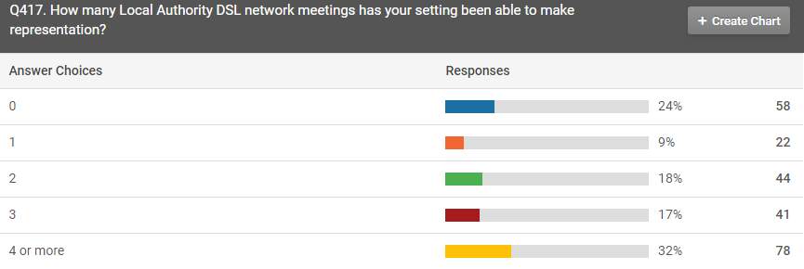
Data reporting Headliners
Topic | Range
How many staff have completed formal DSL Training | 0 - 19
How many members of staff make up your safeguarding Team | 0 - 12
Police Safeguarding Notifications | 0-4
GCP2 | 0-2
ACES | 0-4
Concerns
Varying levels :
- of compliance with statutory guidance.
- Engagement with national updates and Local Safeguarding Partnership processes.

Slide 6
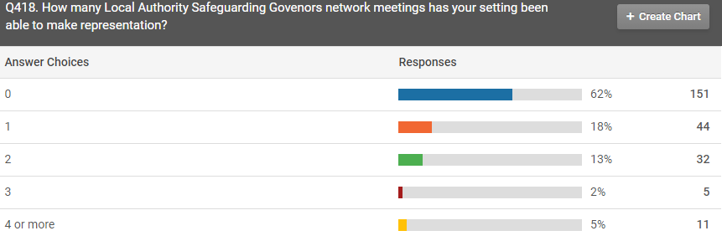
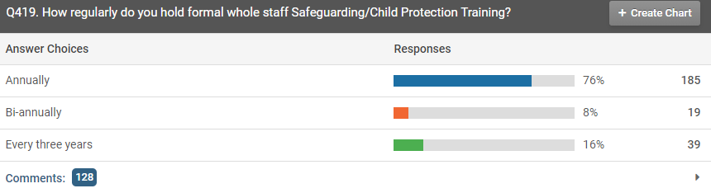
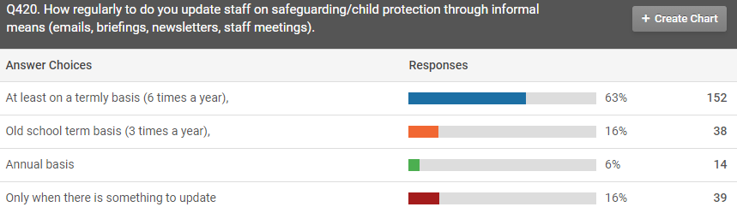
Since September 2020 there have been more explicit duties on governance (or equivalent) to engage with Local Safeguarding Partnerships not just Designated Safeguarding leads.
The Safeguarding in Education Team have been putting on Safeguarding Governors network to assist with this. Data has suggested that this has not been greatly engaged with, but extremely positive feedback from those who have. Approx. (60 colleagues/ old school term)
Positive response from mainstream schools – more vulnerability from our Alternative learning providers and EY’s Private Voluntary Independent sectors. This indicates that there is a need to rethink the infrastructure of support (network meetings/ accessibility of materials/ perceived relevancy of resources).

Slide 7
Feedback
Key challenges:
The pandemic,
Timing of the audit
Number of questions (length of time took)
Troubleshooting with the survey.
Question relevancy.
Positive elements
RAG rating
Timing of the audit
Action plan
Having the questions available in a different format
Support from the Safeguarding in education team.
Improvements
Break it up
More CPD and resources
Less questions.

Slide 8
Task and Finish group objectives
Consider a different ‘format’ and break it up throughout the academic year to be less task orientated.
Review of questions in line with statutory guidance and updates.
Reduce number of questions to just compliance with statutory duties and remainder put into resources/guidance.
Develop more detailed guidance for governors around supporting their DSLs.
Further analyses and full report generated. Comparable data and progress to be made with last year’s audit.

