Slide 1
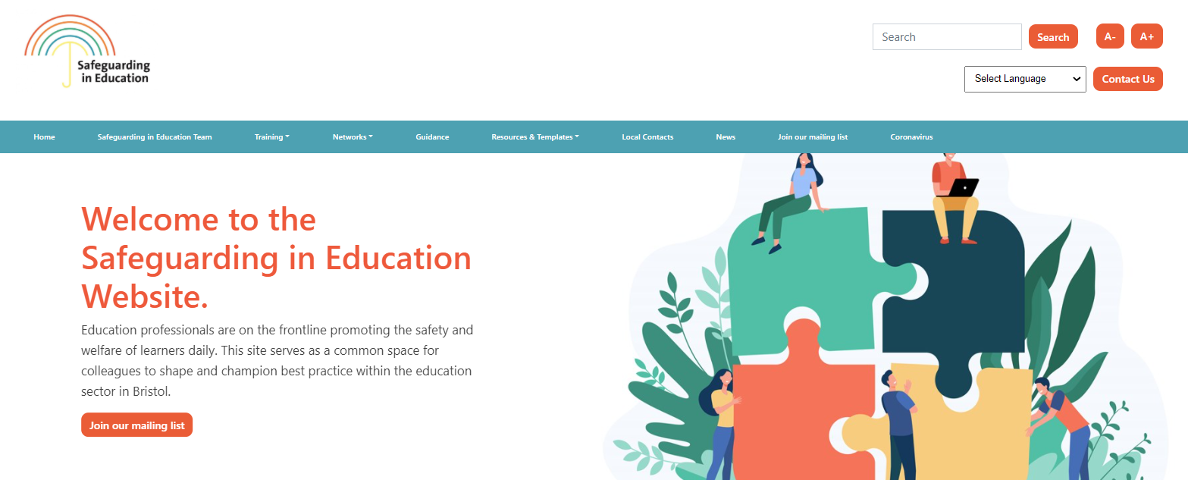
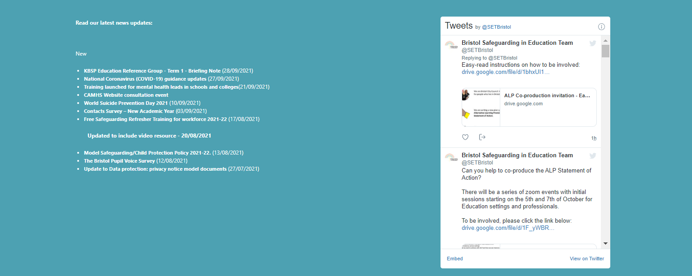


Welcome to the Governors Safeguarding Network
If you haven't already done so, bookmark our website https://www.bristolsafeguardingineducation.org/
The session will start promptly at: 18.00.
(If you are early – you have time to grab a drink)
Facilitated by Henry Chan
Check your sound settings. You should hear some holding music.
Please make sure you have your name on your display. Click the three dots (…) on your ‘tile’ to edit.
To sign in– provide your name and setting in the Chat function
If you have any technical difficulties please email the safeguardingineducationteam@bristol.gov.uk
If you have the functionality, please can you put your cameras on out of respect for colleagues.
Follow us @SETBristol

Slide 2

Safeguarding Governors Network
November (Term 1 rescheduled)

Slide 3

Agenda
News and Local Safeguarding Partnership Updates
Bristol Belonging Strategy
Updates in Keeping Children Safe in Education
Any Other Business/ Time to network

Slide 4





COVID 19 updates and summaries – click here for advice from Public Health. Ensure that headteachers are signed up to the Head teachers bulletin – email linda.Bryant@bristol.gov.uk if not already receiving these.
Senior Mental Health Lead Training – apply for a grant (£1200) and links to sign up to courses with support to develop a whole setting approach. Click here
Anti Bullying Alliance - All Together Programme has now ended – the ABA are rolling out a new whole school anti-bullying programme but are taking expressions of interest pending the contract being finalised
#AntibullyingWeek – 15-19th November – This years theme – ‘One Kind Word’
Beyond Referrals – Contextual Safeguarding Network – Extra Familial Harm Audit toolkit
Harmful Sexualised Behaviour Audit toolkit
Low Level Concerns – KCSIE 21 changed advice in finalised version to highlight that these should be reported to the head teacher/principal in line with any concern regarding a staff member (para 74).
Farrier & Co 2021– Developing and implementing a low-level concern policy: A guide for organisation which work with children.
Notes:
-COVID19- updated the guidance on asymptomatic testing and accountability arrangements for this academic year. We’ve also updated the advice around clinically extremely vulnerable pupils and staff and added information on the vaccination of 12 to 17 year olds. Centralised on our website for easy access.
-Senior Mental Health Lead Training - Member of SLT to apply for grant and training to develop a whole setting approach to responding to MH as per key update in guidance.
-ABA – All Together programme now ended – well done to all those that registered and obtained awards. We will cascade updates when confirmed.
-Beyond Referrals – 60% of you said you had completed audit on the s175 audit. Given Ofsted review we recommend carrying our assessment and audit for due diligence and develop a ‘it could happen here’ approach.
-Low Level Concerns – all reports should be reported to headteacher/principal. Guide is easy reading and based on caselaw.

Slide 5
Black History Month –October - Cotham and Fairfield have collaborated on a programme of activities (shared with permission from Domini Leong BAME ed)
Black History Month Resource Pack 2021– Proud to be (KS3, 4, 5)
BHM BBC resources/ Bitesize (K1, 2)
Inspecting teaching of the protected characteristics in schools - GOV.UK (www.gov.uk) - amendments in the ‘Brief outline of guidance’ and the ‘Eliminate unlawful discrimination, harassment and victimisation and other conduct prohibited by the Act’ sections.
16 Days of Action – 25th November – 10th December. - Click here for toolkit
Domestic abuse: how to get help - GOV.UK (www.gov.uk) – Updated to include guidance in different languages.
International Day against violence against Women/ White Ribbon Day 2021 — White Ribbon UK – 25th November #Allmencan
Disrespect NoBody: resources on preventing teenage relationship abuse (pshe-association.org.uk)
Tackling Domestic Abuse in Education - 08/12/2021 8:45 - 12:30
  World Aids Day – 01st December 2021 - Schools and Colleges - World AIDS Day
  Human Rights Day – 10th December 2021 - Human Rights Day | Assemblies For All
Notes:
Black History Month – resources from Domini Leong (Cotham). Ofsted inspection framework.
Update in guidance to reinforce duties.
Honour based abuse, forced marriage and FGM conference.
DSL/RSHE Leads – contact if you want to contribute to ongoing research/work to develop resources, share your practice, curriculum plans etc.
National Hate Crime Awareness week – link to resources for training plans, posters, etc. conference – please book on. Supports your duties to respond to online harm.

Slide 6

Safeguarding in Education Team updates
The team are experiencing significant capacity issues and increasing demand on service.
New North School Safeguarding Advisor.
Business Support Officer recruitment.
Data Officers – resource not secured.
Significant disruption/cessation re:
Daily incident risk meetings
Police Safeguarding Notifications
MARAC
S.175 Audit
Notes:
There have been robust attempts to lobby and obtain funding for the 2 Data Officers in the Safeguarding in Education Team who operationalise the notifications, attend the Daily Incident Review Meeting (DIRM), and coordinate reports for MARAC.
The Data Officers also support with processing vulnerable children’s lists (those open to Social Care and those with EHCPs).
Public health has supported with funding for 1 post. The Safeguarding in Education Team has not yet been successful in obtaining match funding from other statutory agencies. Whilst we remain hopeful, colleagues currently in the roles have been served notice on their current contracts.
It is important (yet regrettable) to notify the education workforce that there will likely be significant disruption to the above processes and changes to service whilst we attempt to work with agencies to balance work commitments and capacity to meet them.
This will likely remain high on any agendas to ensure that colleagues are kept up to date and can modify processes accordingly.

Slide 7


Keeping Bristol Safe Partnership Updates
KBSP Training - Natalie Keeley Training officer now in post. Multi-agency Advanced CP training now back running.
KBSP Ed Reference Group –Term 1 Briefing note on Safeguarding in Education website. Minutes to follow in members area.
Shadow Board recruitment – Young people wanted (11-25 years old) – please cascade the poster and target young people who may want to make a difference city wide. Click here for more info
Safeguarding Contacts update – you have a statutory duty to provide information to assist the safeguarding of learners. Click here if you have yet to complete this academic year.
*amended form to obtain consent to share information with other partners to assist with processes to safeguard learners.
Notes:
KBSP Training – please refer to training program. Advanced CP training – should be completed before DSL training.
Shadow Board – picture is hyperlinked. Aimed at those that may have experience of services in Bristol.
Safeguarding contacts – to provide for the purposes of safeguarding children and statutory processes. Also complete if there are any short/mid term changes ie, staff sickness/mat leave etc. we need consent inline with GDPR

Slide 8

S. 175 Audit Update
Reduce the number of questions – this has currently been reduced from 411 to approximately 150. This still needs to be refined and agreed upon considering new versions of statutory guidance.
Form guidance to allow for more structured support for governance around what good, adequate, and poor responses look like to assist with quality assurance
Remove the ‘task completion’ element which is quite static, but allow for meaningful change for practice development and growth– recommendation to review time limit, giving more time, but also set reminders with calendar invites multiple times an academic year to maintain progress.
Review the format, supporting an ability to pick up and drop to reflect work commitments and develop a format to allow for true collaboration – decision to stop using SMART survey and send out survey as an Excel document
Notes:
The audit is currently delayed given team’s capacity issue. Please look out for updates.
The main feedback you gave and what we did:
A lot completed in record time when chased – not fully reflected – encourage to be transformational, not ticking boxes, change the tone of the audit, giving deadlines wasn’t effective and not helpful. End of academic year.
Excel – back to basics!

Slide 9
7 x Rapid reviews – involving school aged children and young people.
(6 criminal exploitation/serious youth violence, 1 honour based abuse/forced marriage)
1 x Child Safeguarding Practice Review - cross boarder thematic review
Child criminal /serious youth violence – incorporating learning from the above.
Learning from Statutory reviews
Develop competency around managing issues relating to BAME/ SEN/Post 16/ contextual risk/ wider family and putative relationships
EHCPs do not contain contextual or safeguarding information- how do we effectively share information about risk and historical harm?
Risk assessments are varied in quality and effectiveness leading to risk averse decisions
Emergency SEN reviews did not take place following a significant incident. SEN and Safeguarding were seen as separate processes.
Need for LA teams (social care, SEN) to develop safeguarding knowledge around attendance, education entitlement and safeguarding systems in education (E.g, record keeping and police safeguarding notifications)
Email Helen.macdonald@bristol.gov.uk to join learning and practice review task and finish group.
Notes:
7 rapid reviews – 6 were re: CCE/Serious Youth Violence - disproportionately black males with SEND needs
Honour based Violence – assumed no action could be taken as abroad – always make referrals as usual despite whether in the UK or not
Draw back to quality duty – moral duty to refresh how looking at equality objective. Not always considering what “family” is in terms of significant relationships – need to be valued alongside PR – the lived experience of the family.
SENCOS – throw down the gauntlet – Educational Health and Care Plan for a reason – Health and Care need to be part of that – Children and Families Act 2014 – social care act, not education – how are we supporting colleagues in social care and health to contribute towards that intervention.
Risk assessments – term potentially negative - safety plan. “can’t meet needs” – children pushed from pillar to post – what makes you think another setting can? Schools alone cannot solve society’s issues, need multiagency assessments.
Encourage the use of emergency SEN review, particularly at point of risk of exclusion.
LA colleagues don’t necessarily know about SEN processes and attendance issues – but this does have an impact. Strengthen that training for colleagues in social care. FIF are working very closely with schools to understand all systems.
Case in point – will come to later – Police tend to issue advice, but not based on education legislation – eg encourage to move a child seen as a risk to another setting – there is education legislation and human rights you might need to push back on other agencies.
If resonates, looking for colleagues across phases and areas of education sector – please contact Helen – contribution towards systems change.

Slide 10


Bristol Belonging Strategy
Bristol’s Belonging Strategy for Children and Young People - Belonging in Education (bristolonecity.com)
Notes:
The audit is currently delayed given team’s capacity issue. Please look out for updates.
The main feedback you gave and what we did:
A lot completed in record time when chased – not fully reflected – encourage to be transformational, not ticking boxes, change the tone of the audit, giving deadlines wasn’t effective and not helpful. End of academic year.
Excel – back to basics!

Slide 11

Even before COVID-19 outcomes for children and young people in Bristol needed to improve. In 2019 we knew that:
17% of our city’s children aged 16 and under lived in low-income families
At the end of Key Stage 2 only 23% of children with SEN achieved the required standard in reading, writing and maths combined, compared to 74% for children without SEN
There was a 17-point difference between disadvantaged and non-disadvantaged in attainment 8 scores at the end of Key Stage 4
Absence rates in Bristol secondary schools were 6.4% and 15.4% in special schools
Bristol’s suspensions rate stood at 7.4% across all phases with a rate of 24.4% in special schools
In 2020 3.1% of our young people aged 16-17 were Not in Employment, Education or Training (NEET)

Slide 12

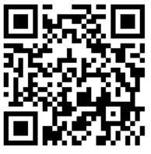
Long-term outcomes and measuring progress 2021 - 2030
An improvement in our attendance rates
Fewer suspensions
Continued low rates of permanent exclusions
More diversity in our education workforce
More children/young people from underrepresented groups engaging in active citizenship
Better attainment for all our children/ young people and a rapid improvement in the attainment of those with SEND and those entitled to Free School Meals
In break out rooms, for 10 mins discuss;
How can you ensure the belonging strategy is known about in your setting?
What can you do in your role to ensure that this isn’t just a ‘tick box exercise’?
Notes:
https://www.smartsurvey.co.uk/s/DF70VQ/

Slide 13
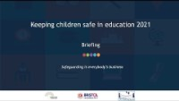
Keeping Children Safe in Education updates
Updates pre: summer holiday YouTube video
Resources
Safeguarding Governors Training

Slide 14

Who should read what?
Annex A?
Staff who do not work with children now have the option of reading and understanding Annex A instead of Part 1.
Part 1 and Annex B?
Those who work with learners need to read and understand Part 1 and Annex B.
The National Grid for Learning - KCSIE Translate (lgfl.net)
The whole document?
Governors, Safeguarding Teams and SLT should read the whole document.
KCSIE with highlights for governors roles and responsibilities

Slide 15

KCSIE 2021 role of governing body/proprietors
Whole school approach to safeguarding:
Safeguarding and child protection are at the forefront and underpin all relevant aspects of process and policy development.
All systems, processes and policies should operate with the best interest of the child at their heart.
Systems should be in place, well promoted, easily understood and easily accessible for children to confidently report abuse.
Concerns will be treated seriously, where learners can express their views and give feedback.
The Designated Safeguarding Lead:
Support development in role with new responsibilities around promoting the educational outcomes for children with a social worker.

Slide 16
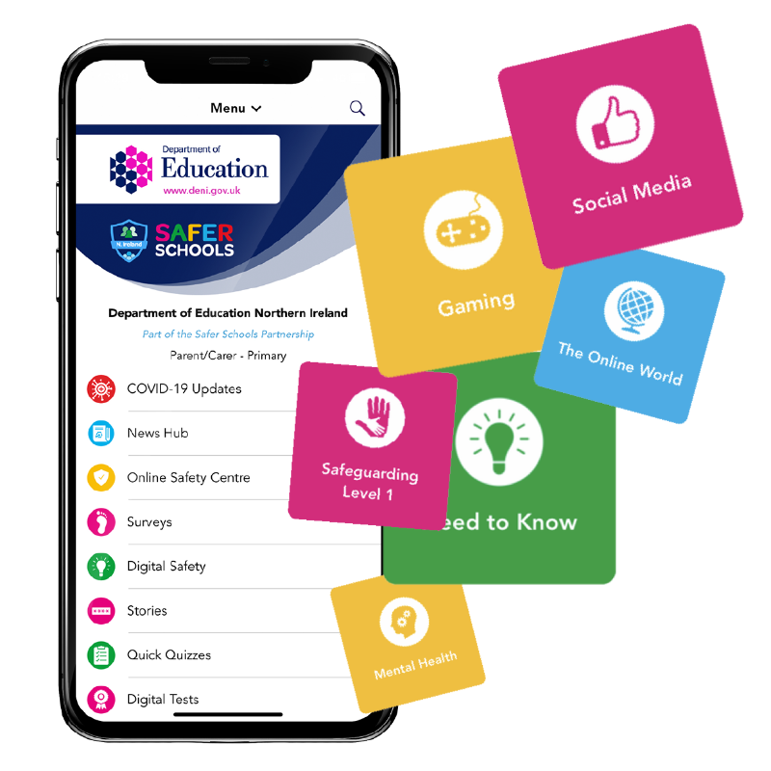
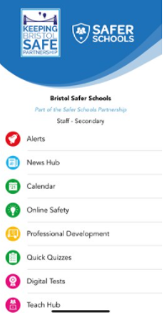
Staff training and opportunities to teach safeguarding
Ensure that staff undergo safeguarding training (including online safety) and safeguarding on the curriculum is integrated.
Teachers standards expectations for managing behaviour effectively requires teachers to have a clear understanding of needs of all pupils.
Online Safety
Online safety should be a running and interrelated theme whilst devising and implementing policies and procedures.
Ensure appropriate filters and monitoring systems are in place.
Review the effectiveness of online safety provisions. Online safety in schools and colleges: Questions from the Governing Board - GOV.UK (www.gov.uk)
Bristol Safer Schools App (bristolsafeguardingineducation.org)

Slide 17


Peer on peer harm
Your safeguarding and child protection policy should contain:
Procedures to minimise peer on peer abuse,
The systems in place for children to confidently report abuse
how incidents are recorded, investigated and dealt with,
Clear processes of how victims, perpetrators, and other children affected by peer on peer abuse will be supported,
A recognition that even if there are no reported cases of peer on peer abuse, abuse may still be taking place.
Zero tolerance approach to abuse - should not be passed off as ‘banter’, or ‘part of growing up’…..
Gender – girls more likely to be victims – (cultural competency)
Different forms that peer on peer harm can take.
Part 4 - Managing allegations made against/concerns raised about staff
Ensure that policies and processes are in place to deal with concerns that do not meet the harm threshold – staff code of conduct and safeguarding policies.

Slide 18

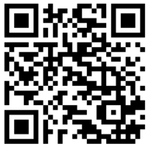
How can we support?
10 mins in breakout rooms.
Discuss your needs
Is there anything you want from us to help you with your roles responsibilities?
98. It is especially important that schools and colleges understand their role within the local safeguarding arrangements. Governing bodies, proprietors, and their senior leadership teams, especially their designated safeguarding leads, should make themselves aware of and follow their local arrangements.
100. Working Together is very clear that all schools (including those in multi-academy trusts) and colleges in the local area should be fully engaged, involved, and included in safeguarding arrangements. It is expected that, locally, the safeguarding partners will name schools and colleges as relevant agencies and will reach their own conclusions on the best way to achieve the active engagement with individual institutions in a meaningful way.
Notes:
https://www.smartsurvey.co.uk/s/41S0E0/

Slide 19
Any Other Business.
Put any questions in the chat function or unmute.
We will stick around for another 10-15 minutes.
Notes:
Please note change to the governor’s network – 2nd November

Slide 20
Welcome to the DSL Network Meeting
If you haven't already done so, bookmark our website https://www.bristolsafeguardingineducation.org/
The session will start at: 8.00am.
(If you are early – you have time to grab a drink)
Facilitated by Jess Curtis & Rosanna Buckland
Check your sound settings. You should hear some holding music.
Please make sure you have your name on your display. Click the three dots (…) on your ‘tile’ to edit.
To sign in– provide your name and setting in the Chat function
If you have any technical difficulties please email the safeguardingineducationteam@bristol.gov.uk
If you have the functionality, please can you put your cameras on out of respect for colleagues.
Follow us @SETBristol

